Slide 1
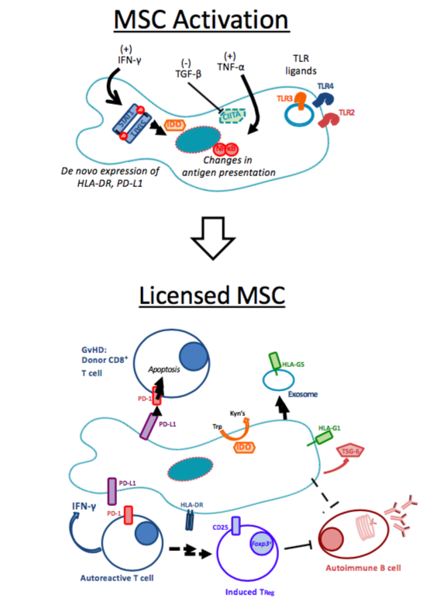
Chapter 1: Figure 1:
Licensing of MSCs Activates their Immunomodulatory Capabilities
Chapter 1: Figure 1:
Licensing of MSCs Activates their Immunomodulatory Capabilities:
Exposure to inflammatory stimuli causes mesenchymal stromal cells (MSCs) to undergo a number of RNA- and protein-level changes, activating their immunomodulatory capabilities. This includes the de novo expression of PD-L1, HLA-DR, as well as increased expression of Class I HLA molecules. TNF-α signaling causes a number of NF-κB-mediated signaling events, consistent with immune activation. TGF-β treatment abrogate expression of HLA-DR via CIITA inhibition [92]. After in vitro licensing, MSCs have been shown to more efficiently suppress the function and proliferative capacity of T and B cells. In the setting of cellular therapy, it is thought that inflammatory factors in the patient can activate these same mechanisms, resulting in immunomodulation by the transfused MSCs.

Slide 2
Chapter 2: Figure 1: IDO and AHR expression in resting and IFN-γ-stimulated MSC treated with 1MT
A.
Mesenchymal stromal cells (MSC) were isolated from the marrow of healthy human donors (N=3). Cells were removed from flasks after 5d of growth and stained using a panel approved by the International Society for Cell Therapy. Panel A represents the flow cytometry gating strategies for an isotype control sample, compared to an MSC sample stained with PE-conjugated CD73. These data are representative of all MSC samples utilized in this study.
B.
Panel B represents the sub-gating analysis, interrogating MSC for CD45, CD44, CD73 and CD90 and CD105. In each histogram, the black unfilled-line represents relevant isotype-matched control, and the three gray lines are independent but contemporaneously-analyzed MSC samples.
C.
Untreated, resting (r) MSCs and IFN-γ stimulated (γ), MSCs were analyzed for expression of the IDO protein (IFN-γ: 50 ng/ml for 24 h). Additionally, treatment with (D)-1MT, (L)-1MT or racemic (R) mixture was tested (1 mM each). Figure 1C represents the immunoblotting results of a single membrane that was first blotted for IDO1, then stripped, re-blocked and probed for actin. These are results from an experiment with MSC sample, which was replicated three times.
D.
At baseline, resting MSCs (r) demonstrate presence of the AHR protein. The effects of 24h treatment with IFN- γ (γ), or D-MT, L-MT or R-MT on AHR protein expression was evaluated. IFN-γ: 50 ng/ml; all 1MT: 1mM). AHR is indicated by the arrowhead near the 100 kDa band. Figure 1D represents the immunoblotting results of a single membrane that was cut into two and blotted separately for AHR and actin. These are results from an experiment with one MSC sample, which was replicated three times.

Slide 3
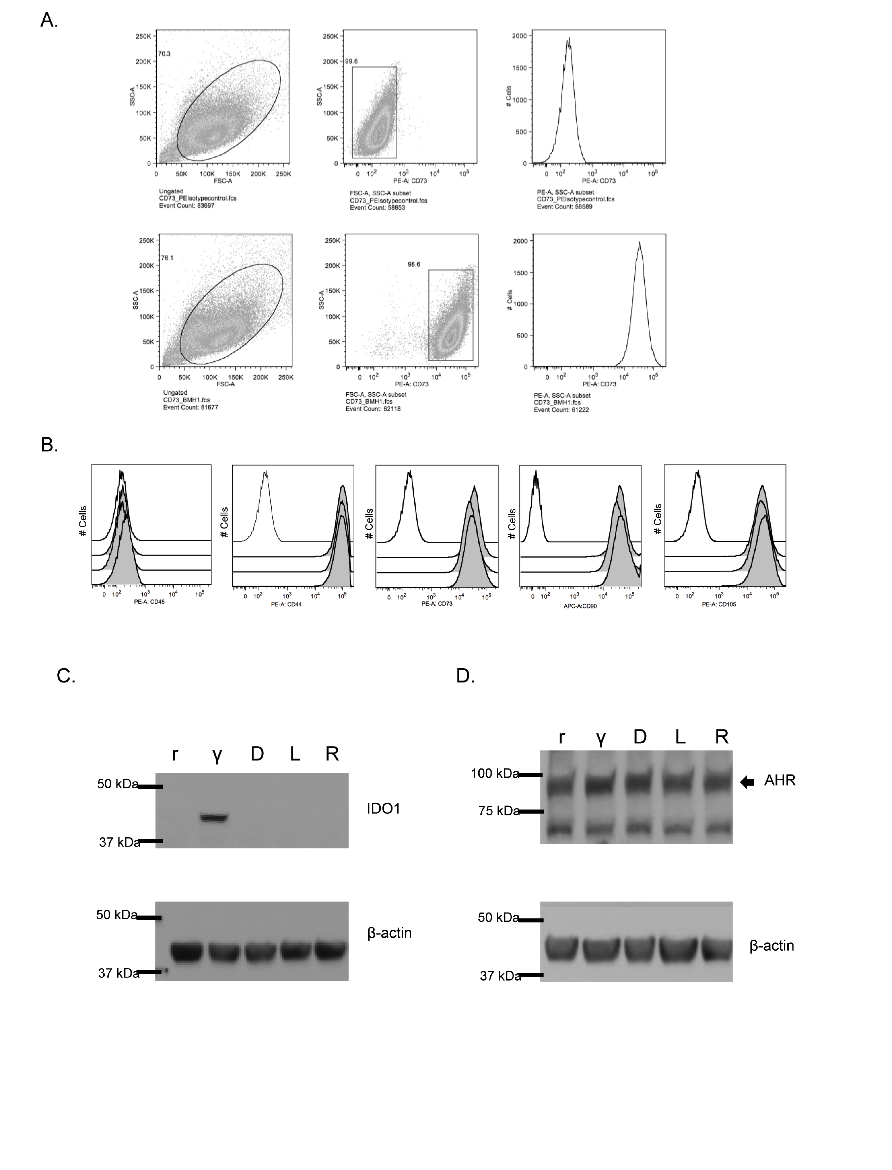
Chapter 2: Figure 1: IDO and AHR expression in resting and IFN-γ-stimulated MSC treated with 1MT

Slide 4
Chapter 2: Figure 2: AHR nucleotransloaction in MSCs treated with 1MT and AHR agonists
A, B.
MSCs were plated onto glass coverslips and allowed to adhere overnight. Media was aspirated and replaced with R10 or the indicated drug. Drugs were left on cells for 5h, after which cells were fixed and AHR was visualized via immunofluorescence; DAPI was used to visualize nuclei. Isotype-control was a non-specific murine-derived IgG. TCDD concentration was 10 nM. Concentrations of D-MT, L-MT, R-MT all at 1mM. These results (A, B) from an experiment with one MSC sample, which was replicated four times with independent MSC samples. All images were taken using a confocal microscope with the same exposure settings.
C.
The bar graph represents the quantified results of nucleotranslocation, as observed via immunofluorsence. The Leica LASX software package was utilized to delimit regions of interest, defined by the DAPI-visualized nucleus. From these regions, the signal of Alexa488 was computed and normalized per µm². These data are the cumulative average of three experiments using independent MSC samples, each with an average of twelve enumerations per high-power field. Statistical test performed was one-way ANOVA, P=0.003.

Slide 5
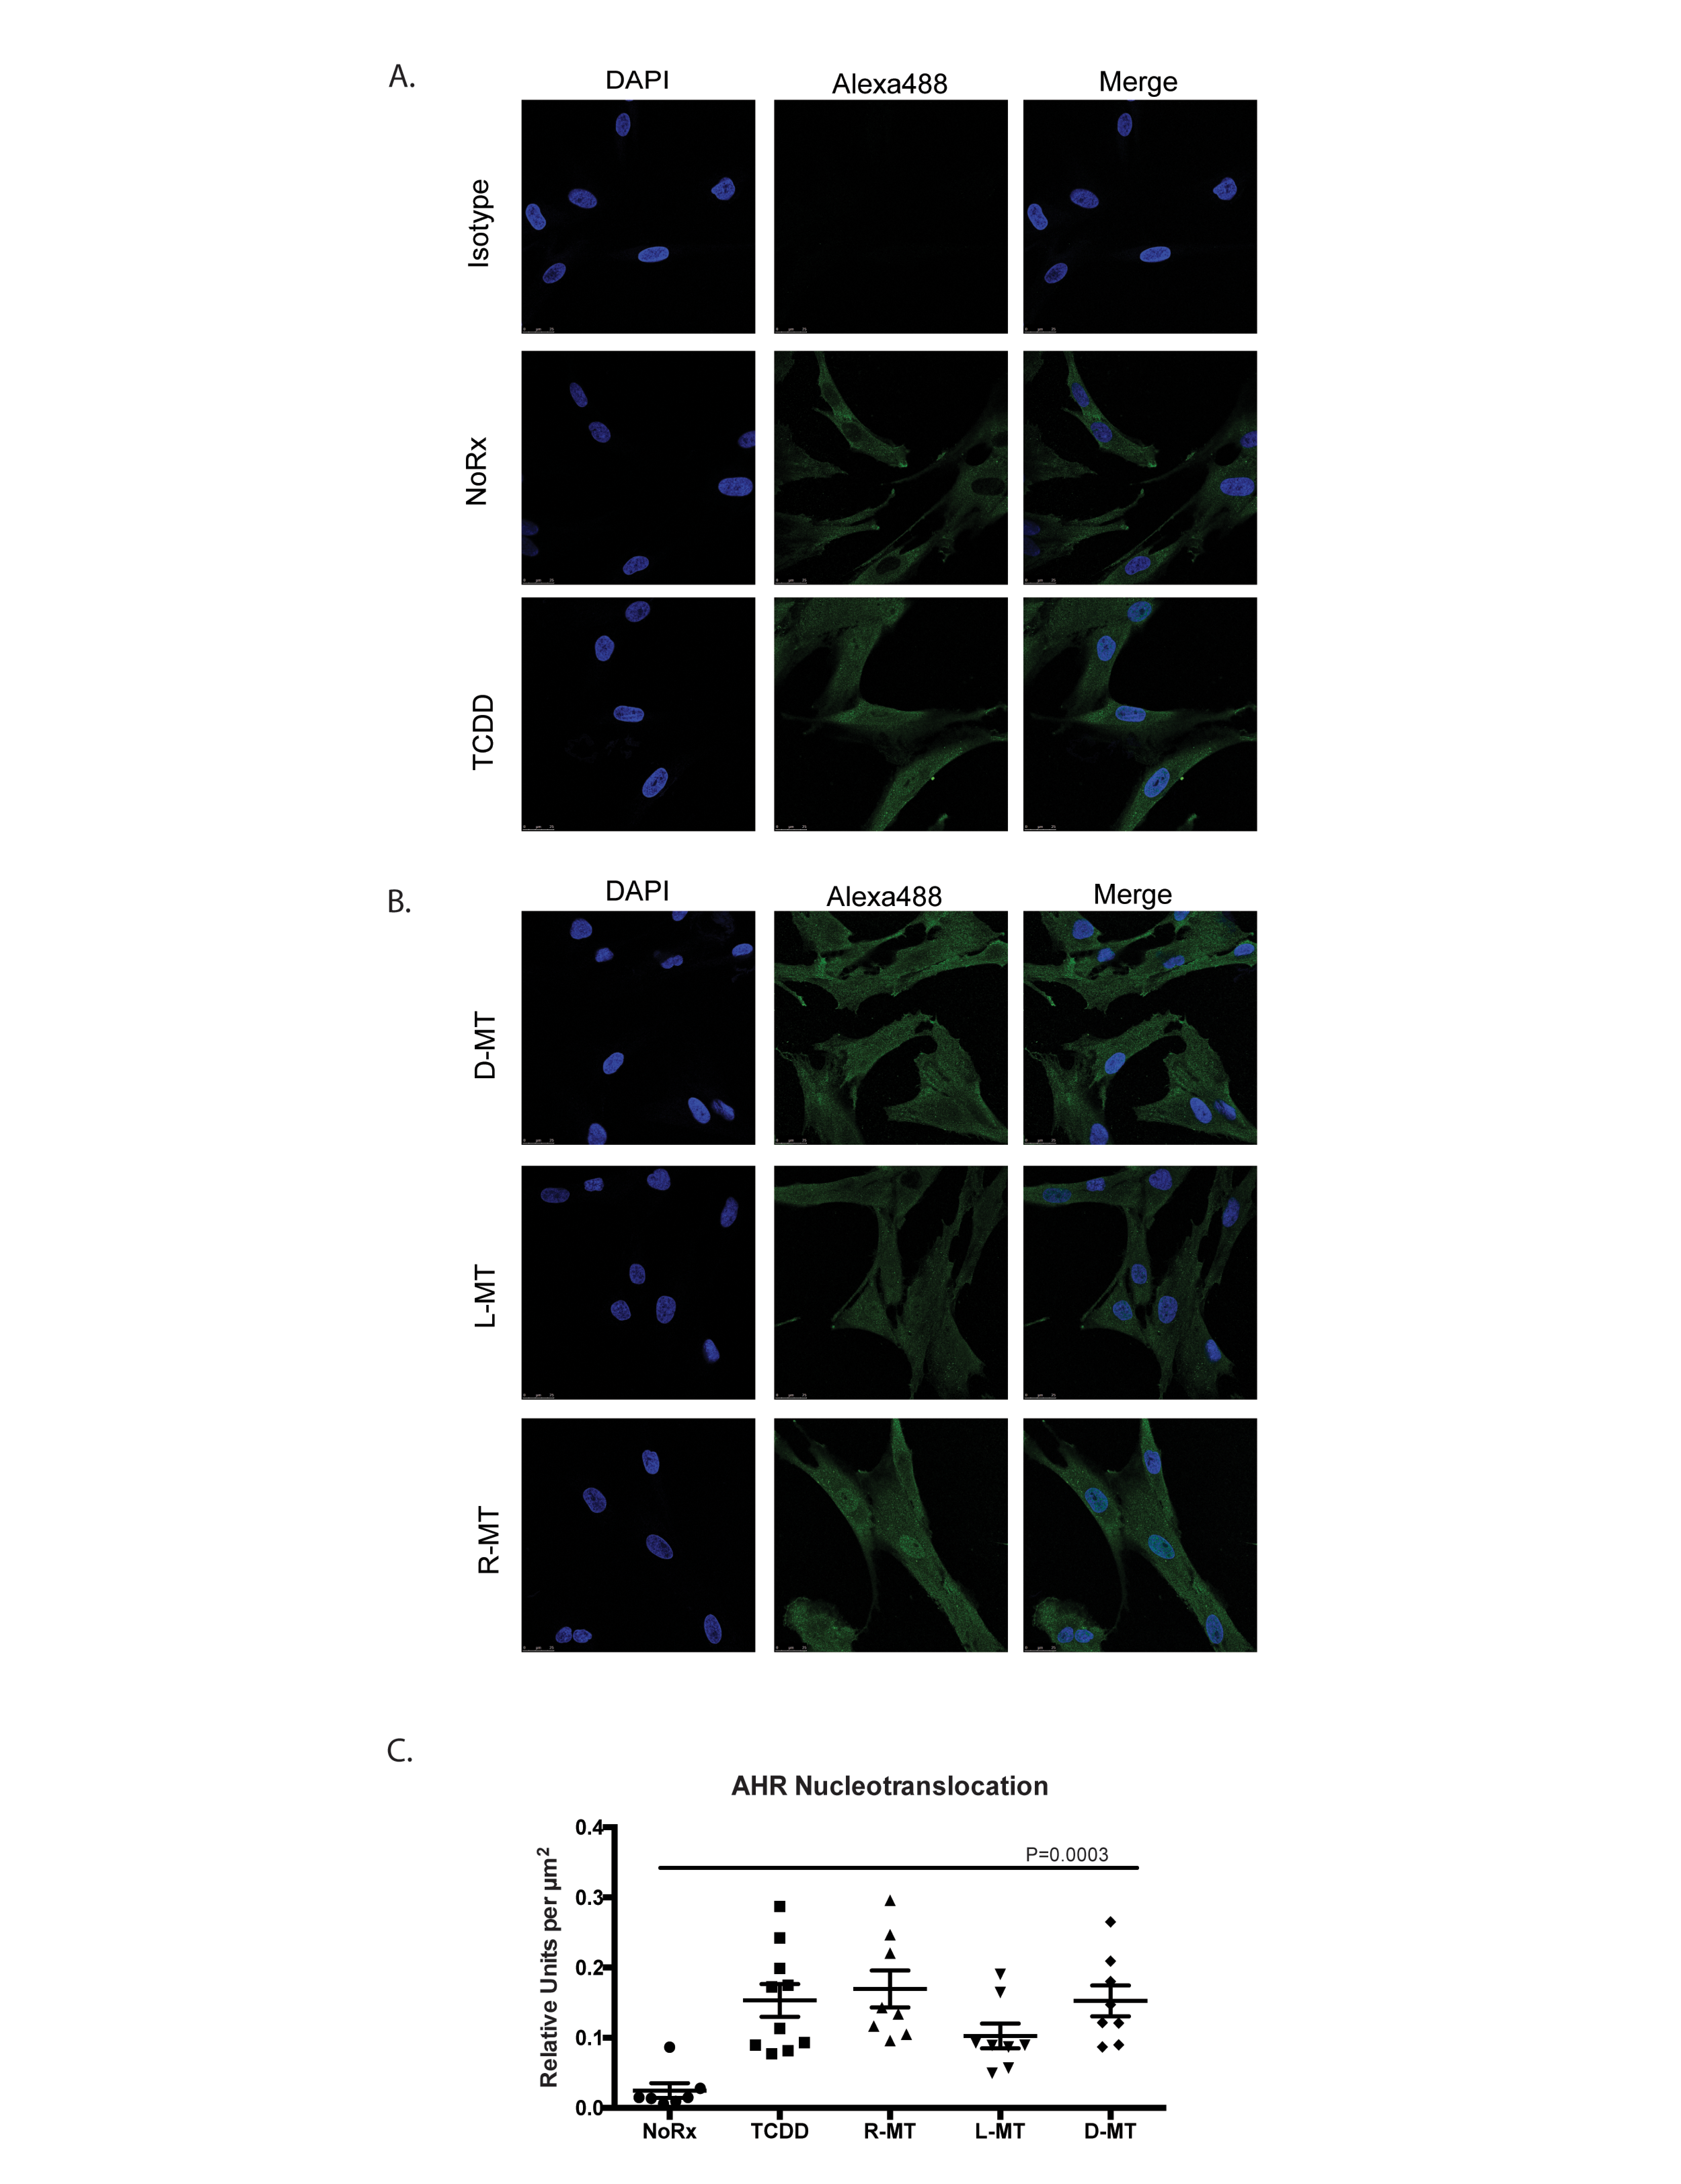
Chapter 2: Figure 2: AHR nucleotransloaction in MSCs treated with 1MT and AHR agonists

Slide 6
Chapter 2: Figure 3: Known AHR ligands and Trp derivatives activate the AHR response in MSCs
A-D.
MSCs were cultured in the presence of well-characterized AHR-binding ligands or other derivatives of tryptophan. Concentrations used in these fixed-dose studies were FICZ, TCDD: 10nm; Kyn, KynAc: 500 µM, 1MT: 1mM. After 6 or 24h, cells were harvested, lysed and total RNA was extracted, converted to cDNA and analyzed via quantitative real-time PCR. Panels A and C show the relative fold-induction of mRNA for the gene Cytochrome 1a1, calculated using each sample’s GAPDH expression, and then normalized to vehicle-treated controls via the delta-delta CT method; panels B and D are the same experiments, plotting Cytochrome 1b1. A one-way ANOVA test was used with Dunnet’s correction for multiple comparisons to assess statistical significance between R-MT-treated and untreated cells. These data are the calculated average of four independent experiments using two independent MSC samples.
E.
MSCs were cultured in the presence of racemic 1MT (R-MT), or the pure enantiomer (L)-MT or (D)-MT at varying doses: (0.1 µM to 5000 µM). After 24h, cells were harvested, lysed and total RNA was extracted, converted to cDNA and analyzed via quantitative real-time PCR. Panel E shows the relative fold-induction of mRNA for the gene Cytochrome 1a1, calculated using each sample’s GAPDH expression, and then normalized to vehicle-treated controls. Each treatment condition was fitted to a linear regression model, which were then compared by F-test to assess differences in line slope (P=0.009).

Slide 7
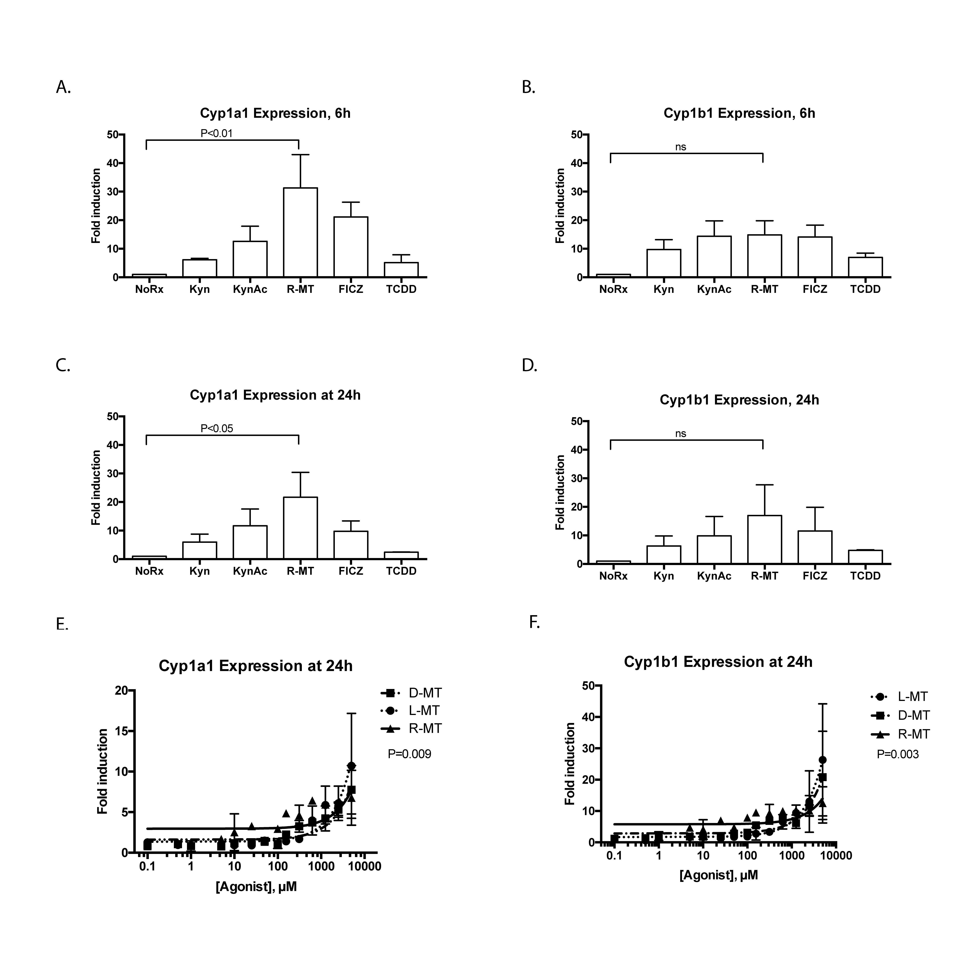
Chapter 2: Figure 3: Known AHR ligands and Trp derivatives activate the AHR response in MSCs

Slide 8
Chapter 2: Figure 4: Interferon-γ licensing of MSCs and AHR response
A.
Resting MSCs (r) and IFN-γ stimulated (γ) MSCs were analyzed for IDO expression after pre-stimulation with a fixed dose of IFN-γ (50 ng/ml), followed by treatment with a fixed 1mM dose of 1MT. Figure represents the immunoblotting results of a single membrane that was first blotted for IDO1, then stripped, re-blocked and probed for actin. Lanes 1-5 represent mono-treated cells. Lanes 6-8 represent 1MT and IFN-γ co-treatment; lanes 9-11 are an IFN-γ pre-stimulation, a PBS wash then 1MT alone. Lanes 12-14 represent a mono-treatment of IFN-γ, followed by 1MT co-treatment. These are results from an experiment with one MSC sample, which was replicated three times.
B, C, D.
MSCs were cultured for 24h in the presence of a variable dose (0.1 µM to 5000µM) of racemic 1MT (R-MT), or the sole enantiomer (L)-MT or (D)-MT. In parallel experiments, MSCs were given 12h of pre-stimulation with IFN-γ, followed by 24h of 1MT treatment, using the same dose-titration curve. After the 1MT treatments, cells were harvested, lysed and total RNA was extracted, converted to cDNA and analyzed via quantitative real-time PCR. Panel B shows the relative fold-induction of mRNA for the gene Cytochrome 1a1, calculated using each sample’s GAPDH expression, and then normalized to vehicle-treated controls. Each treatment condition was fitted to a linear regression model, which were then compared by F-test to assess for differences in line slope.
E, F, G.
Panels E, F and G show data from the same experiments as B, C, D, but plot fold-induction of Cytochrome 1b1. As above, each treatment condition was fitted to a linear regression model, which were then compared by F-test to assess for differences in line slope. These six panels are the summary data for nine experiments using two independent MSC samples.

Slide 9
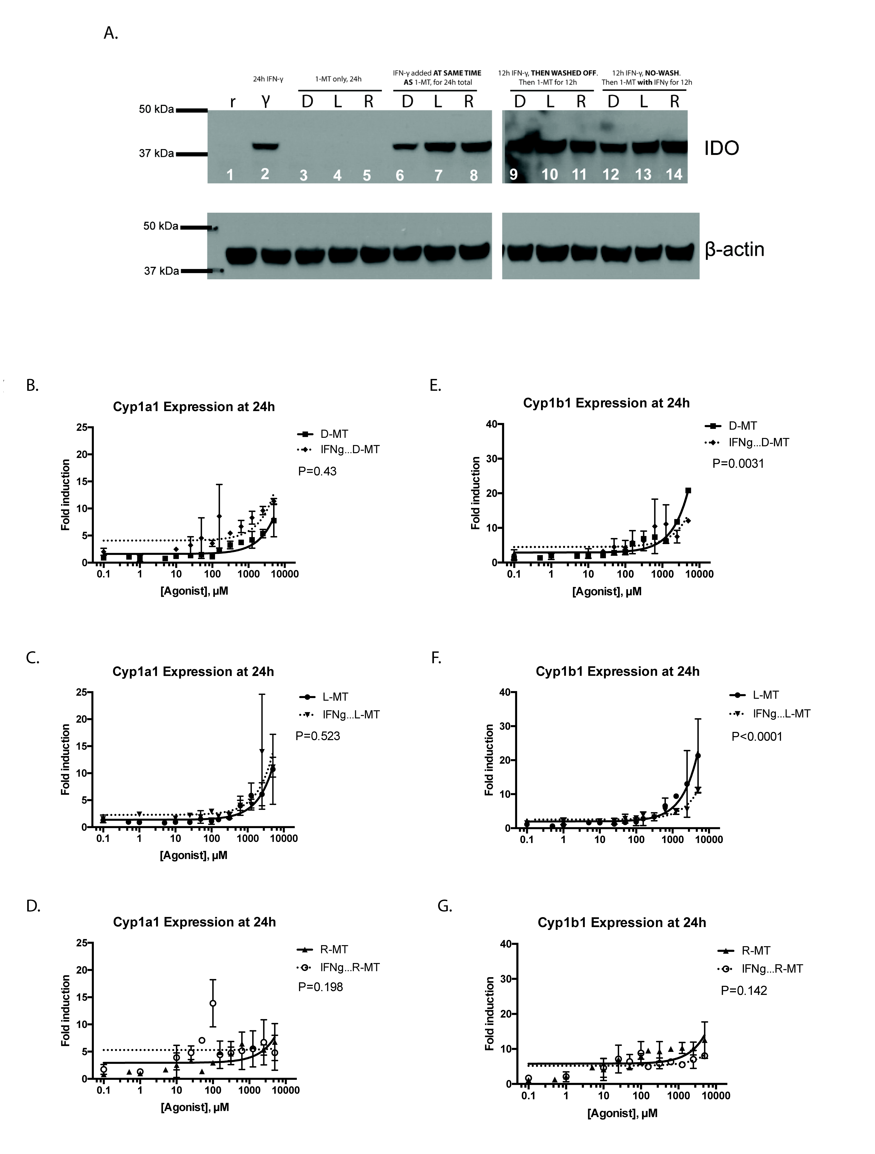
Chapter 2: Figure 4: Interferon-γ licensing of MSCs and AHR response

Slide 10
Chapter 2: Figure 5 : RNA-seq analysis of 1MT and TCDD treated MSCs
A.
MSC samples (N=5) were cultured for 24h in vitro in the presence of R-MT (1 mM), TCDD (10 nM), or R10 vehicle (NoRx), and analyzed via mRNA-Seq. Heat map displaying the union of all differentially-expressed genes (DEGs) found between control vehicle treated cells (NoRx) and TCDD treated cells or R-MT treated cells. DEGs were defined as +/-2-fold change and FDR <0.05. Hierarchical clustering was used to organize genes by expression pattern across samples. The color scale shown at bottom is defined as the ratio of each read-count to a gene-centric median, and maximum and minimums defined by a 2-fold upregulation (log2 = +1, red color) or downregulation (log2 = -1, blue color).
B.
Venn diagrams showing degree of overlap of genes found to up-regulated or down-regulated in R-MT treated cells or TCDD treated cells relative to vehicle-treated controls.
C.
Ingenuity Pathway Analysis (IPA) was used to identify sets of functionally-related genes with statistically-significant enrichment in the genes differentially regulated by R-MT. Panel C is a curated list of 24 immunomodulatory pathways from the IPA databases found to be most significantly altered by R-MT, with the bar color indicating if net pathway activation was up, down, or more diversely activated, as determined by IPA Z-scores.
D.
Figure 5D presents a heat map for four of the aforementioned 24 gene sets. To generate this heat map, each MSC sample was normalized to its own untreated control, allowing gene transcripts to be illustrated for up- or down-regulation on a per-MSC sample basis. They were subsequently scaled, whereby a +1.0 is a relative doubling from untreated samples and -1.0 is a relative halving. Patient samples were clustered separately along treatment parameters to compare the TCDD- and R-MT responses side-by-side.

Slide 11
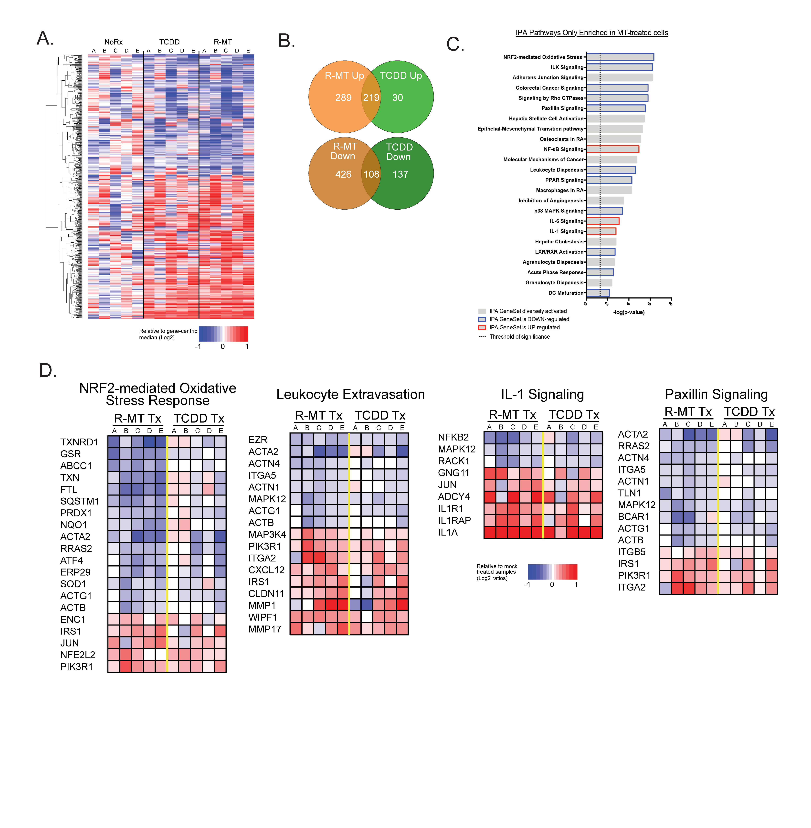
Chapter 2: Figure 5 : RNA-seq analysis of 1MT and TCDD treated MSCs

Slide 12
Chapter 2: Figure 6 Supplementary Table 1
(Page 1 of 3)
Figure 6 Supplementary Table 1
A listing of the genes that were identified in the RNAseq analysis for Figure 5 to be differentially expressed upon treatment with R-MT and also by TCDD.

Slide 13
Chapter 2: Figure 6 Supplementary Table 1
(Page 2 of 3)
Figure 6 Supplementary Table 1
A listing of the genes that were identified in the RNAseq analysis for Figure 5 to be differentially expressed upon treatment with R-MT and also by TCDD.

Slide 14
Chapter 2: Figure 6 Supplementary Table 1
(Page 3 of 3)
Figure 6 Supplementary Table 1
A listing of the genes that were identified in the RNAseq analysis for Figure 5 to be differentially expressed upon treatment with R-MT and also by TCDD.

Slide 15
Chapter 2: Figure 7 Supplementary Table 2
(Page 1 of 5)
Figure 6 Supplementary Table 2
A listing of the genes that were identified in the RNAseq analysis for Figure 5 to be differentially expressed ONLY upon treatment with R-MT.

Slide 16
Chapter 2: Figure 7 Supplementary Table 2
(Page 2 of 5)
Figure 6 Supplementary Table 2
A listing of the genes that were identified in the RNAseq analysis for Figure 5 to be differentially expressed ONLY upon treatment with R-MT.

Slide 17
Chapter 2: Figure 7 Supplementary Table 2
(Page 3 of 5)
Figure 6 Supplementary Table 2
A listing of the genes that were identified in the RNAseq analysis for Figure 5 to be differentially expressed ONLY upon treatment with R-MT.

Slide 18
Chapter 2: Figure 7 Supplementary Table 2
(Page 4 of 5)
Figure 6 Supplementary Table 2
A listing of the genes that were identified in the RNAseq analysis for Figure 5 to be differentially expressed ONLY upon treatment with R-MT.

Slide 19
Chapter 2: Figure 7 Supplementary Table 2
(Page 5 of 5)
Figure 6 Supplementary Table 2
A listing of the genes that were identified in the RNAseq analysis for Figure 5 to be differentially expressed ONLY upon treatment with R-MT.

Slide 20
Chapter 2: Figure 8 Supplementary Table 3
(Page 1 of 2)
Figure 6 Supplementary Table 3
A listing of the genes that were identified in the RNAseq analysis for Figure 5 to be differentially expressed ONLY upon treatment with TCDD.

Slide 21
Chapter 2: Figure 8 Supplementary Table 3
(Page 2 of 2)
Figure 6 Supplementary Table 3
A listing of the genes that were identified in the RNAseq analysis for Figure 5 to be differentially expressed ONLY upon treatment with TCDD.

Slide 22
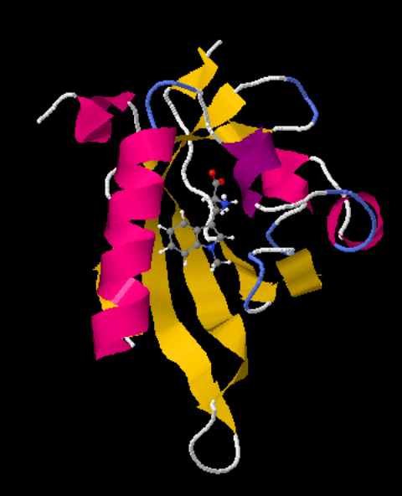
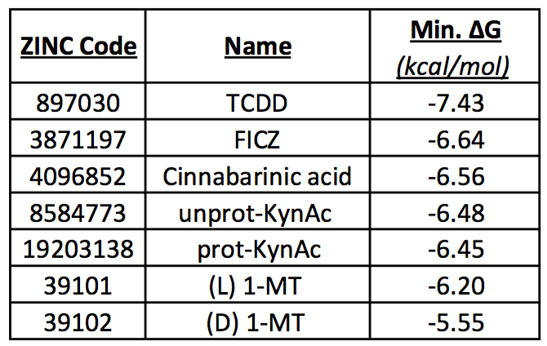
Chapter 3: Figure 1: In Silico Modeling of AHR Ligation
A rendering of D-1-methyl-tryptophan in complex with a simulated x-ray crystal structure of the aryl hydrocarbon receptor.
Changes in Gibbs free energy (ΔG) upon simulated ligation with various known and putative AHR ligands.
A.
B.

Slide 23
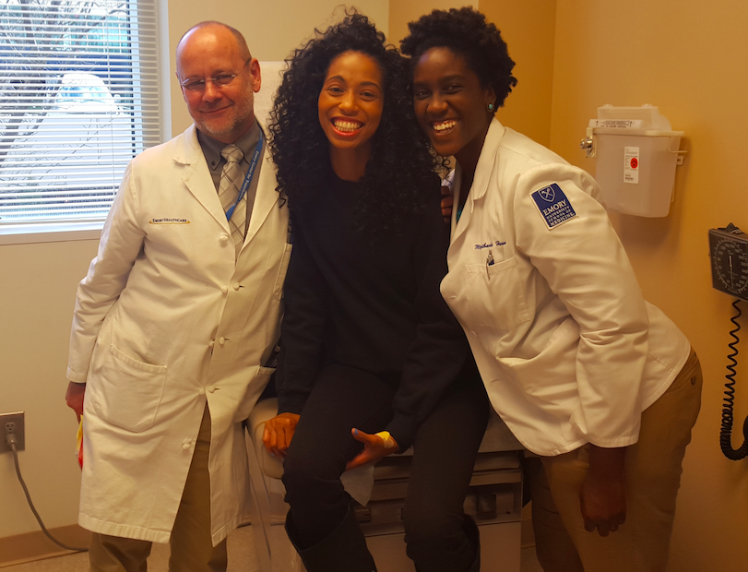
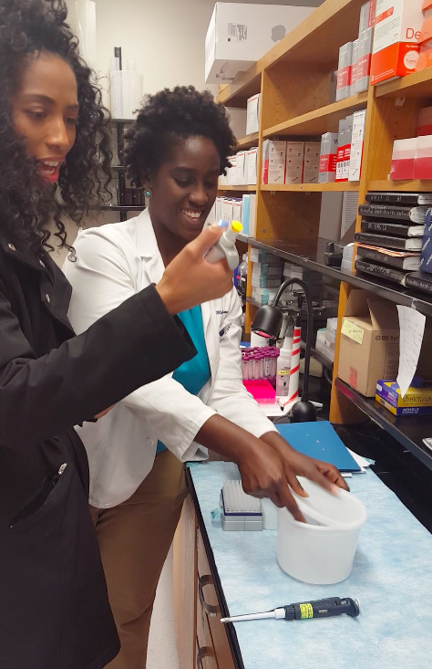
Chapter 4: Figure 1: Translational Stem Cell Therapy
A: Dr. Ned Waller (Emory Hematology/Oncology) and Moji Hassan (Emory Immunology MD/PhD candidate, Sickle & Flow co-director) are featured with Constance Benson, the first person cured of sickle cell by this current protocol. This was her 12-month check-up appointment, at which she exhibited zero clinical signs of graft rejection.
B. Holly Chris Lewis with Constance Benson at the Galipeau lab cell culture facility, discussing mesenchymal stromal cell biology.
C. Moji Hassan at the Waller Lab, teaching Constance Benson how a micropipette is used.
A.
C.
B.

Slide 24
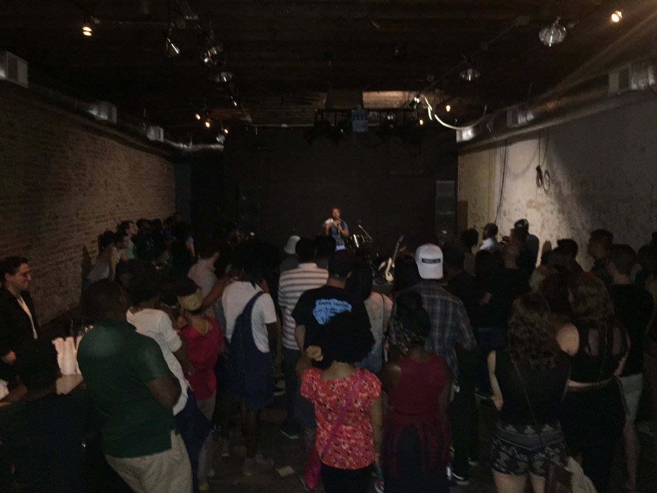
Chapter 4: Figure 2: Sickle & Flow Event June 18, 2016.
A. Background: Holly Chris Lewis introduces Georgia State Rep. Park Cannon (D-Atlanta) to deliver the welcome address. Back lot of Peaceful Clouds Smoke Shop, adjacent to Our Lady of Lourdes Catholic Church, Old Fourth Ward, Atlanta.
Midground: Emory immunology PhD Candidate Lisa Mills manages the Be-the-Match cheek swab donation station.
Foreground: Two patients cured of sickle cell by the Emory marrow transplantation teams speak with representatives of the Atlanta Chapter for the National Association for the Advancement of Colored People.
B. Sickle & Flow featured speeches by sickle cell patients, clinicians and scientists, interspersed with live music performances. In this photograph at the Sound Table on Edgewood Avenue, Dr. Margo Rollins (Children’s Healthcare of Atlanta, Pediatric Hematology/Oncology, Blood Banking/Transfusion Medicine) addresses the crowd, sharing her personal experiences treating sickle cell patients in Atlanta, emphasizing the importance of stem cell donation.
A.
B.

Slide 25



Chapter 5: Figure 1: MSC CM maintains in vitro ASC survival, but is abrogated by lipid-disruption
A.
B.
Representative ELISPOTs, t=3d
CM (Irr)
CM (Irr) +Cleanascite
Vehicle (R10)
Healthy, freshly-sorted blood ASCs were cultured in RPMI + 10 %FCS (R10, or Vehicle), Conditioned medium (CM) from MSC cultures, or MSC CM that had been pre-treated with the lipid disrupting agent Cleanascite. Each condition was set with the same ASC input cell number (approx. 2,000). Cells were harvested at days 0, 1, 3, and 7 post-culture and the frequency of IgG-secreting ASCs were measured by ELISPOT and normalized to Day 0 (100%). A repeated-measures one-way ANOVA afforded a P-value of 0.02,indicating that the lipid disruption statistically abrogated the in vitro support to ASCs.
Representative photomicrographs of the wells from ELISPOT experiments in panel A.

Slide 26
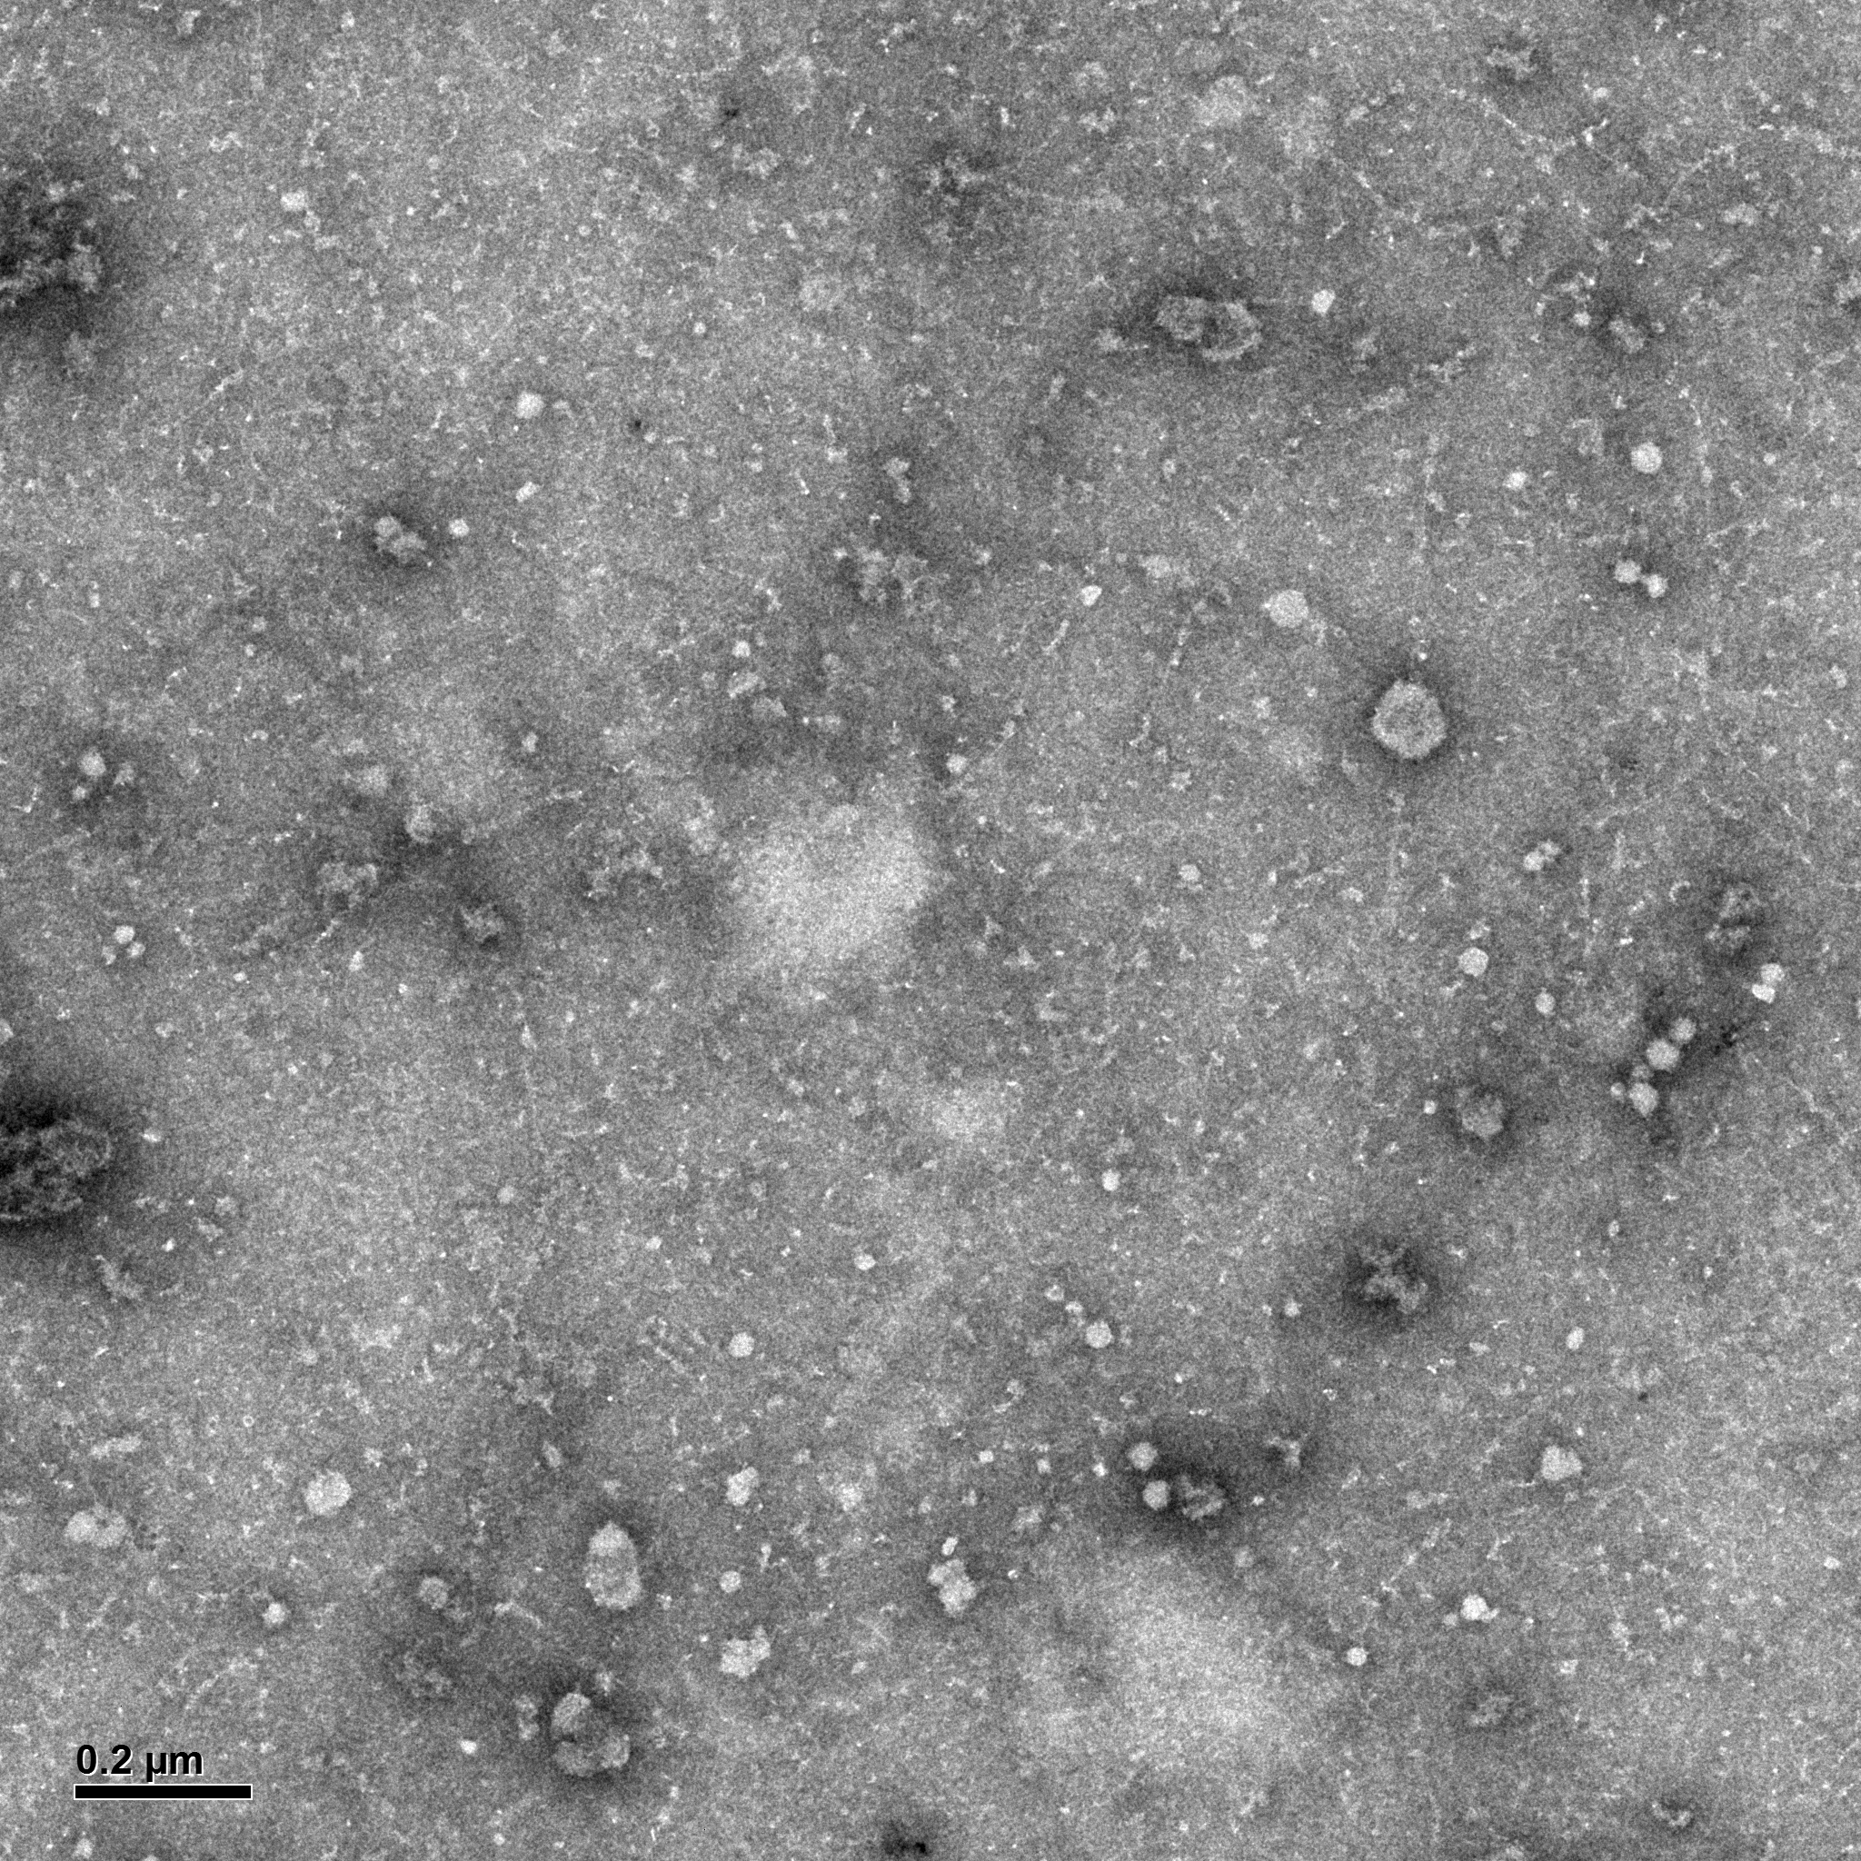
Chapter 5: Figure 2. Electron microscopy shows CM from irradiated MSCs contains a greater number of exosome-sized extracellular vesicles
A
Exosomes from Non-Irradiated MSCs
B
Exosomes from Irradiated MSCs
C
Number of 50-100nm vesicles
Count per HPF
200 nm
200 nm
A-B. Negative-staining electron microscopy was performed on exosomal fractions isolated from Irradiated or Non-Irradiated MSCs. Imaging was performed using uranyl-oxalate negative staining and observed using a JEOL Transmission electron microscope. Twelve grids were prepared and imaged by a trained microscopist who was blinded to the samples’ radiation-treatment-status. Scale bar indicates 200 nm. Exosomes are 50 to 100 nm in size, and two such putative vesicles are indicated by green dashed lines.
C. Two technicians were trained on what 50-100nm vesicles should look like via electron microscopy, and blinded to radiation-treatment status. They enumerated the number of 50-100nm vesicles that could be appreciated on all twelve of the TEM grids, which were shown to the observer in a randomized sequence. A Mann-Whitney test (employed due to the counted nature of integer-based data) afforded a test statistic of 0.015.

Slide 27
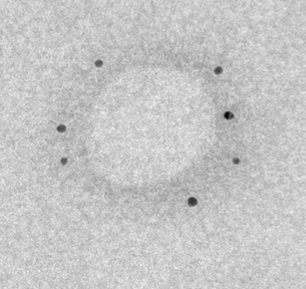
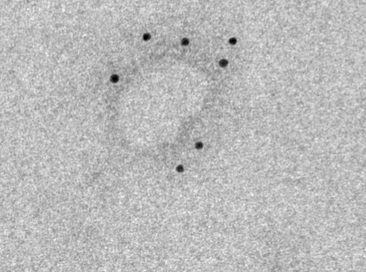
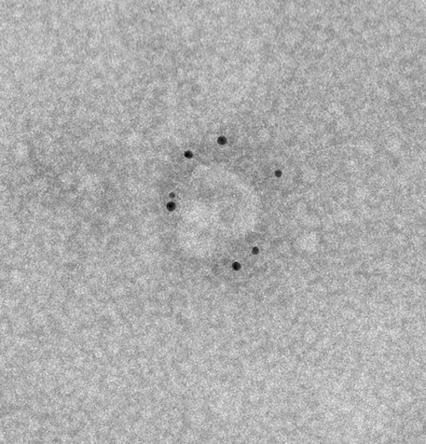
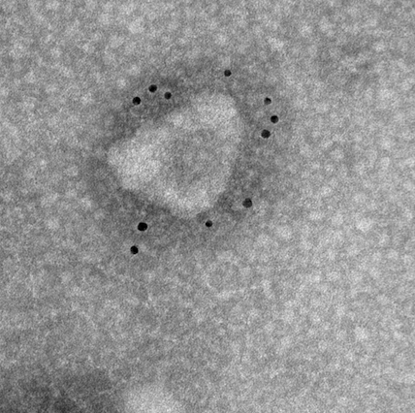
Chapter 5: Figure 3. Immuno-gold electron microscopy confirms presence of known MSC-derived exosome markers
A. CD63 Immunogold
A-B.
Immunogold-labeling electron microscopy was utilized to confirm if the 50-100nm vesicles could justifiably be referred to as exosomes. Commercial antibodies for CD63 and CD81 were acquired and conjugated to colloidal gold by trained electron microscopists; both these molecules are known to be present on MSC-derived exosomes. The scale bar indicates 50 nm. As only positively-marked vesicles can be visualized using the immunogold technique, we demur in quantifying the number or proportion of vesicles thusly stained, apart from noting that the ultrastructure of exosomes appeared comparable for those derived from non-irradiated and irradiated MSCs. These micrographs are representative of over two dozen such images, using exosomes derived from three independent patient donors.
50 nm
50 nm
Non-Irradiated
Irradiated
B. CD81 Immunogold
50 nm
50 nm
Non-Irradiated
Irradiated

Slide 28
Chapter 5: Figure 4. Highly-specific ELISA shows that Irradiated and Non-irradiated MSCs release the same quantity of CD9-positive exosomes
A.
Yield of CD9-positive Exosomes
A. Exosomes were collected and isolated using the flowchart in panel A. We obtained an exosome-customized ELISA kit utilizing CD9, a surface protein marker known to be present on MSC-derived exosomes. It uses conventional sandwich ELISA technology, with human CD9 as the capture antibody, and also includes professional-grade exosome standards for the generation of an exact standard curve. Panel B shows the results of this ELISA result, comparing the results of three independent experiments using independent MSC patient donors, each replicated twice. An unpaired t-test was performed, yielding a P value of 0.84, showing an insignificant difference between the amount of CD9-specific exosomes generated from Irradiated or Non-Irradiated MSCs.
Notes:
ExoTEST is a patented double sandwich ELISA assay for quantitative and qualitative analysis of exosomes. In particular ExoTEST is a successful platform for exosomes quantification and characterization from small amount of human biological fluids or cell media and it may be exploited tExoTEST consists in ELISA plates pre-coated with proprietary pan-exosome antibodies enabling specific capture of exosomes from different biological samples, including cell culture supernatants and human biological fluids. Quantification and characterization of exosomal proteins is subsequently performed using appropriate detection antibodies against exosome associated antigens that can be for either generic or cell/tissue-specific exosomes. Lyophilized Exosome Standards, charcterized for protein content and particle number (NTA) allow the quantification of unknown sample by a standard calibration curve.
Applications: Exosome capture and quantification from human biofluids and cell culture media. Exosome comprehensive profiling. Pre-clinical research on non-invasive biomarkers for detection and monitoring of a number of pathological conditions (inflammation, cancer, neurodegeneration, etc.).
Advantages: Ready to use, No initial exosome purification required. User friendly and suitable for multiple marker analyses. Available in TEST format (limited to 3 ELISA strips, 24 wells).
o identify exosomes released by cancer cells in the plasma and urine of tumor patients in various disease conditions.

Slide 29
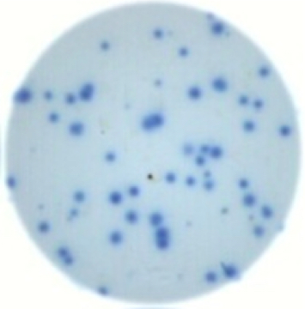
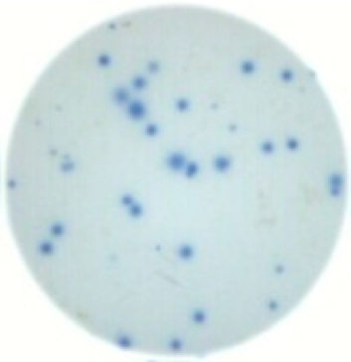
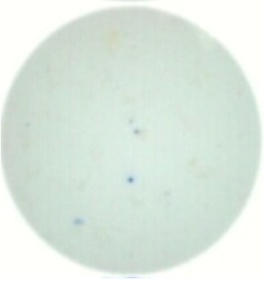
Chapter 5: Figure 5: Exosomes from MSCs support ASC function irregardless of irradiation status
A.
B.
Representative ELISPOTs, t=3d
Exosomes (irr)
Exosomes (non-irr)
Vehicle (R10)
Figure 5: Exosomes from MSCs support ASC function irrespective of irradiation status
A. Figure 5 shows the cumulative data for three independent experiments, plotted in two separate graphs for condition-based comparisons. Panel A shows only exosome samples, in comparison to vehicle alone. We noted that irrespective of irradiation status, exosomes were no different in the support of ASC function, when comparing to the vehicle alone (two-way ANOVA, p-value<0.0001). Figure shows the cumulative data for three independent experiments.
B. Representative photomicrographs of the wells from ELISPOT experiments in panel A.
Notes:
Figure 6 shows the cumulative data for three independent experiments, plotted in two separate graphs for condition-based comparisons. Panel A shows only exosome samples, in comparison to vehicle alone. We noted that irrespective of irradiation status, exosomes were no different in the support of ASC function, when comparing to the vehicle alone (two-way ANOVA, p-value<0.0001).
Representative photomicrographs of the wells from ELISPOT experiments in panel A.
C. Panel C summarizes data from the same experimental datasets as Panel A, but shows only the Exo-Depl CM fractions, derived from Irradiated or Non-Irradiated MSCs, in comparison to vehicle alone. We noted a statistically-significant drop in support by the non-irradiated additive (two-way ANOVA, p-value<0.0001).
D. Representative photomicrographs of the wells from ELISPOT experiments in panel C.

Slide 30
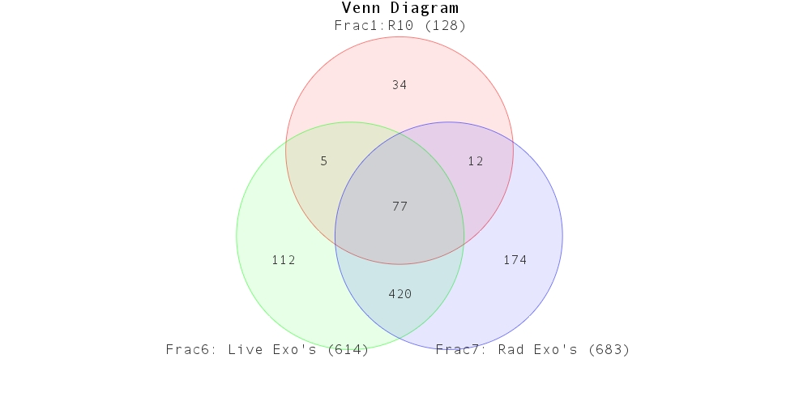
Chapter 5: Figure 6: Exosome proteomics reveals high significance for exosome-mediated delivery of integrin signaling proteins
A.
B
R10 that was not exposed to MSCs
(128 total proteins)
Exosomes from Non-Irrad MSCs
(614 total proteins)
Exosomes from Irrad MSCs
(683 total proteins)
Figure 6: Exosome proteomics reveals high significance for exosome-mediated delivery of integrin signaling proteins
A. After statistical thresholding as described in Methods, the datasets from Supplemental Table 1 were used as input for the IPA software, to generate pathways most highly-associated with those proteins. Only unique proteins present in both exosome samples but absent in the R10 media were used as input for IPA.
B. Panel B presents a curated listing of five of the most significantly-represented pathway lists generated by IPA. Within the IPA platform, a pathway is considered statistically-significant according to the proportion of pathway members present. A statistically-significant p-value of 0.05 is equivalent to a –log(p-value of 1.35, which is indicated on the plot as a vertical dashed line, at the x-value of 1.35.

Slide 31
Chapter 5: Figure 7: Supplemental FlowChart for Generation of Exosomes from MSCs
A.
α-MEM + 20% FCS
100,000 x g Spin, 18h.
Take supernatant.
Combine 1:1 with
α-MEM + 0% FCS
“Exo-Free M10”
For 7 days, collect CM daily, replace with fresh Exo-Free M10. Store separately at 4˚C.
Unmanipulated Conditioned Medium (CM)
300 x g Spin; Take supernatant.
Pass through 0.2µM filter.
5-day M10-culture-recovered MSCs
2000 x g Spin; Take supernatant.
10,000 x g Spin; Take supernatant.
X 3 flasks
100,000 x g Spin;
30 Gray
Take supernatant, this is
X 3 flasks
Exo-Depleted CM
100,000 x g Spin;
The pellet is
Exosomes
A. This flowchart illustrates how exosomes were generated from MSC conditioned medium (CM). Full details may be found in Methods, but here we wish to point out how the same population of MSCs was passaged and irradiated, and how the subsequent fractionation of CM was performed. It may be helpful to envision the theoretical sum of (Exosomes + Exo-depleted CM) to be relatively equivalent to the overall unmanipulated CM.

Slide 32
Chapter 5: Figure 7 Supplementary Table 1 (Page 1 of 8)
All protein hits from proteomic analysis of the R10 media alone and exosomes derived from Irradiated or Noni-Irradiated MSCs. Greyed-out proteins indicate low-abundance proteins that were excluded in downstream bioinformatic analyses.

Slide 33
Chapter 5: Figure 7 Supplementary Table 1 (Page 2 of 8)
All protein hits from proteomic analysis of the R10 media alone and exosomes derived from Irradiated or Noni-Irradiated MSCs. Greyed-out proteins indicate low-abundance proteins that were excluded in downstream bioinformatic analyses.

Slide 34
Chapter 5: Figure 7 Supplementary Table 1 (Page 3 of 8)
All protein hits from proteomic analysis of the R10 media alone and exosomes derived from Irradiated or Noni-Irradiated MSCs. Greyed-out proteins indicate low-abundance proteins that were excluded in downstream bioinformatic analyses.

Slide 35
Chapter 5: Figure 7 Supplementary Table 1 (Page 4 of 8)
All protein hits from proteomic analysis of the R10 media alone and exosomes derived from Irradiated or Noni-Irradiated MSCs. Greyed-out proteins indicate low-abundance proteins that were excluded in downstream bioinformatic analyses.

Slide 36
Chapter 5: Figure 7 Supplementary Table 1 (Page 5 of 8)
All protein hits from proteomic analysis of the R10 media alone and exosomes derived from Irradiated or Noni-Irradiated MSCs. Greyed-out proteins indicate low-abundance proteins that were excluded in downstream bioinformatic analyses.

Slide 37
Chapter 5: Figure 7 Supplementary Table 1 (Page 6 of 8)
All protein hits from proteomic analysis of the R10 media alone and exosomes derived from Irradiated or Noni-Irradiated MSCs. Greyed-out proteins indicate low-abundance proteins that were excluded in downstream bioinformatic analyses.

Slide 38
Chapter 5: Figure 7 Supplementary Table 1 (Page 7 of 8)
All protein hits from proteomic analysis of the R10 media alone and exosomes derived from Irradiated or Noni-Irradiated MSCs. Greyed-out proteins indicate low-abundance proteins that were excluded in downstream bioinformatic analyses.

Slide 39
Chapter 5: Figure 7 Supplementary Table 1 (Page 8 of 8)
All protein hits from proteomic analysis of the R10 media alone and exosomes derived from Irradiated or Noni-Irradiated MSCs. Greyed-out proteins indicate low-abundance proteins that were excluded in downstream bioinformatic analyses.

Slide 40
Chapter 5: Figure 8 Supplementary Table 2 (Page 1 of 3)
After thresholding as described in Methods, datasets from Supp.Table 1 were used as input for the IPA software, to generate pathways most highly-associated with the exosomes’ proteomes. Supp.Table 2 presents the unredacted list of all pathways identified by the IPA software, along with the –log(p-value) for each pathway. Pathways with –log(p-value) below the significance value of 1.35 are greyed-out. The adjacent column indicates the Pathway Ratio, which the IPA software computes; it is a proportion of how many proteins were found in the sample (then names them in the adjacent column) based on the company’s proprietary list of the proteins they have identified to be in that pathway. The immunology-relevant pathways of interest to our team are shaded yellow.

Slide 41
Chapter 5: Figure 8 Supplementary Table 2 (Page 2 of 3)
After thresholding as described in Methods, datasets from Supp.Table 1 were used as input for the IPA software, to generate pathways most highly-associated with the exosomes’ proteomes. Supp.Table 2 presents the unredacted list of all pathways identified by the IPA software, along with the –log(p-value) for each pathway. Pathways with –log(p-value) below the significance value of 1.35 are greyed-out. The adjacent column indicates the Pathway Ratio, which the IPA software computes; it is a proportion of how many proteins were found in the sample (then names them in the adjacent column) based on the company’s proprietary list of the proteins they have identified to be in that pathway. The immunology-relevant pathways of interest to our team are shaded yellow.

Slide 42
Chapter 5: Figure 8 Supplementary Table 2 (Page 3 of 3)
After thresholding as described in Methods, datasets from Supp.Table 1 were used as input for the IPA software, to generate pathways most highly-associated with the exosomes’ proteomes. Supp.Table 2 presents the unredacted list of all pathways identified by the IPA software, along with the –log(p-value) for each pathway. Pathways with –log(p-value) below the significance value of 1.35 are greyed-out. The adjacent column indicates the Pathway Ratio, which the IPA software computes; it is a proportion of how many proteins were found in the sample (then names them in the adjacent column) based on the company’s proprietary list of the proteins they have identified to be in that pathway. The immunology-relevant pathways of interest to our team are shaded yellow.

Slide 43
Chapter 6: Figure 1: Exosomes from Rhesus Macaques
Figure 1: Exosomes from Rhesus Macaques
A. Photomicrograph of exosomes derived from the red blood cells from a Rhesus macaque infected with Plasmodium cynomolgi. Exosomes were fixed in 2% paraformaldehyde (PFA) o.n. at 4˚C. Fixed exosomes were deposited onto formvar grids for 20 min. Grids were then fixed in glutaraldehyde 1% for 5 min, washed in distilled water and negatively stained for 5 min with a solution of uranyl-oxalate (pH = 7) and for 10 min at 4˚C with uranyl acetate (4%)-methyl cellulose (2%). After thoroughly drying, grids were observed with a JEOL 1010 transmission electron microscope. Micrographs were used to quantify the diameter of exosomes; scale bar is 100 nm.
A.
100nm
Lewis CN, Lapp, Breding, Galinski.
Unpublished data, 2013.

Slide 44

Chapter 6: Figure 2 Exosomes from AHR+ MSCs
Figure 2: Exosomes from AHR+ MSCs
Tattooed artistic renderings, designed by Holly Chris Lewis, based on images in Chapter 2: Figure 2 and injected by Dustin Swinks of Memorial Tattoo Shop, East Atlanta. Panel portrays green holly leaves interspersed with GFP- and DAPI-colored MSCs. Perinuclear stippling is noted in a distribution consistent with the subcellular location of the AHR protein. Panel also includes the antecubital fossa of Holly Chris Lewis, is the site typically used for peripheral blood phlebotomy. This tattoo portrays an MSC releasing multi-colored exosomes shaped like holly berries.

