Slide 1
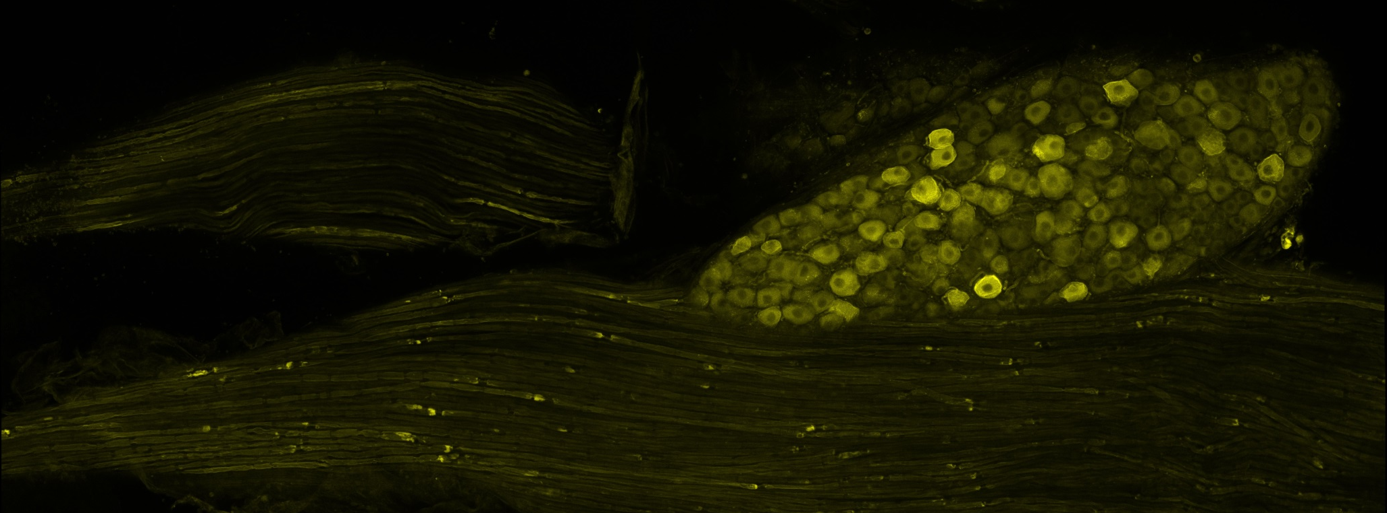

A
DR
VR
100 µm
B
C
FIGURE 1: A. Image of a whole mount of the L4 dorsal root ganglion, dorsal root, and ventral root from a Thy1-ChR2 mouse. Panels B and C are higher magnification images of the regions in the white boxes in panel A. B. ChR2-YFP is found in the cell bodies of ganglion cells, especially at the cell membrane (arrow). YFP is in axons in both the ventral root (VR) and dorsal root (DR). C. Higher concentration of ChR2-YFP is found in punctate regions (arrow heads).

Slide 2
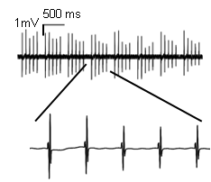
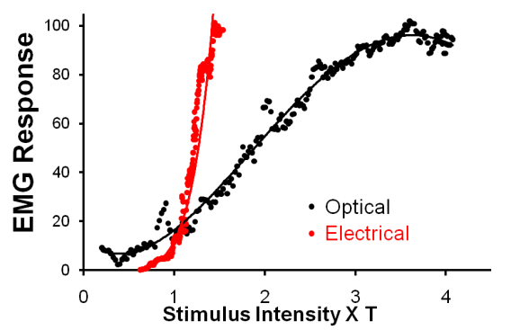
A
B
C
FIGURE 2: A. The magnitude of the direct muscle EMG response to optical activation vs. electrical stimulation is shown as a function of the minimum voltage that evokes a response that is statistically significantly greater than baseline, which was defined by threshold, the minimal stimulus intensity required to recruit a response 50% of the time. Data are from recordings made in a single gastrocnemius muscle of an intact mouse. B. EMG responses to a patterned train of optical activations. Muscles will follow up to 20Hz trains. C. The relationship between stimulus voltage applied to the LEDs in the optical cuffs and the light intensity axons were exposed to during testing and treatment is shown. Almost all activation used was less than 60 μW/mm2.

Slide 3

A
B
LEDs
Nerve cut with sharp scissors
*,‡
Common
Fibular n.
*
*
10-15 mm long Graft secured with fibrin glue
FIGURE 3: A. Schematic of experimental design. Sciatic nerves were cut and repaired using segments of the sciatic nerve harvested from strain-matched non-fluorescent donor mice. B. The distributions of lengths of YFP+ profiles of regenerating axons measured two weeks after cut and repair of the sciatic nerve are shown for the different groups studied as cumulative frequency histograms. Inset: Average (+SEM) median axon profile lengths are shown for each of the groups. *=p<0.05 vs. Untrained. ‡=p<0.05 vs. Electrical treatment and Optical treatment.
Notes:
Rerun ANOVA now that I’ve reanalyzed several of the outlying cases

Slide 4
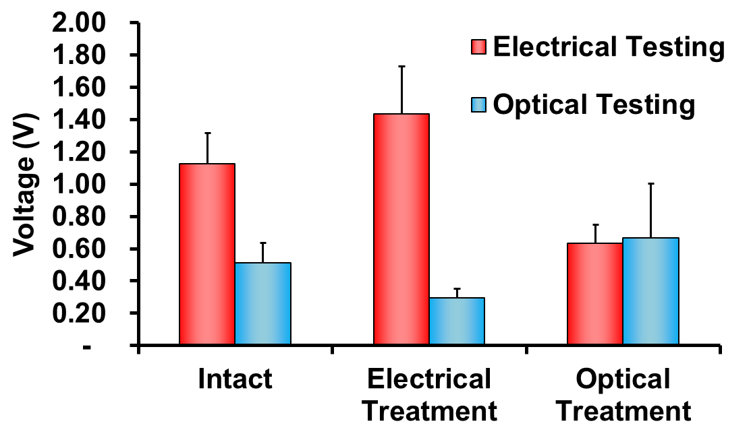
*
‡
*
‡
NS
FIGURE 4: Nerves were cut and repaired by end-to-end anastomosis. M-responses elicited by optical and electrical nerve stimulation prior to and 3 weeks after transection were measured. Mean (+SEM) M-responses elicited both optically and electrically, is shown for the three treatment groups: Intact, Optically treated, and electrically treated. *=p<0.05 vs. optical treatment.

Slide 5

A
B
LEDs
*
Stumps
of cut
nerve
secured
with
fibrin
glue
*
*
*
C
Tibial n.
*
*
Gastroc
Force
FIGURE 5: A. Schematic of experimental design. Nerves were cut and repaired by end-to-end anastomosis. Twitch forces elicited by optical and electrical nerve stimulation prior to and 4 weeks after transection were measured. B. Mean (+SEM) percent recovery, the ratio of post-transection to pre-transection maximal force, elicited both optically and electrically, is shown for the three treatment groups: Untreated, Optically treated, and electrically treated. *=p<0.05 vs. electrical treatment C. The average ratio of forces generated optically vs. electrically is used as a measure of the percentage of motor axons which were ChR2+ in intact mice and four weeks after sciatic nerve transection and repair in different treatment groups. * =p<0.05 vs. Intact and Untreated.

Slide 6
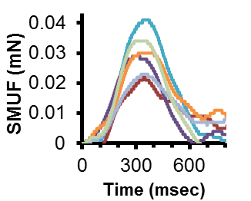
A
B
FIGURE 6: An array of six single motor unit twitch forces (SMUF) which were extracted from incremental stimulation of the sciatic nerve of a single mouse (inset). All peak forces were pooled for each stimulus protocol within each treatment group and used to generate the cumulative histograms shown in panels A and B, for electrically and optically evoked SMUFs, respectively.
Notes:
TO DO:
Smooth out the lines in A

Slide 7
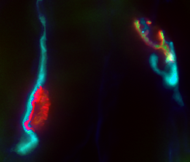
A
A
B
B
E
E
*ᵻ
*
*
α-BTx
50 µm
ChR2
α-BTx
ChR2
C
D
C
D
SV2
Merged
FIGURE 7: Two reinnervated motor endplates are shown (A-D). One isChR2+ (right) and the other is ChR2- (left). E. Mean (+SEM) percentage of all endplates that were reinnervated (SV2+) and ChR2+ is shown for the different groups studied. *=p<0.05 vs. ChR2 percentage within each treatment, ᵻ=p<0.05 vs. all other percentages.
Notes:
Change blue in merged image

