Slide 1
Figure 1
A
A1
1.4
1.2
1.0
0.8
0.6
0.4
0.2
0.0
ALP
Fold change of mRNA
****
****
****
Time (hr)
0
2
4
8
24
B
Fold change of mRNA
1.4
1.2
1.0
0.8
0.6
0.4
0.2
0.0
Osx
***
****
****
Time (hr)
0
2
4
8
24
1.2
RUNX2
C
Fold change of mRNA
1.0
**
0.8
0.6
****
****
0.4
****
0.2
0.0
Time (hr)
0
2
4
8
24

Slide 2
Figure 2
A2
A
1.2
Fold change of mRNA
1.0
ALP
0.8
0.6
0.4
0.2
0.0
HAp
ns
##
#
****
-
iFGFr (nM) -
+
-
+ 10
+ 30
+ 100
+ 300
B
1.2
ALP
Fold change of mRNA
1.0
0.8
0.6
##
##
0.4
0.2
****
0.0
HAp
-
-
+
-
+ 0.3
+ 1
iP_{i}T (mM)
C
1.2
Fold change of mRNA
ALP
1.0
0.8
0.6
ns
0.4
0.2
****
0.0
HAp
-
-
+
-
+ 100
+ 300
iCaSR (nM)

Slide 3
Figure 3
A3
A
Fold change of mRNA
1.8
1.6
1.4
1.2
1.0
0.8
0.6
0.4
0.2
0.0
ALP
##
###
####
****
HAp -
inhibitor -
+
-
+
iP_{i}T
+
iFGFr
+
iP_{i}T & iFGFr
1.6
1.4
1.2
1.0
0.8
0.6
0.4
0.2
0.0
Osx
####
B
Fold change of mRNA
####
####
****
HAp -
inhibitor -
+
-
+
iP_{i}T
+
iFGFr
+
iP_{i}T & iFGFr
C
2.5
RUNX2
Fold change of mRNA
2.0
###
1.5
###
1.0
###
0.5
**
0.0
HAp -
inhibitor -
+
-
+
iP_{i}T
+
iFGFr
+
iP_{i}T & iFGFr

Slide 4
Figure 4
A
A4
1.2
1.0
0.8
0.6
0.4
0.2
0.0
HAp
Fold change of mRNA
ALP
ns
****
-
-
+
-
+ 0.3
+ 1
+ 3
iFGFr1 (µM)
B
1.2
1.0
0.8
0.6
0.4
0.2
0.0
HAp
ALP
Fold change of mRNA
###
ns
****
-
-
+
+
+
iFGFr4
+
iFGFr
inhibitor
C
2.0
FGFrs
Fold change of mRNA
1.5
*
1.0
0.5
***
0.0
HAp
-
+
-
+
-
+
-
+
FGFr
1
2
3
4

Slide 5


Figure 5
A5
Minutes
Hours
Time HAp
p-ERK1/2
ERK1/2
0 | 15 | 30 | 45 |  | 1 | 2 | 4 | 8 | 24
- | + | + | + |  | + | + | + | + | +

Slide 6
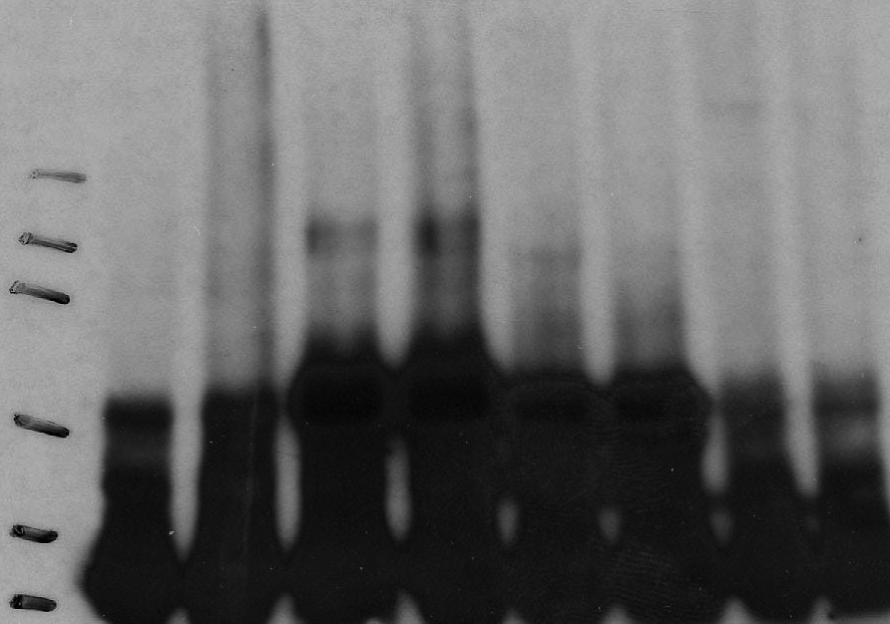
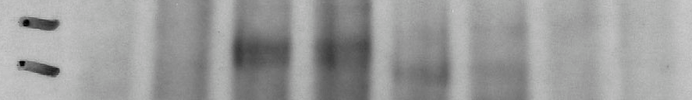
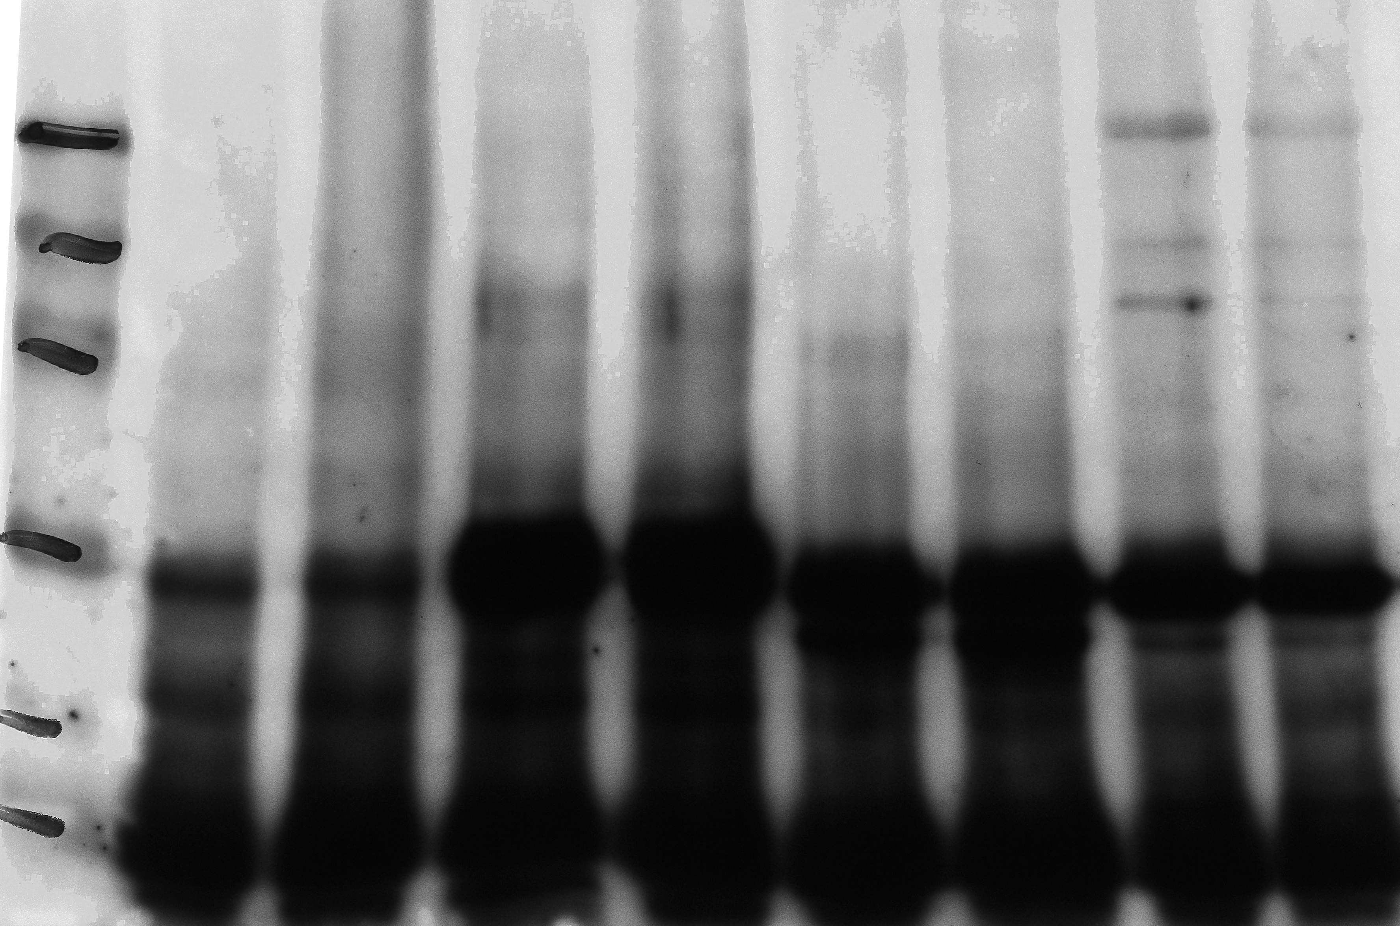
Figure 6
A6
A
p-FGFR1/2
FGFR1 FGFR2 FGFR3 FGFR4
M
- +
- + - + -
+
150
102
76
52
38
31
B
FGFR1 FGFR2 FGFR3 FGFR4
- + - +
-
- + +
102
FGFR2 ₇₆
C
FGFR1 FGFR2 FGFR3 FGFR4
p-Tyrosine M
- + - + - +
-
+
150
102
76
52
38
31

Slide 7
Figure 7
A7
4.0
***
3.5
Fold change of mRNA
3.0
***
2.5
2.0
1.5
1.0
0.5
0.0
HAp
-
+
-
+
-
+
-
+
-
+
SLC
SLC34A1
SLC34A2
SLC34A3
SLC20A1
SLC20A2

Slide 8
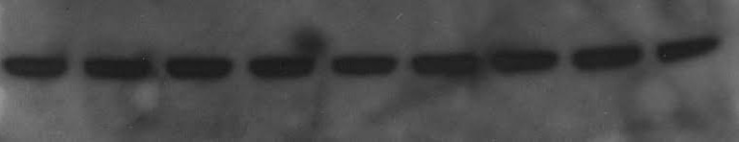
Figure 8
A8
 |  | Minutes |  |  |  |  | Hours
0 | 15 | 30 | 45 |  | 1 | 2 | 4 | 8 | 24
- | + | + | + |  | + | + | + | + | +
time HAp
A
RUNX2
B
Osterix
C
Actin

Slide 9


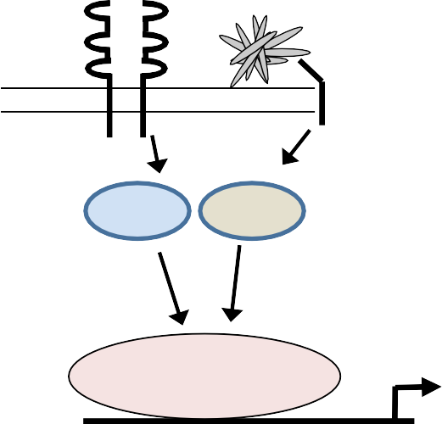






Figure 9
A9
A
FGFr2
B
FGFr2
Pi-T
Pi-T
1
2
1
Repressor
X
Repressor
X
C
FGFr2
D
FGFr2
Pi-T
Pi-T
1
2
1
Activator
X
Activator
X
represents HAp

