Slide 1
Investigating Solvent Dynamics and Spin Probe Behavior Around the Intrinsically Disordered Protein β-Casein Through EPR Spectroscopy
By Erin Neely
Advisor: Dr. Kurt Warncke

Slide 2
Intrinsically Disordered Proteins
Globular proteins have a well-defined 3D structure; intrinsically disordered proteins (IDPs) do not
IDPs are important because they play roles in diseases
  Cancer
  Diabetes
  Neurodegenerative diseases (e.g. Alzheimer’s)
β-casein representative of IDPs in general
  Phosphoprotein; 209 amino acid residues
  Molecular mass ~ 24 kDa
NMR study of IDPs has been prevalent, but EPR study is less so

Slide 3
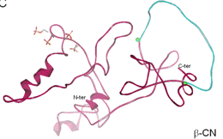
Disulfide bridges
C-terminus
α helix
N-terminus
β-casein
β sheet
from Jardin et al. 2010

Slide 4
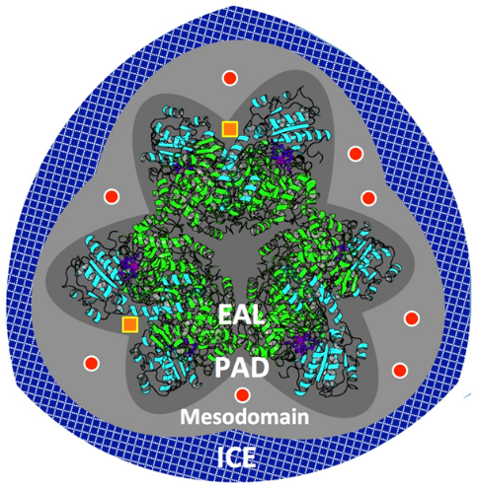
Behavior of Globular Proteins
Past studies of globular proteins have placed them in frozen aqueous solution with TEMPOL
  TEMPOL: Paramagnetic nitroxide spin probe
  Some experiments have also used 2% v/v dimethyl sulfoxide (DMSO) as a cosolvent
2 layers revealed: protein-associated domain (PAD) and mesodomain
  PAD observed only in systems with protein
  Mesodomain observed even without protein
Rotation of TEMPOL is about 10 times faster in the mesodomain compared to the PAD
Faster rotation = narrower, sharper features on EPR spectrum
Aim to find concentration, rotational speed of TEMPOL in each domain

Slide 5

Electron Paramagnetic Resonance
Unpaired electrons have a net spin which gives them a magnetic moment $\vec{μ }$_{s}
In an external magnetic field $\vec{B}$, those spins can have one of two orientations: along or against the field
  If $\vec{B}$ = +B$\hat{z}$, “spin-down” ($\vec{μ }$_{s} = +µ_{s} $\hat{z}$) is more energetically favorable
Microwave radiation is applied to the electrons
Resonance condition: hν = $g_{e}βB$
  $g_{e}$ = electron g-factor
  $β$ = Bohr magneton

Slide 7
The Hyperfine Interaction(s)
2 types: isotropic (direct) and anisotropic (indirect)
Isotropic interaction: Coupling of electron and nuclear spins
  Adds another term to the Hamiltonian: ΔE_{iso} = m_{s}m_{I} * A_{iso}
  m_{I} can be -1, 0, or +1
    Selection rule: Nuclear spins don’t change during EPR experiments
  Depending on m_{I}, there are three possible energy transitions
Anisotropic interaction: Coupling of electron and nuclear magnetic fields, through space
  Adds another term to the Hamiltonian: ΔE_{an-iso} = m_{s}m_{I}A_{dip}(3cos²θ – 1)
  Greatest when θ = 0 or π
The combined hyperfine term, A = A_{dip} – A_{iso}, appears in the simulation code

Slide 8
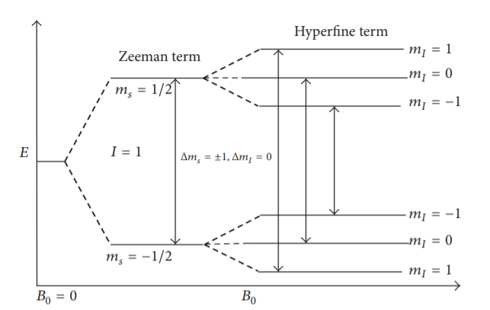
from Sahu and Lorigan (2018)

Slide 9
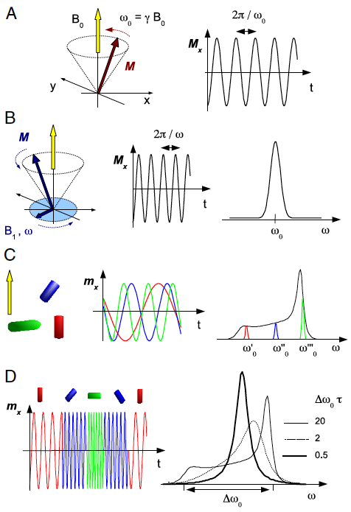
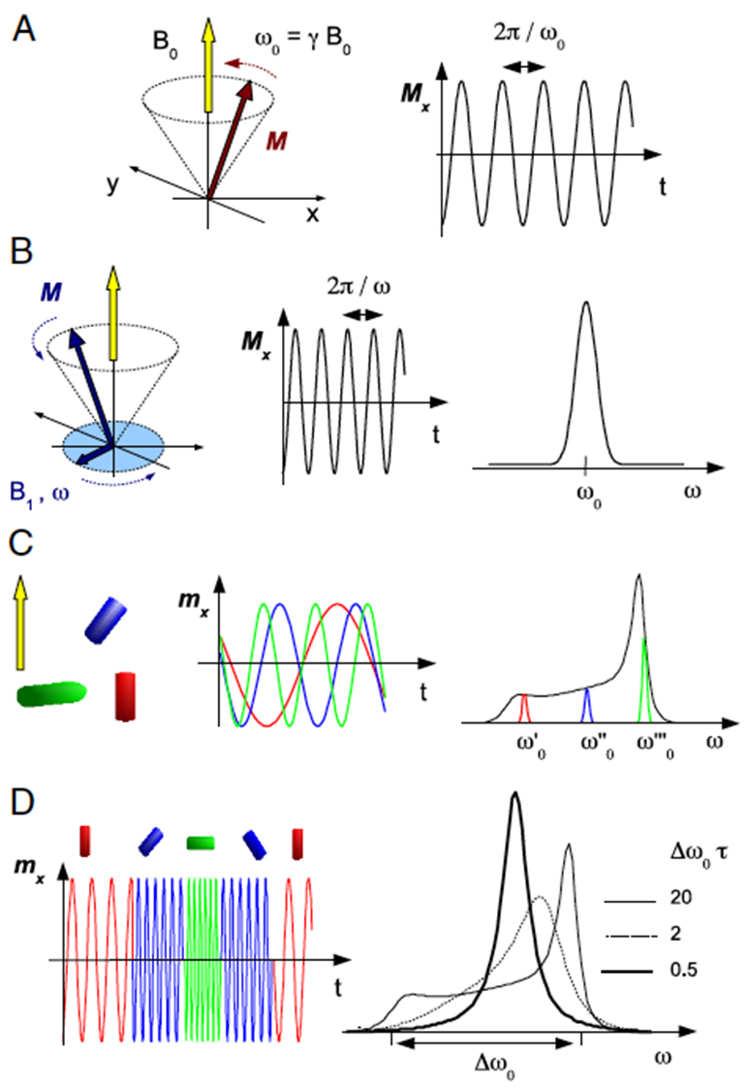

Motional Effects
Electron dipoles precess around the external magnetic field with ω₀ = γB
Microwave radiation also exerts a magnetic field $\vec{B}$₁ on the electron dipoles, in the xy-plane, that rotates with ω
As ω → ω₀, $\vec{µ}$_{s} aligns along $\vec{B}$_{eff} = $\vec{B}$ + $\vec{B}$₁
Different polar angles θ = different ω₀ and different transition energies
  This broadens the line shape
Dipoles start at many different θ, but rotation
averages out their contributions
  This narrows the line shape
This motion is reflected in the system parameters: the weights and log correlation times of each component
from Banerjee et al. (2009)

Slide 11
Experimental and Computational Procedures
β-casein frozen in solution with water and TEMPOL
  One trial added 2% v/v DMSO
Spectrometer data exported to Matlab
Simulation run to optimize parameters
  Microwave frequency corrected
  For T = 265 K, used starting parameter values from Mb experiments
  Over decreasing T, used optimized values from last trial as starting parameter values
  Data plotted
  Manual corrections to log(τ) of slow component examined

Slide 13
Open = slow
Closed = fast
Blue = BC
Black = EAL

Slide 14
Open = slow
Closed = fast
Red = BC
Black = EAL

Slide 15
Open = slow
Closed = fast
Blue = BC
Black = EAL

Slide 16
Open = slow
Closed = fast
Red = BC
Black = EAL

Slide 17
Summary
For both proteins, adding DMSO increases spin probe motion
Correlation times are similar in both systems
In 0% DMSO trials, significance of differences in component weights (between protein systems) is unclear
In 2% DMSO trials, the β-casein system consistently shows less spin probe motion
  Weights of slow components are consistently higher
  Spectra maintain rigidity to higher T

Slide 18
Interpretation
PAD and mesodomain create broadly similar rotational dynamics for TEMPOL, between proteins
  EAL has uneven surface topography
  β-casein has open structure
Hypothesis of more rotational motion in β-casein system contradicted
  Based on prediction of solvent microenvironments
Simulation algorithm may be misleading, if β-casein system has >2 components
Globular proteins may carry spin probes with them
Phase separation may be occurring in β-casein system, trapping TEMPOL
  Suggested by poor signal-to-noise ratio
  Likely not the complete explanation

Slide 19
Future Directions
Expand experiments to low T
Change the simulation program to account for >2 components of motion
Examine the motion of globular proteins, in themselves
  Possible with NMR labeling: ¹³C, ¹⁵N
Check for phase separation with known techniques
  Fluorescence microscopy
  1, 6-hexanediol application
Investigate role of solvent dynamics and particle motion in disease processes

Slide 20
Acknowledgements
Dr. Kurt Warncke
Wei Li and Katie Whitcomb
Dr. David Lynn
Dr. Frosso Seitaridou
Emory Physics
My Family

Slide 21


Thank
You!

Slide 22

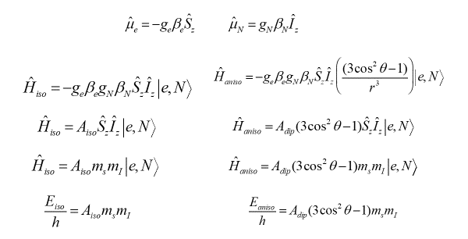

Slide 23
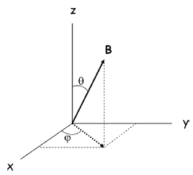

$$\vec{µ}$$
Some Constants
g_{e} = [g_{xx} g_{yy} 2.0023]
β_{e} = 9.274 × 10⁻²⁴ J/T
|γ_{e}| = 1.76 × 10¹¹ rad/T*s
A_{iso} = 48 MHz
A_{dip} = [-26.9 -28.5 +55.4] MHz
A = [20.9 19.26 103.2] MHz
ν = ω / 2π ≈ 9.5 MHz (X-band)

Slide 25
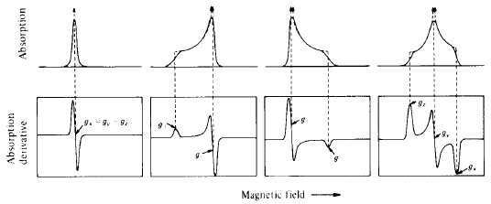
Isotropic Axial Axial Rhombic
g_{x}=g_{y}=g_{z} g_{x}=g_{y}<g_{z} g_{x}=g_{y}>g_{z} g_{x}≠g_{y}≠g_{z}

Slide 26
References, Part 1
Adamski, W., Salvi, N., Maurin, D., Magnat, J., Milles, S., Jensen, M. R., ... & Blackledge, M.
(2019). A unified description of intrinsically disordered protein dynamics under
physiological conditions using NMR spectroscopy. Journal of the American Chemical Society, 141(44), 17817-17829.
Banerjee, D., Bhat, S. N., Bhat, S. V., & Leporini, D. (2009). ESR evidence for 2 coexisting liquid
phases in deeply supercooled bulk water. Proceedings of the National Academy of Sciences, 106(28), 11448-11453.
Clore, G. M., & Gronenborn, A. M. (1991). Applications of three-and four-dimensional
heteronuclear NMR spectroscopy to protein structure determination. Progress in nuclear magnetic resonance spectroscopy, 23(1), 43-92.
Eskin, N. M., & Shahidi, F. (2012). Biochemistry of foods.
Leslie, M. (2021). Separation anxiety.
Nforneh, B., & Warncke, K. (2017). Mesodomain and protein-associated solvent phases with
temperature-tunable (200–265 K) dynamics surround ethanolamine ammonia-lyase in
globally polycrystalline aqueous solution containing dimethyl sulfoxide. The Journal of Physical Chemistry B, 121(49), 11109-11118.

Slide 27
References, Part 2
Nforneh, B., & Warncke, K. (2019). Control of Solvent Dynamics around the B12-Dependent
Ethanolamine Ammonia-Lyase Enzyme in Frozen Aqueous Solution by Using Dimethyl
Sulfoxide Modulation of Mesodomain Volume. The Journal of Physical Chemistry B, 123(26), 5395-5404.
Sadat-Mekmene, L., Jardin, J., Corre, C., Mollé, D., Richoux, R., Delage, M. M., ... & Gagnaire,
V. (2011). Simultaneous presence of PrtH and PrtH2 proteinases in Lactobacillus
helveticus strains improves breakdown of the pure αs1-casein. Applied and environmental microbiology, 77(1), 179-186.
Sahu, I. D., & Lorigan, G. A. (2018). Site-directed spin labeling EPR for studying membrane
proteins. BioMed research international, 2018.
Uversky, V. N., Oldfield, C. J., & Dunker, A. K. (2008). Intrinsically disordered proteins in human
diseases: introducing the D2 concept. Annu. Rev. Biophys., 37, 215-246.
Wertz, J. E., & Bolton, J. R. (1986). Biological Applications of Electron Spin Resonance.
In Electron Spin Resonance (pp. 378-390). Springer, Dordrecht.

