Slide 1
The Wave Equation and the Timpani: An Exploration into Various Models for the Vibration of a Timpani Drumhead
Jack Li, Emory University

Slide 2
Outline
Introduction
  A Timpani
  2D wave equation, closed-form solution, Fourier-Bessel expansion, vibrational modes
  Limitations of the classical modeling + numerical methods
Methods
  Specifying the models
  Accounting for different points of impact
Results
  Animations, periodograms, and audio of models
  Accounting for points of impact
  Obtaining frequencies and amplitudes of vibrational mode + comparison to undamped model and reality
Discussion
  Effect of initial conditions, damping, viscoelastic effects, and point of impact
  Effect of air-loading and how to account for it
  Other future steps (optional)

Slide 3
Introduction: A Timpani
Widely used instrument across multiple genres music
  Music of the classical tradition (symphony orchestras)
  Concert band/wind ensemble
Appears as a potential instrument in digital music
  Sound typically sampled from a real-life recording of a timpani

Slide 4
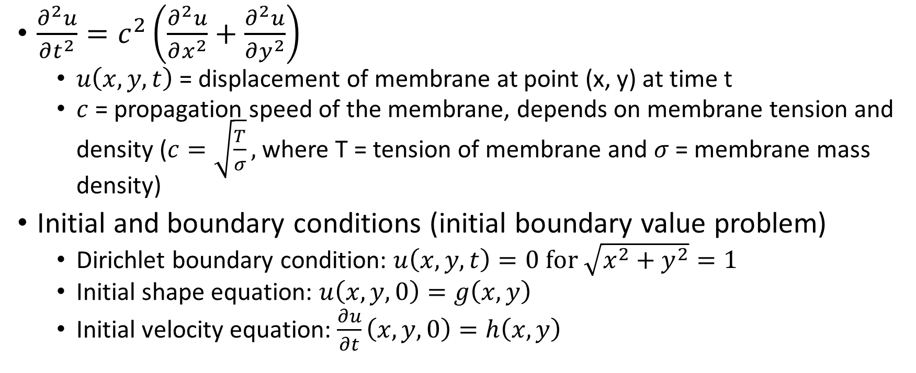
Introduction: the 2D Wave Equation
$\frac{∂^{2}u}{∂t^{2}}=c^{2}\left(\frac{∂^{2}u}{∂x^{2}}+\frac{∂^{2}u}{∂y^{2}}\right)$
  $u\left(x, y, t\right)$ = displacement of membrane at point (x, y) at time t
  $c$ = propagation speed of the membrane, depends on membrane tension and density ($c=\sqrt{\frac{T}{σ}},$ where T = tension of membrane and $σ$ = membrane mass density)
Initial and boundary conditions (initial boundary value problem)
  Dirichlet boundary condition: $u\left(x, y, t\right)=0 for \sqrt{x^{2}+y^{2}}=1$
  Initial shape equation: $u\left(x, y, 0\right)=g\left(x,y\right)$
  Initial velocity equation: $\frac{∂u}{∂t}\left(x, y, 0\right)=h\left(x,y\right)$

Slide 5
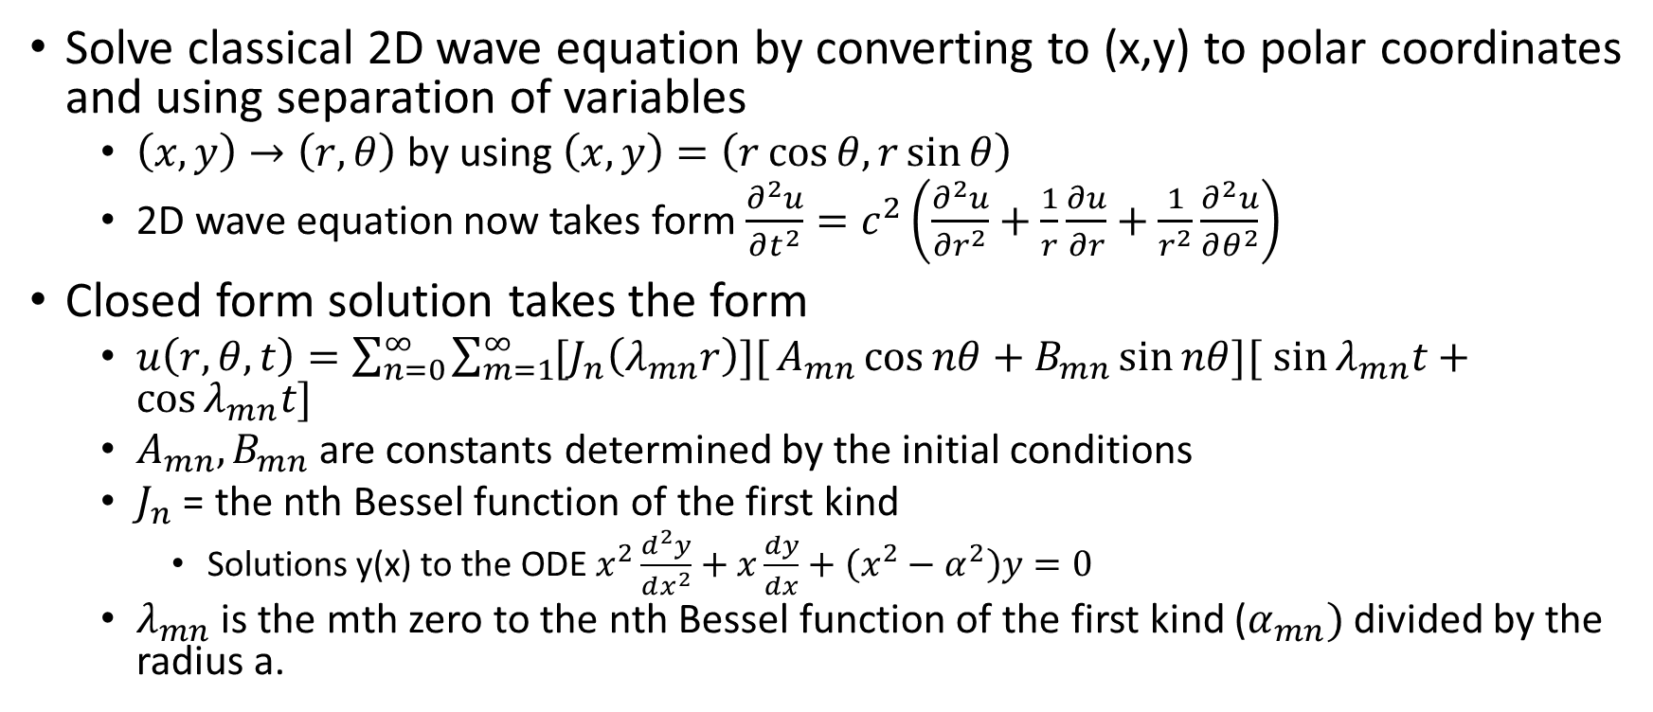
The Classical Solution to the Wave Equation
Solve classical 2D wave equation by converting to (x,y) to polar coordinates and using separation of variables
  $\left(x,y\right)→\left(r, θ\right)$ by using $\left(x,y\right)=\left(r\cos{θ,}r\sin{θ}\right)$
  2D wave equation now takes form $\frac{∂^{2}u}{∂t^{2}}=c^{2}\left(\frac{∂^{2}u}{∂r^{2}}+\frac{1}{r}\frac{∂u}{∂r}+\frac{1}{r^{2}}\frac{∂^{2}u}{∂θ^{2}}\right)$
Closed form solution takes the form
  $u\left(r, θ,t\right)=\sum_{n=0}^{∞}{\sum_{m=1}^{∞}{[J_{n}\left(λ_{mn}r\right)][}}A_{mn}\cos{nθ+}$ $B_{mn}\sin{nθ}{][}$ $\sin{λ_{mn}t+}$ $\cos{λ_{mn}t}{]}$
  $A_{mn},B_{mn}$are constants determined by the initial conditions
  $J_{n}$ = the nth Bessel function of the first kind
    Solutions y(x) to the ODE $x^{2}\frac{d^{2}y}{dx^{2}}+x\frac{dy}{dx}+\left(x^{2}−α^{2}\right)y=0$
  $λ_{mn}$ is the mth zero to the nth Bessel function of the first kind ($α_{mn})$ divided by the radius a.

Slide 6
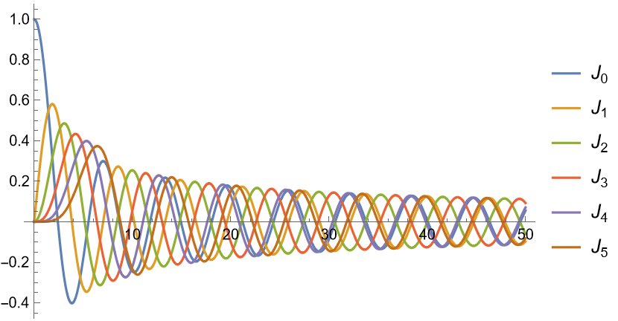
A Plot of Bessel Functions of the First Kind (n = 0 through n = 5)

Slide 7
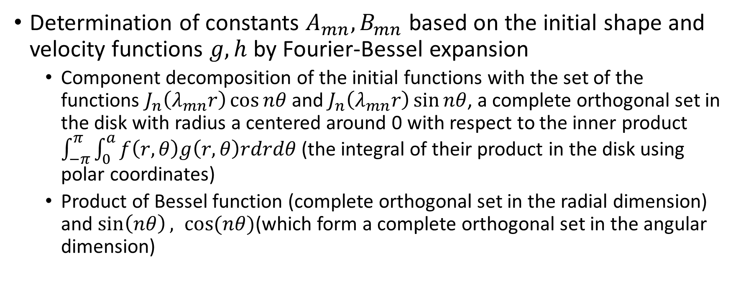
Fourier-Bessel Expansion of the Classical Solution
Determination of constants $A_{mn},B_{mn}$ based on the initial shape and velocity functions $g, h$ by Fourier-Bessel expansion
  Component decomposition of the initial functions with the set of the functions $J_{n}\left(λ_{mn}r\right)\cos{nθ}$ and $J_{n}\left(λ_{mn}r\right)\sin{nθ}$, a complete orthogonal set in the disk with radius a centered around 0 with respect to the inner product $\int_{−π}^{π}{\int_{0}^{a}{f\left(r,θ\right)g\left(r,θ\right)rdrdθ}}$ (the integral of their product in the disk using polar coordinates)
  Product of Bessel function (complete orthogonal set in the radial dimension) and $\sin\left(nθ\right), cos⁡(nθ)$(which form a complete orthogonal set in the angular dimension)

Slide 8
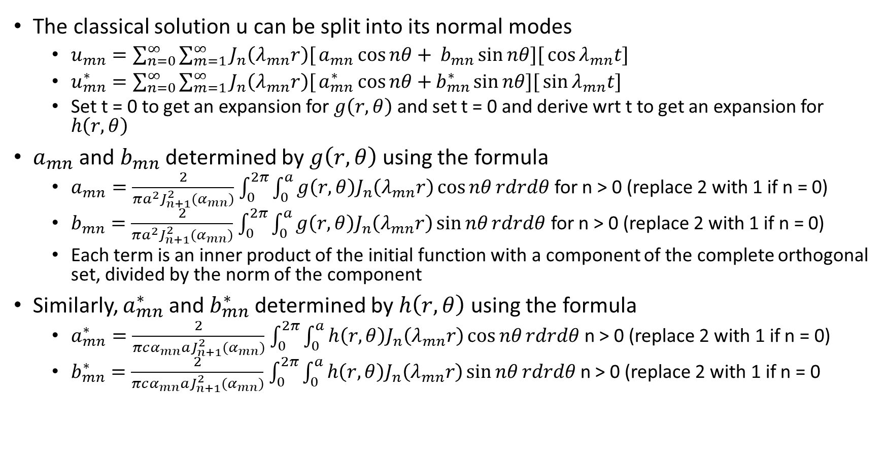
Fourier-Bessel Expansion of the Classical Solution
The classical solution u can be split into its normal modes
  $u_{mn}=\sum_{n=0}^{∞}{\sum_{m=1}^{∞}{J_{n}\left(λ_{mn}r\right)[}}a_{mn}\cos{nθ+} b_{mn}\sin{nθ}{][}\cos{λ_{mn}t}{]}$
  $u_{mn}^{∗}=\sum_{n=0}^{∞}{\sum_{m=1}^{∞}{J_{n}\left(λ_{mn}r\right)[}}a_{mn}^{∗}\cos{nθ+}b_{mn}^{∗}\sin{nθ}{][}\sin{λ_{mn}t}{]}$
  Set t = 0 to get an expansion for $g\left(r,θ\right)$ and set t = 0 and derive wrt t to get an expansion for $h\left(r,θ\right)$
$a_{mn}$ and $b_{mn}$ determined by $g\left(r,θ\right)$ using the formula
  $a_{mn}=\frac{2}{πa^{2}J_{n+1}^{2}(α_{mn})}$ $\int_{0}^{2π}{\int_{0}^{a}{g\left(r,θ\right)J_{n}\left(λ_{mn}r\right)\cos{nθ}rdrdθ}}$ for n > 0 (replace 2 with 1 if n = 0)
  $b_{mn}=\frac{2}{πa^{2}J_{n+1}^{2}(α_{mn})}$ $\int_{0}^{2π}{\int_{0}^{a}{g\left(r,θ\right)J_{n}\left(λ_{mn}r\right)\sin{nθ}rdrdθ}}$ for n > 0 (replace 2 with 1 if n = 0)
  Each term is an inner product of the initial function with a component of the complete orthogonal set, divided by the norm of the component
Similarly, $a_{mn}^{∗}$and $b_{mn}^{∗}$determined by $h\left(r,θ\right)$using the formula
  $a_{mn}^{∗}=\frac{2}{πcα_{mn}aJ_{n+1}^{2}(α_{mn})}$ $\int_{0}^{2π}{\int_{0}^{a}{h\left(r,θ\right)J_{n}\left(λ_{mn}r\right)\cos{nθ}rdrdθ}}$ n > 0 (replace 2 with 1 if n = 0)
  $b_{mn}^{∗}=\frac{2}{πcα_{mn}aJ_{n+1}^{2}(α_{mn})}$ $\int_{0}^{2π}{\int_{0}^{a}{h\left(r,θ\right)J_{n}\left(λ_{mn}r\right)\sin{nθ}rdrdθ}}$ n > 0 (replace 2 with 1 if n = 0

Slide 9
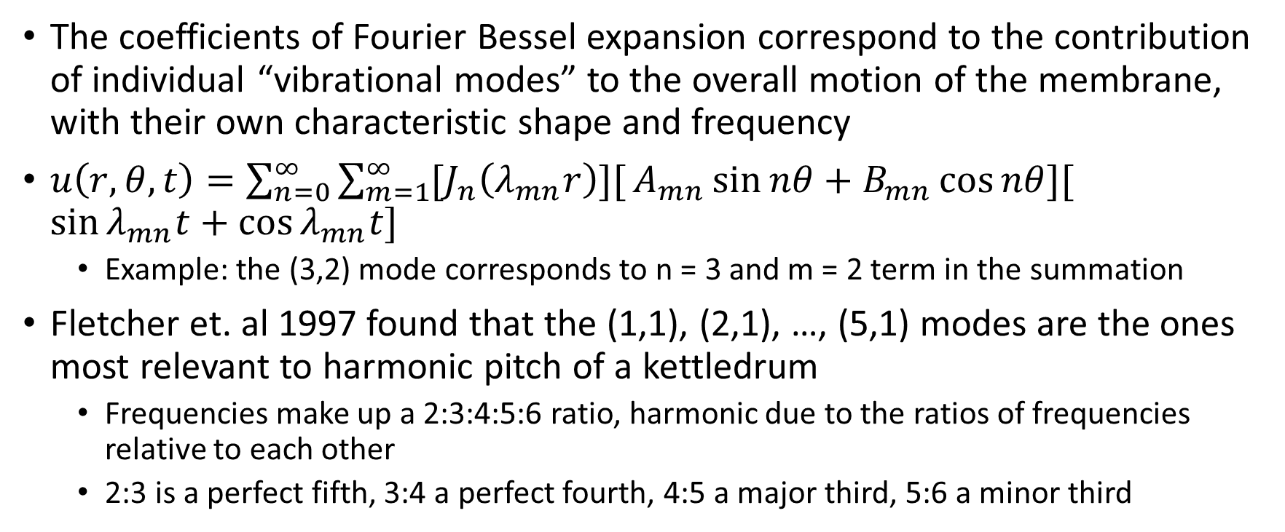
Vibrational Modes
The coefficients of Fourier Bessel expansion correspond to the contribution of individual “vibrational modes” to the overall motion of the membrane, with their own characteristic shape and frequency
$u\left(r, θ,t\right)=\sum_{n=0}^{∞}{\sum_{m=1}^{∞}{[J_{n}\left(λ_{mn}r\right)][}}A_{mn}\sin{nθ+}$ $B_{mn}\cos{nθ}{][}$ $\sin{λ_{mn}t+}$ $\cos{λ_{mn}t}{]}$
  Example: the (3,2) mode corresponds to n = 3 and m = 2 term in the summation
Fletcher et. al 1997 found that the (1,1), (2,1), …, (5,1) modes are the ones most relevant to harmonic pitch of a kettledrum
  Frequencies make up a 2:3:4:5:6 ratio, harmonic due to the ratios of frequencies relative to each other
  2:3 is a perfect fifth, 3:4 a perfect fourth, 4:5 a major third, 5:6 a minor third

Slide 10
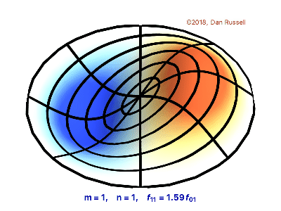
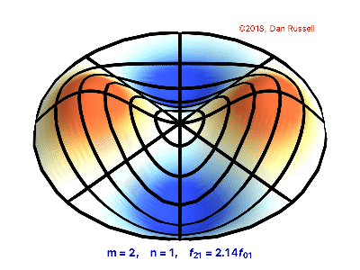
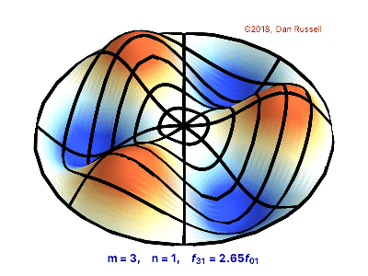
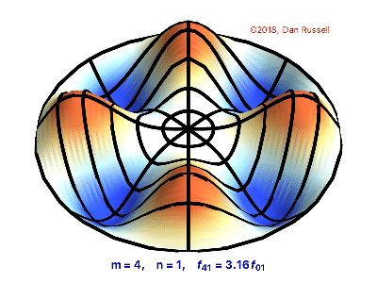
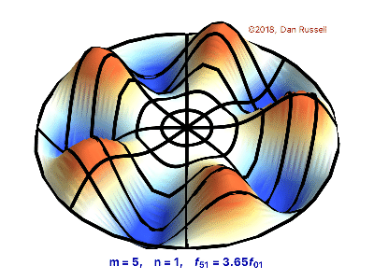
Animations of the n=1,2,3,4,5; m=1 Modes
(Russell 2018)
Animations courtesy of Dr. Dan Russell, Grad. Prog. Acoustics, Penn State

Slide 11
Limitations of the Classical Model
Neglects friction
Viscoelastic effects – the membrane is not purely elastic and will resist deformation/strain from a stress such as a drum impact
Bending stiffness of the membrane (how resistant the membrane is to bending)
  Membrane has some (but not much) degree of rigidity that is modeled using thin-plate vibration rather than the wave equation
Each point on the membrane does not vibrate straight up and down – horizontal displacement is possible

Slide 12
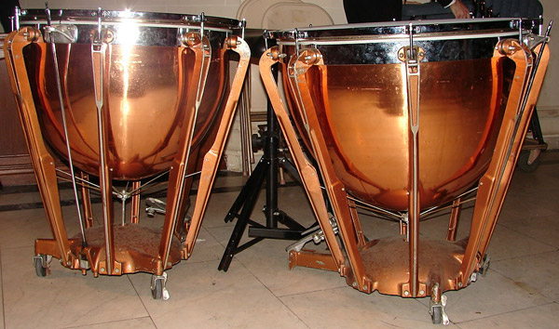
Limitations of the Classical Model: Air Loading
Timpani membrane stretched over a kettle loaded with air
The vibration of membrane affects the acoustic pressure field of the air - leads to pressure differences above and below the membrane
  Pressure differences in turn affect membrane vibration – a coupled system

Slide 13
Numerical Methods: NDSolveValue
Numerical methods to address these limitations
Using Mathematica’s NDSolveValue function for a numerical solution to the model (uses the finite element method)
  Specify boundary conditions
  Specify initial conditions (initial shape and velocity)
  Specify the equation to be solved
  Specify a discretization of the region: a (triangular) mesh
Provides a linearly interpolated numerical solution
  Converges to analytic solution with a fine enough mesh (Ham & Cotter, 2014)

Slide 14
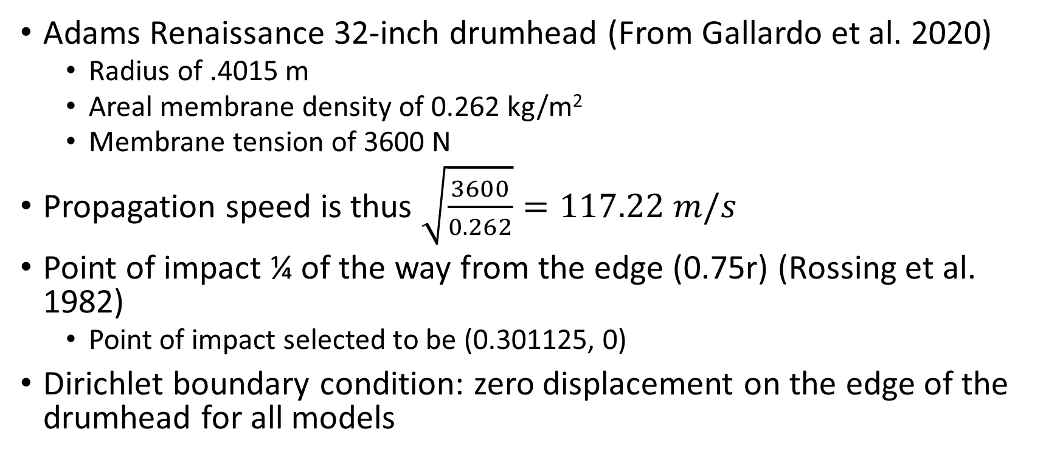
Specifying the Model(s): The Simulated Drumhead
Adams Renaissance 32-inch drumhead (From Gallardo et al. 2020)
  Radius of .4015 m
  Areal membrane density of 0.262 kg/m²
  Membrane tension of 3600 N
Propagation speed is thus $\sqrt{\frac{3600}{0.262}}=117.22 m/s$
Point of impact ¼ of the way from the edge (0.75r) (Rossing et al. 1982)
  Point of impact selected to be (0.301125, 0)
Dirichlet boundary condition: zero displacement on the edge of the drumhead for all models

Slide 15
A List of Explored Models
Mallet Radius (large initial velocity at the region in contact with mallet)
Initial Displacement (specifying an initial displacement)
Initial Velocity (specifying an initial velocity)
Force Model (specifying a forced phase with a conical forcing term + free phase with free vibration)
Modified force model (specifying a forced phase with a conical forcing term + free phase with free vibration accounting for viscoelastic effects)
Dirac modified force model (see above but forcing term is a Dirac function)
  Mostly conical, mostly Dirac, purely Dirac

Slide 16
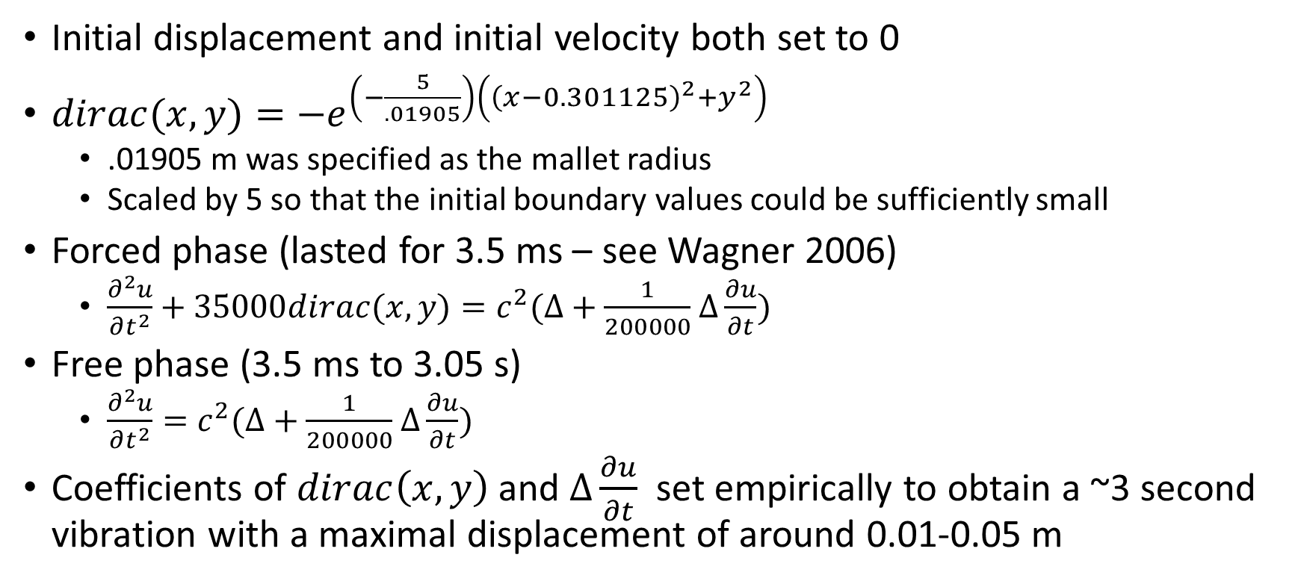
The (purely) Dirac Modified Force Model
Initial displacement and initial velocity both set to 0
$dirac(x,y)=−e^{\left(−\frac{5}{.01905}\right)\left({\left(x−0.301125\right)}^{2}+y^{2}\right)}$
  .01905 m was specified as the mallet radius
  Scaled by 5 so that the initial boundary values could be sufficiently small
Forced phase (lasted for 3.5 ms – see Wagner 2006)
  $\frac{∂^{2}u}{∂t^{2}}+35000dirac(x,y)=c^{2}(∆+\frac{1}{200000}$ $∆\frac{∂u}{∂t})$
Free phase (3.5 ms to 3.05 s)
  $\frac{∂^{2}u}{∂t^{2}}=c^{2}(∆+\frac{1}{200000}$ $∆\frac{∂u}{∂t})$
Coefficients of $dirac\left(x,y\right)$ and $∆\frac{∂u}{∂t}$ set empirically to obtain a ~3 second vibration with a maximal displacement of around 0.01-0.05 m

Slide 17
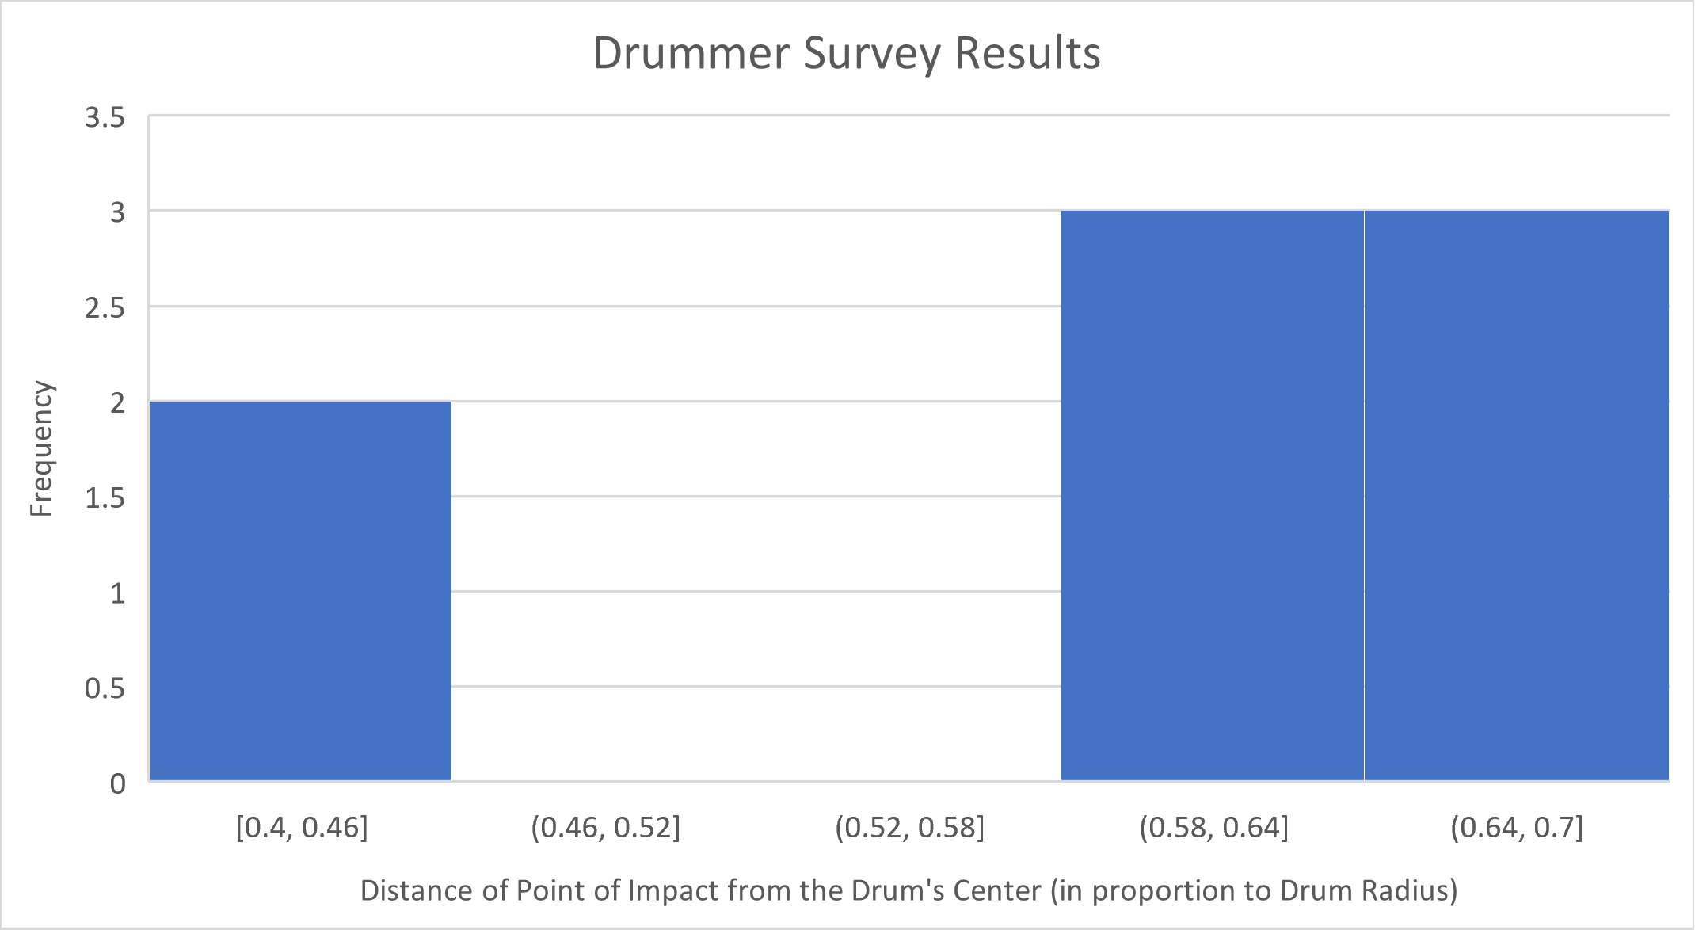
Dirac Modified Force Model on Different Points of Impact
Survey of drummers from Emory Symphony Orchestra, Emory Youth Orchestra, and others (conducted by Zoe Zimmerman)
  n = 8

Slide 18
Dirac Modified Force Model on Different Points of Impact
Two separate clusters
  n = 2 centered around 0.425r
  n = 6 centered around 0.642r
0.642r and 0.425r used as points of impact for Dirac modified force model

Slide 19
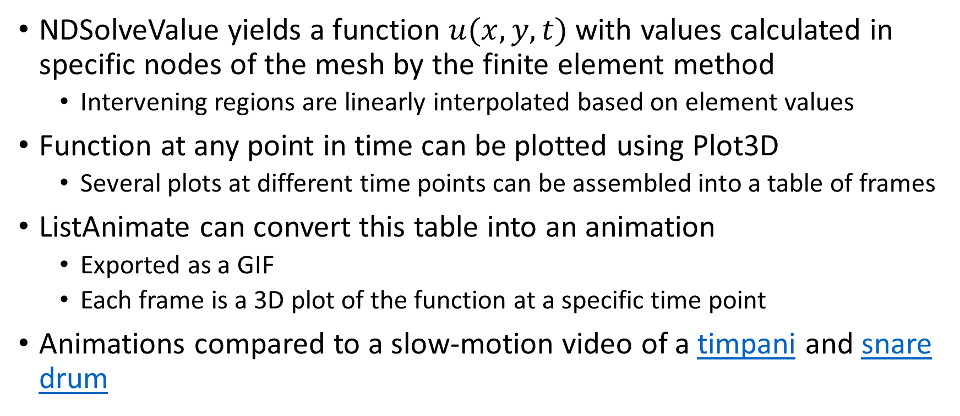
Creating Animations of Vibration
NDSolveValue yields a function $u(x,y,t)$with values calculated in specific nodes of the mesh by the finite element method
  Intervening regions are linearly interpolated based on element values
Function at any point in time can be plotted using Plot3D
  Several plots at different time points can be assembled into a table of frames
ListAnimate can convert this table into an animation
  Exported as a GIF
  Each frame is a 3D plot of the function at a specific time point
Animations compared to a slow-motion video of a timpani and snare drum

Slide 20
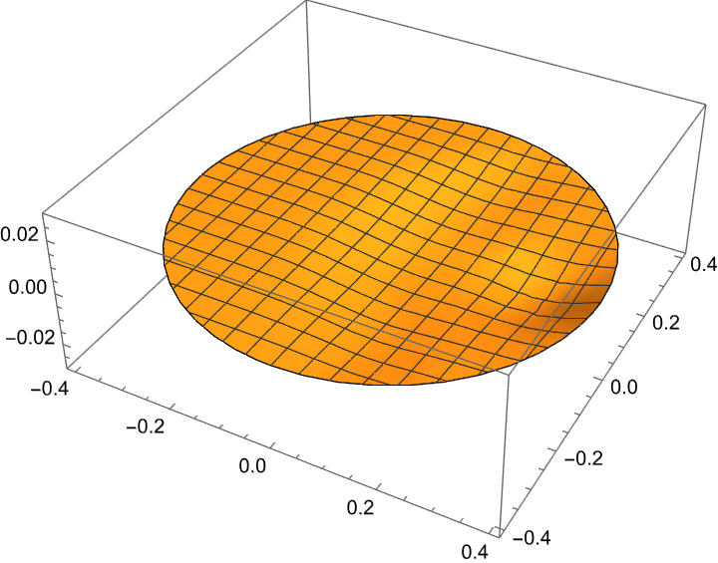
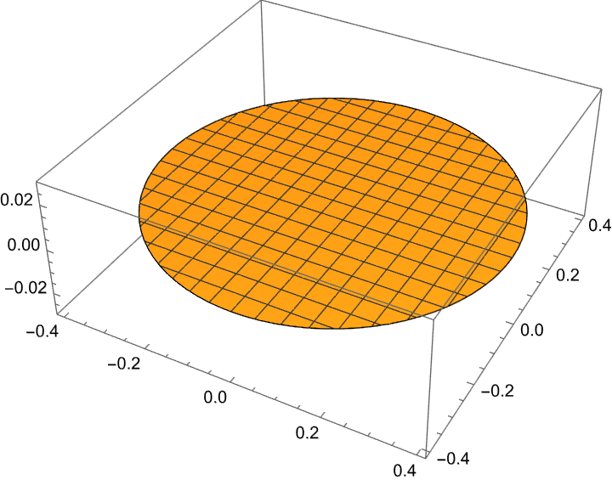
Animations: forced phase and free phase of the Dirac modified force model (at 0.75r)

Slide 21
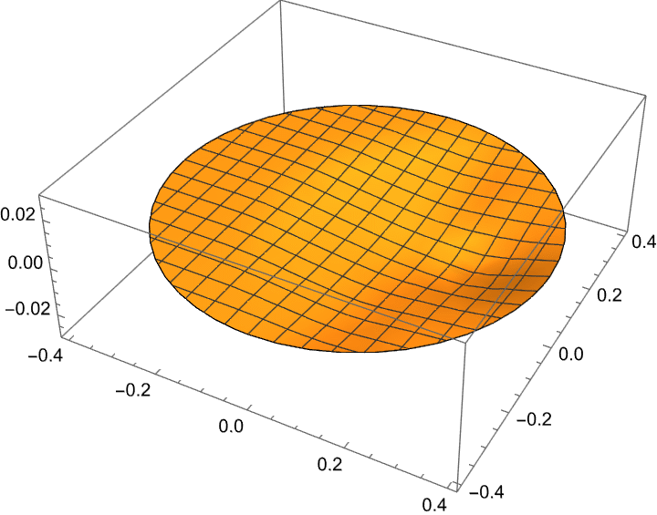
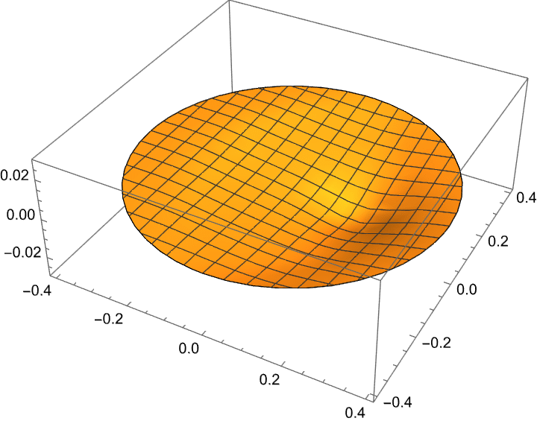
Animations of Differing Points of Impact
0.642r
forced
0.425r
forced
0.642r
free
0.425r
free

Slide 22
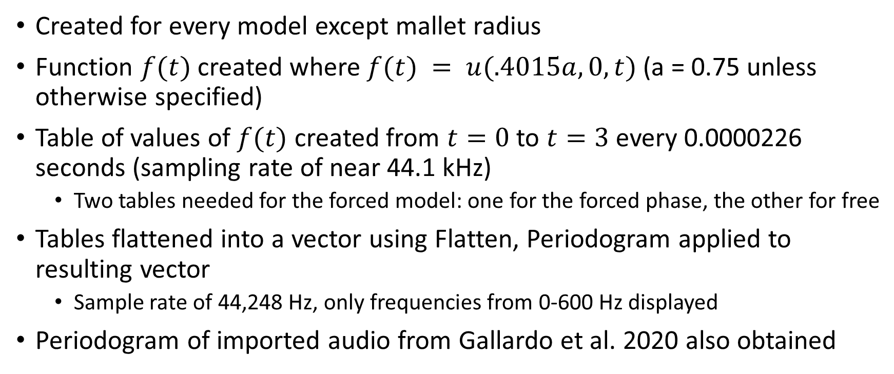
Creating Periodograms of Vibration
Created for every model except mallet radius
Function $f(t)$ created where $f(t) = u(.4015a, 0, t)$ (a = 0.75 unless otherwise specified)
Table of values of $f(t)$ created from $t=0$ to $t=3$ every 0.0000226 seconds (sampling rate of near 44.1 kHz)
  Two tables needed for the forced model: one for the forced phase, the other for free
Tables flattened into a vector using Flatten, Periodogram applied to resulting vector
  Sample rate of 44,248 Hz, only frequencies from 0-600 Hz displayed
Periodogram of imported audio from Gallardo et al. 2020 also obtained

Slide 23
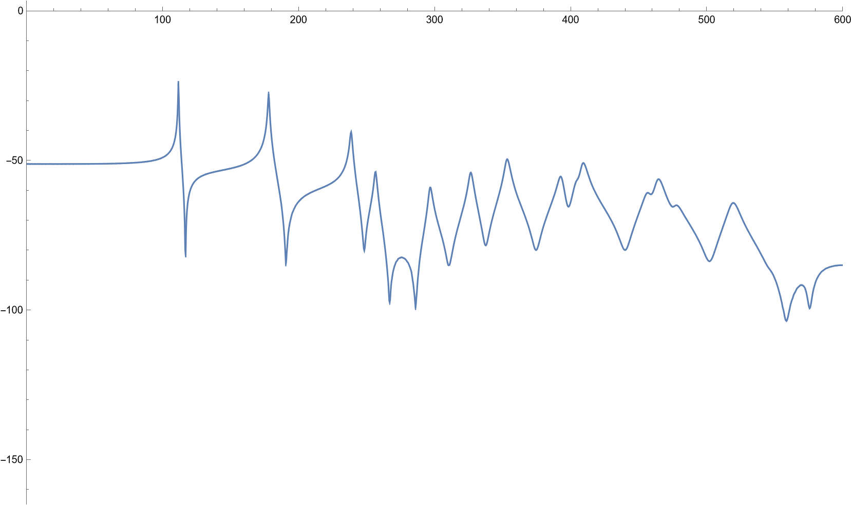
Periodogram of the purely Dirac modified force model at 0.75r

Slide 24
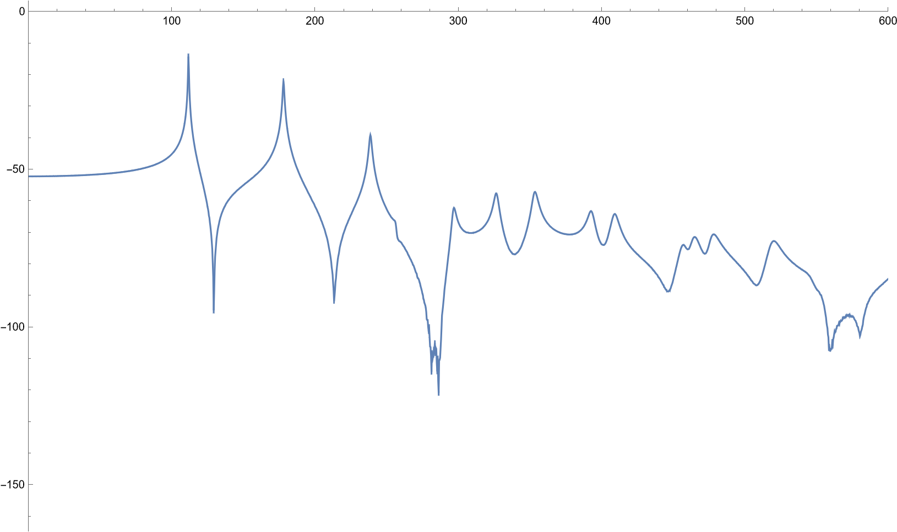
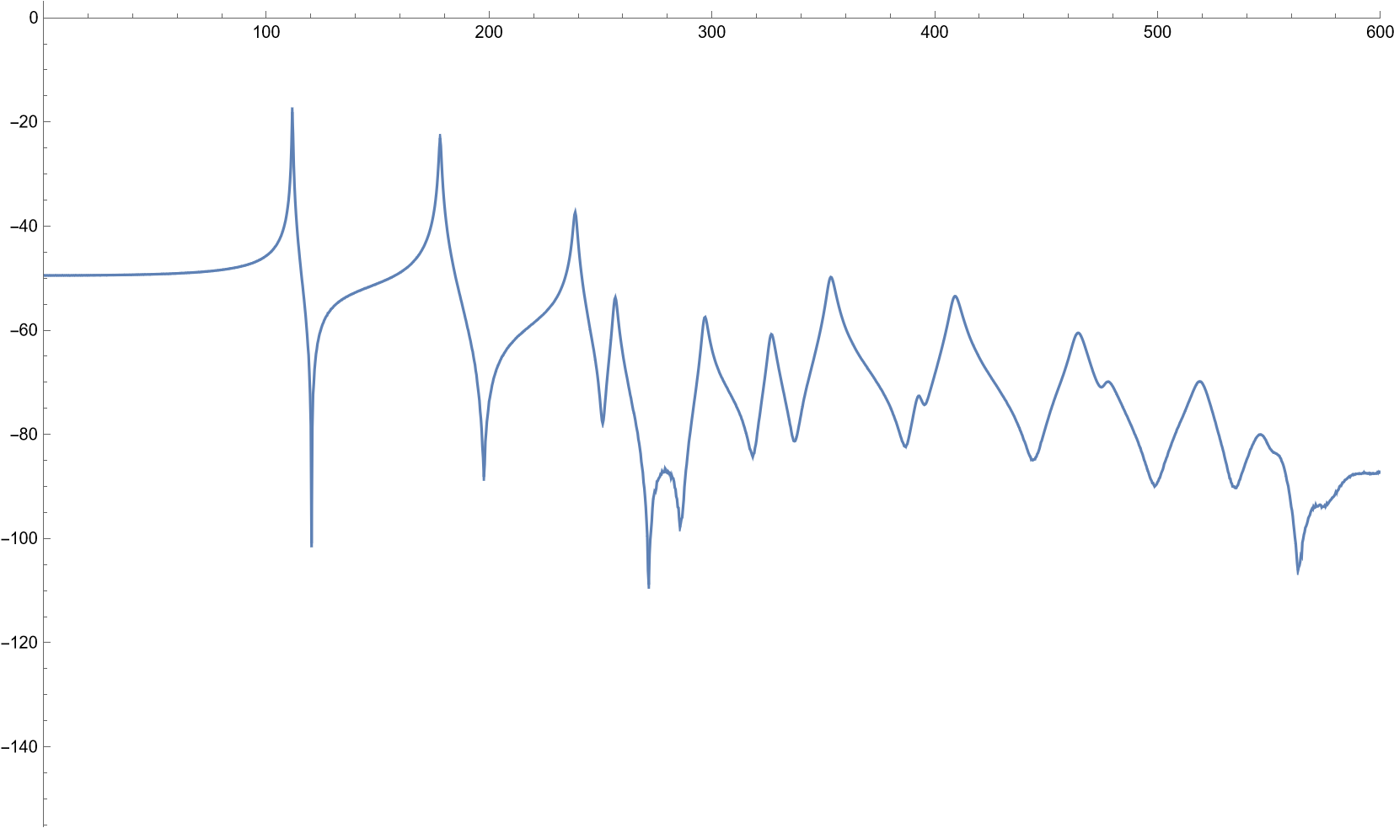
Periodograms of Different Points of Impact
0.642r
0.425r

Slide 25
Synthesized Sounds
Flattened vector also used to generate a sound by use of SampledSoundList
Vectors empirically scaled to reach an appreciable volume
Sample rate of 44,248 Hz
AudioPlot used to generate a waveform (sounds were roughly scaled so that y = 1 on the waveform corresponds to the loudest point of audio)

Slide 26
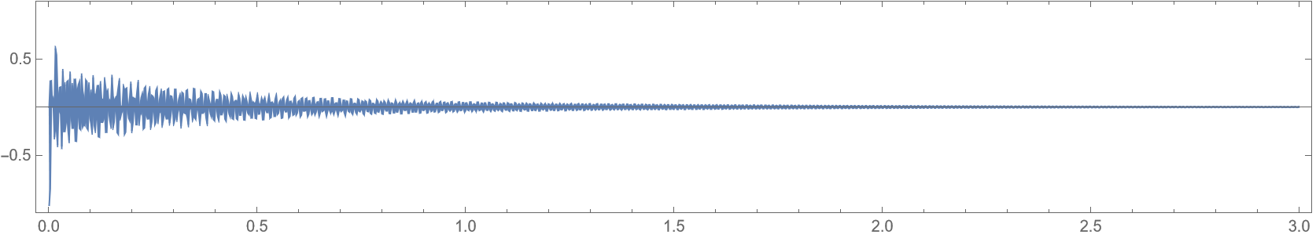

Synthesized Sound + Waveform of the Dirac modified force model

Slide 27
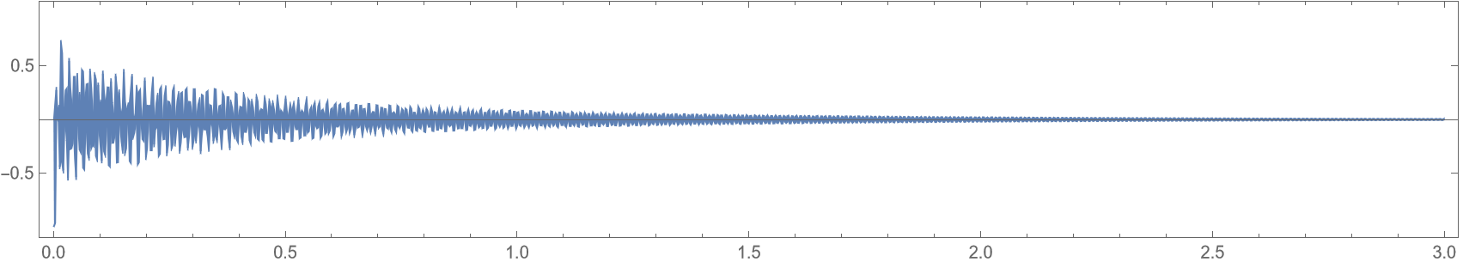
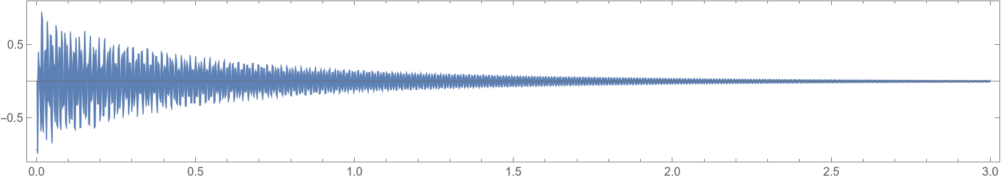
Synthesized Sounds + Waveform of Different Points of Impact
0.642r
0.425r

Slide 28
Frequencies and Relative Amplitudes of Modes
Using “Get Coordinates” on periodograms
Frequencies could be compared to theoretical frequencies of standard wave equation
Amplitudes obtained this way were normalized (highest amplitude set to 0 dB)

Slide 29
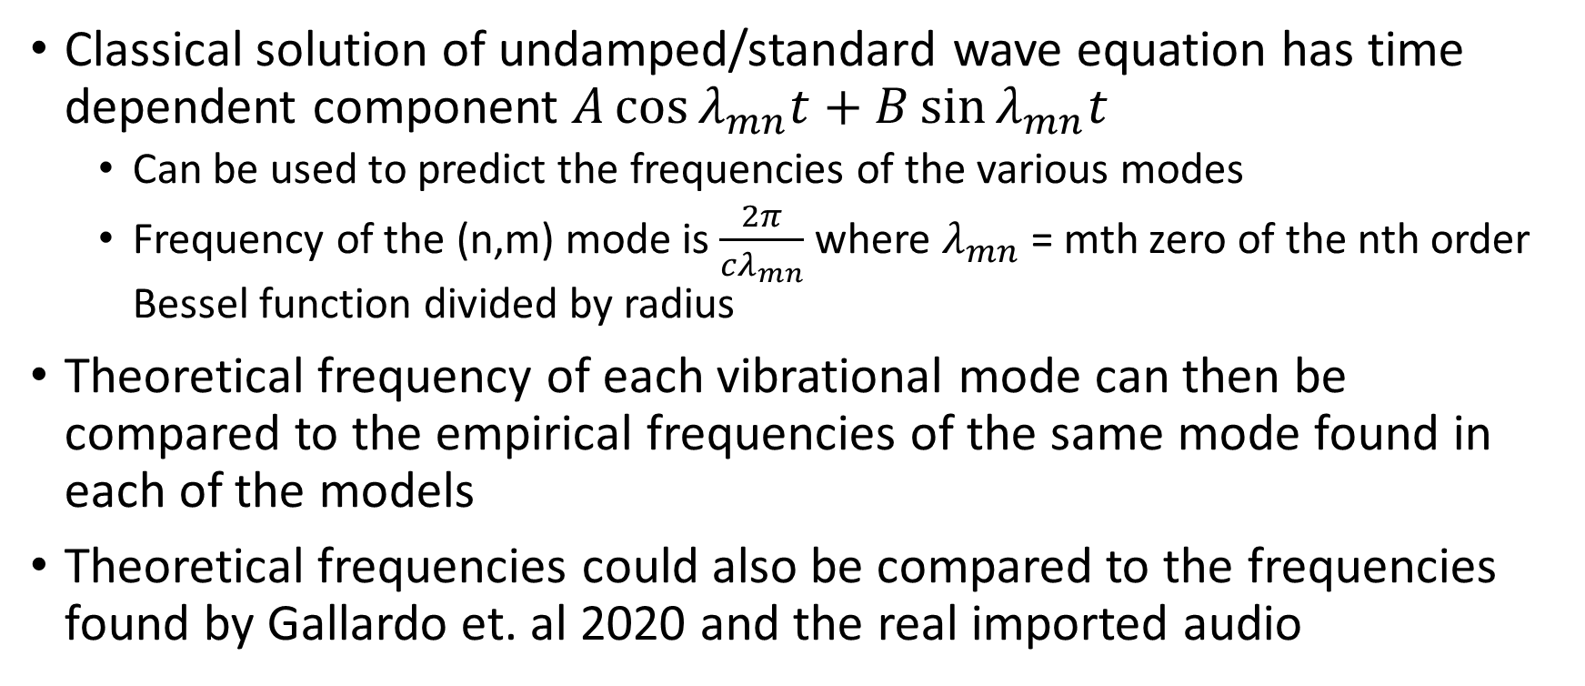
Comparison of Frequencies to the Undamped Wave Equation
Classical solution of undamped/standard wave equation has time dependent component $A\cos{λ_{mn}t+B}\sin{λ_{mn}t}$
  Can be used to predict the frequencies of the various modes
  Frequency of the (n,m) mode is $\frac{2π}{{cλ}_{mn}}$where $λ_{mn}$ = mth zero of the nth order Bessel function divided by radius
Theoretical frequency of each vibrational mode can then be compared to the empirical frequencies of the same mode found in each of the models
Theoretical frequencies could also be compared to the frequencies found by Gallardo et. al 2020 and the real imported audio

Slide 30
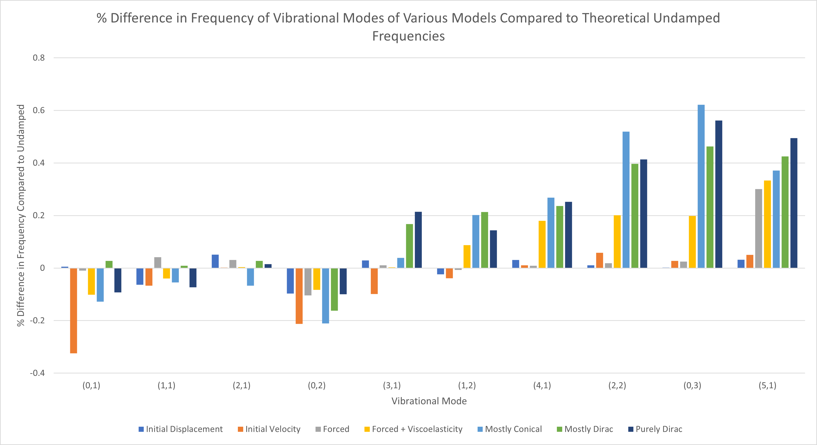
Comparison of Frequencies to the Undamped Wave Equation

Slide 31
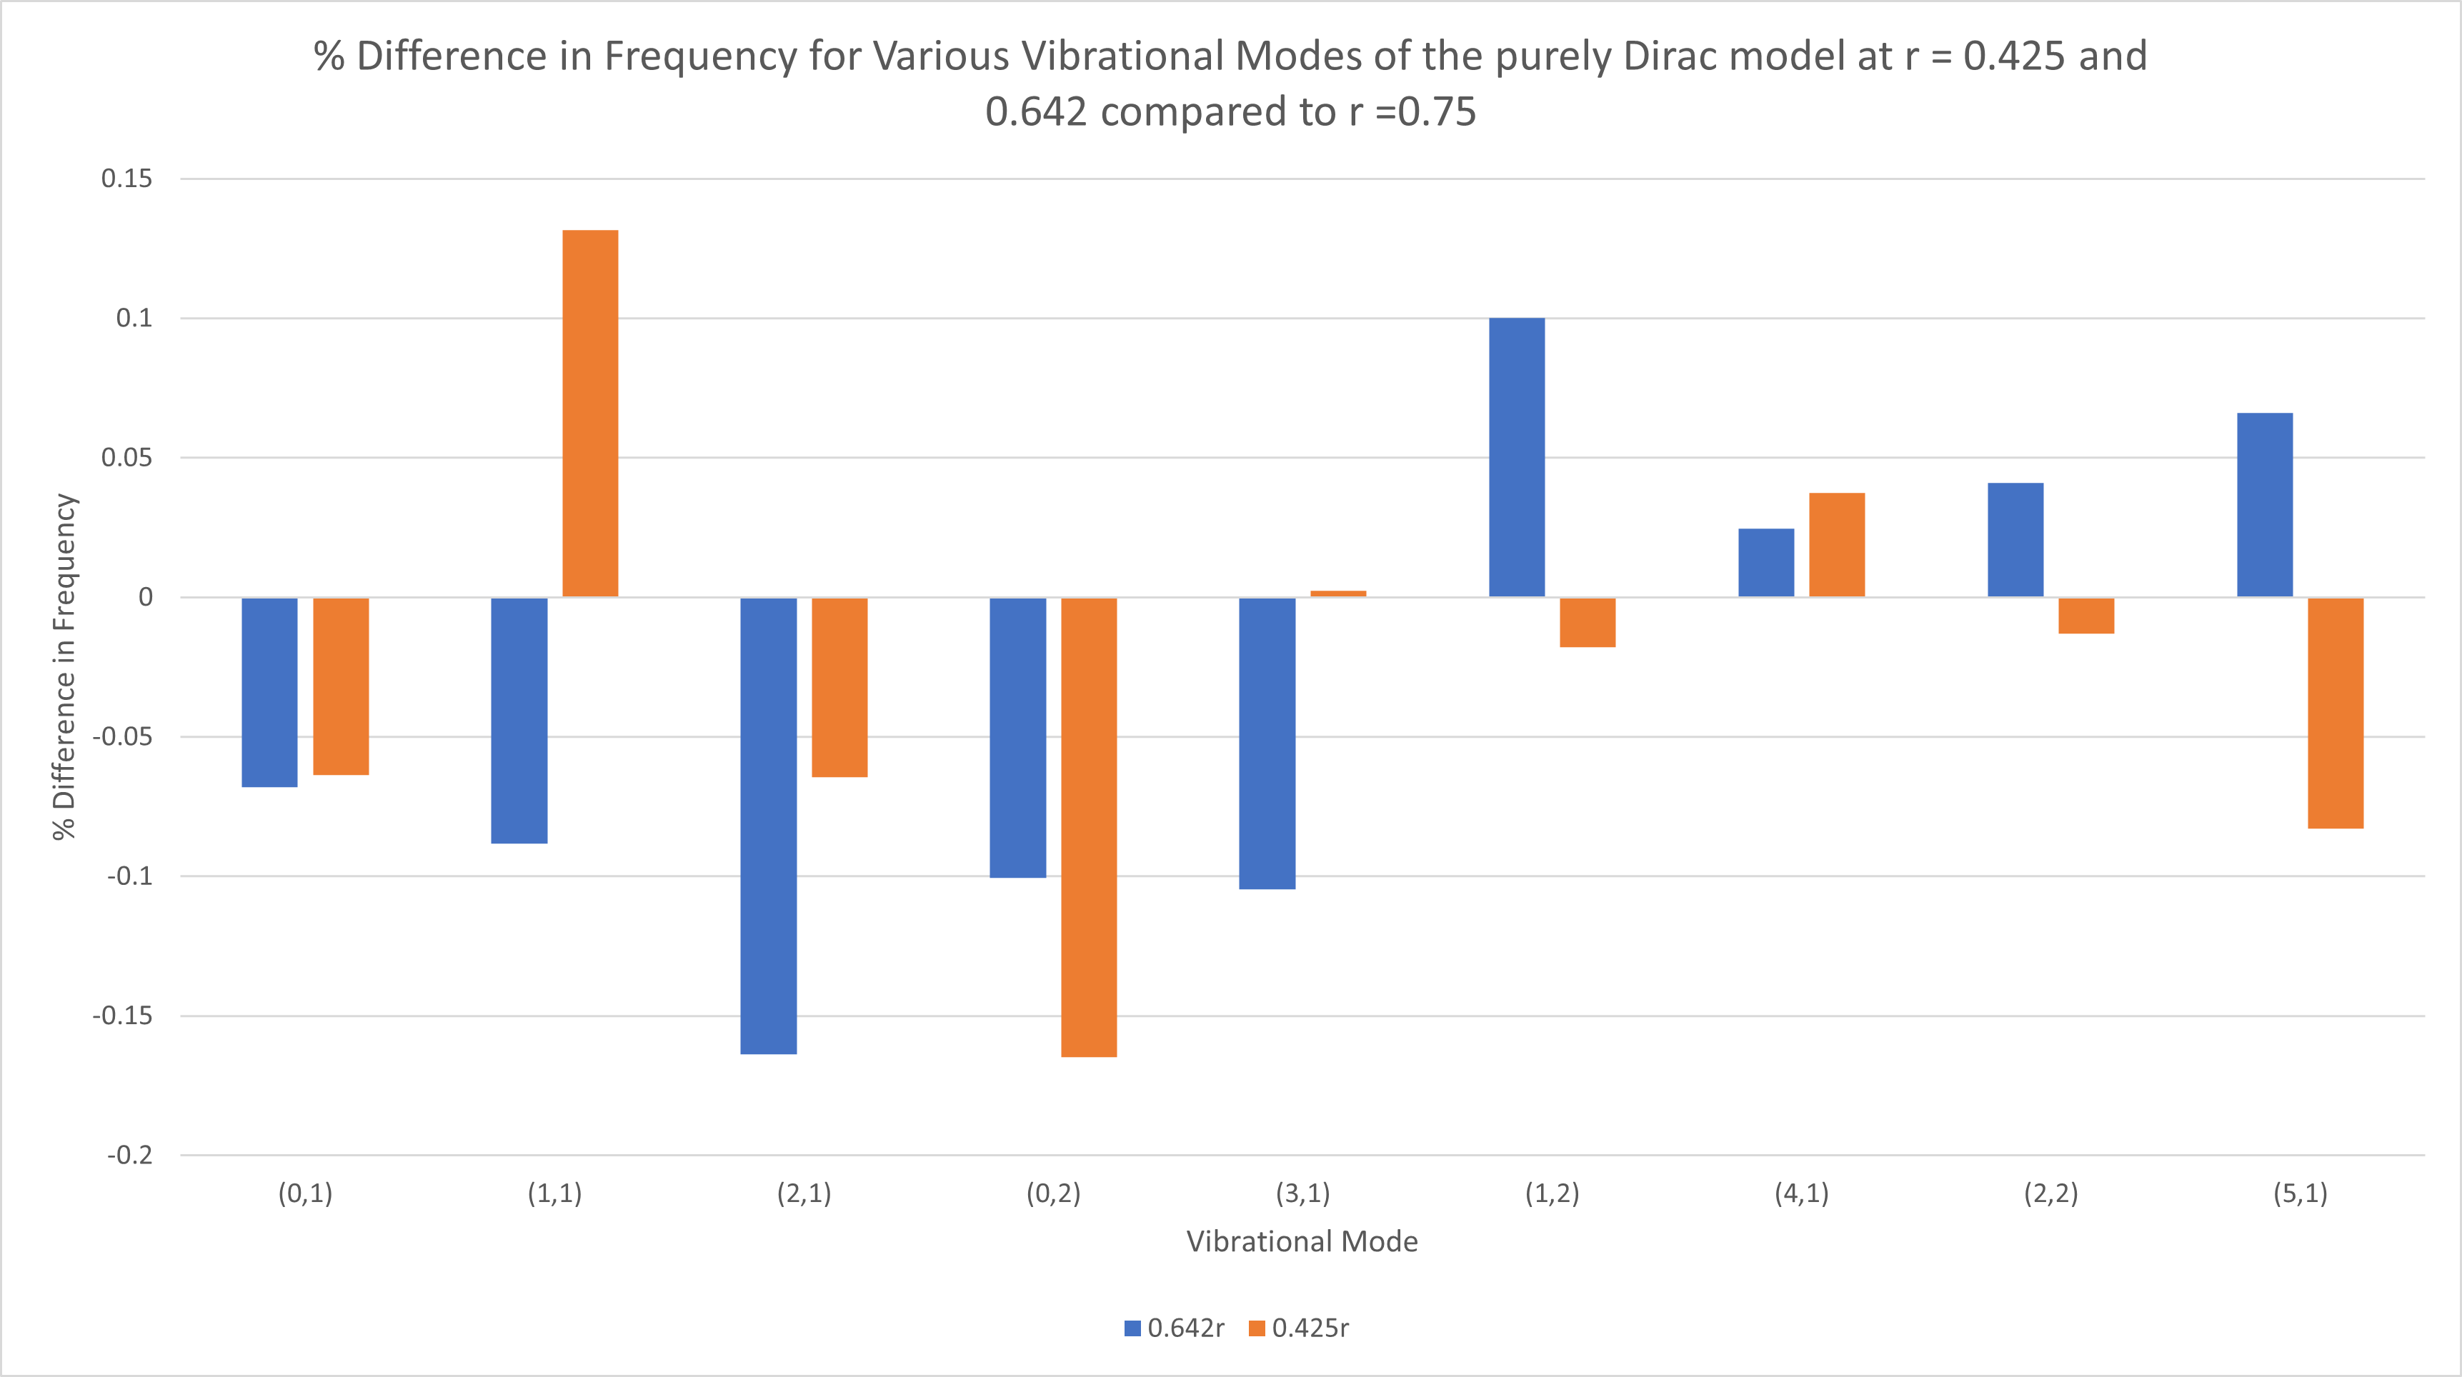
Comparison of Frequencies of Different Points of Impact

Slide 32
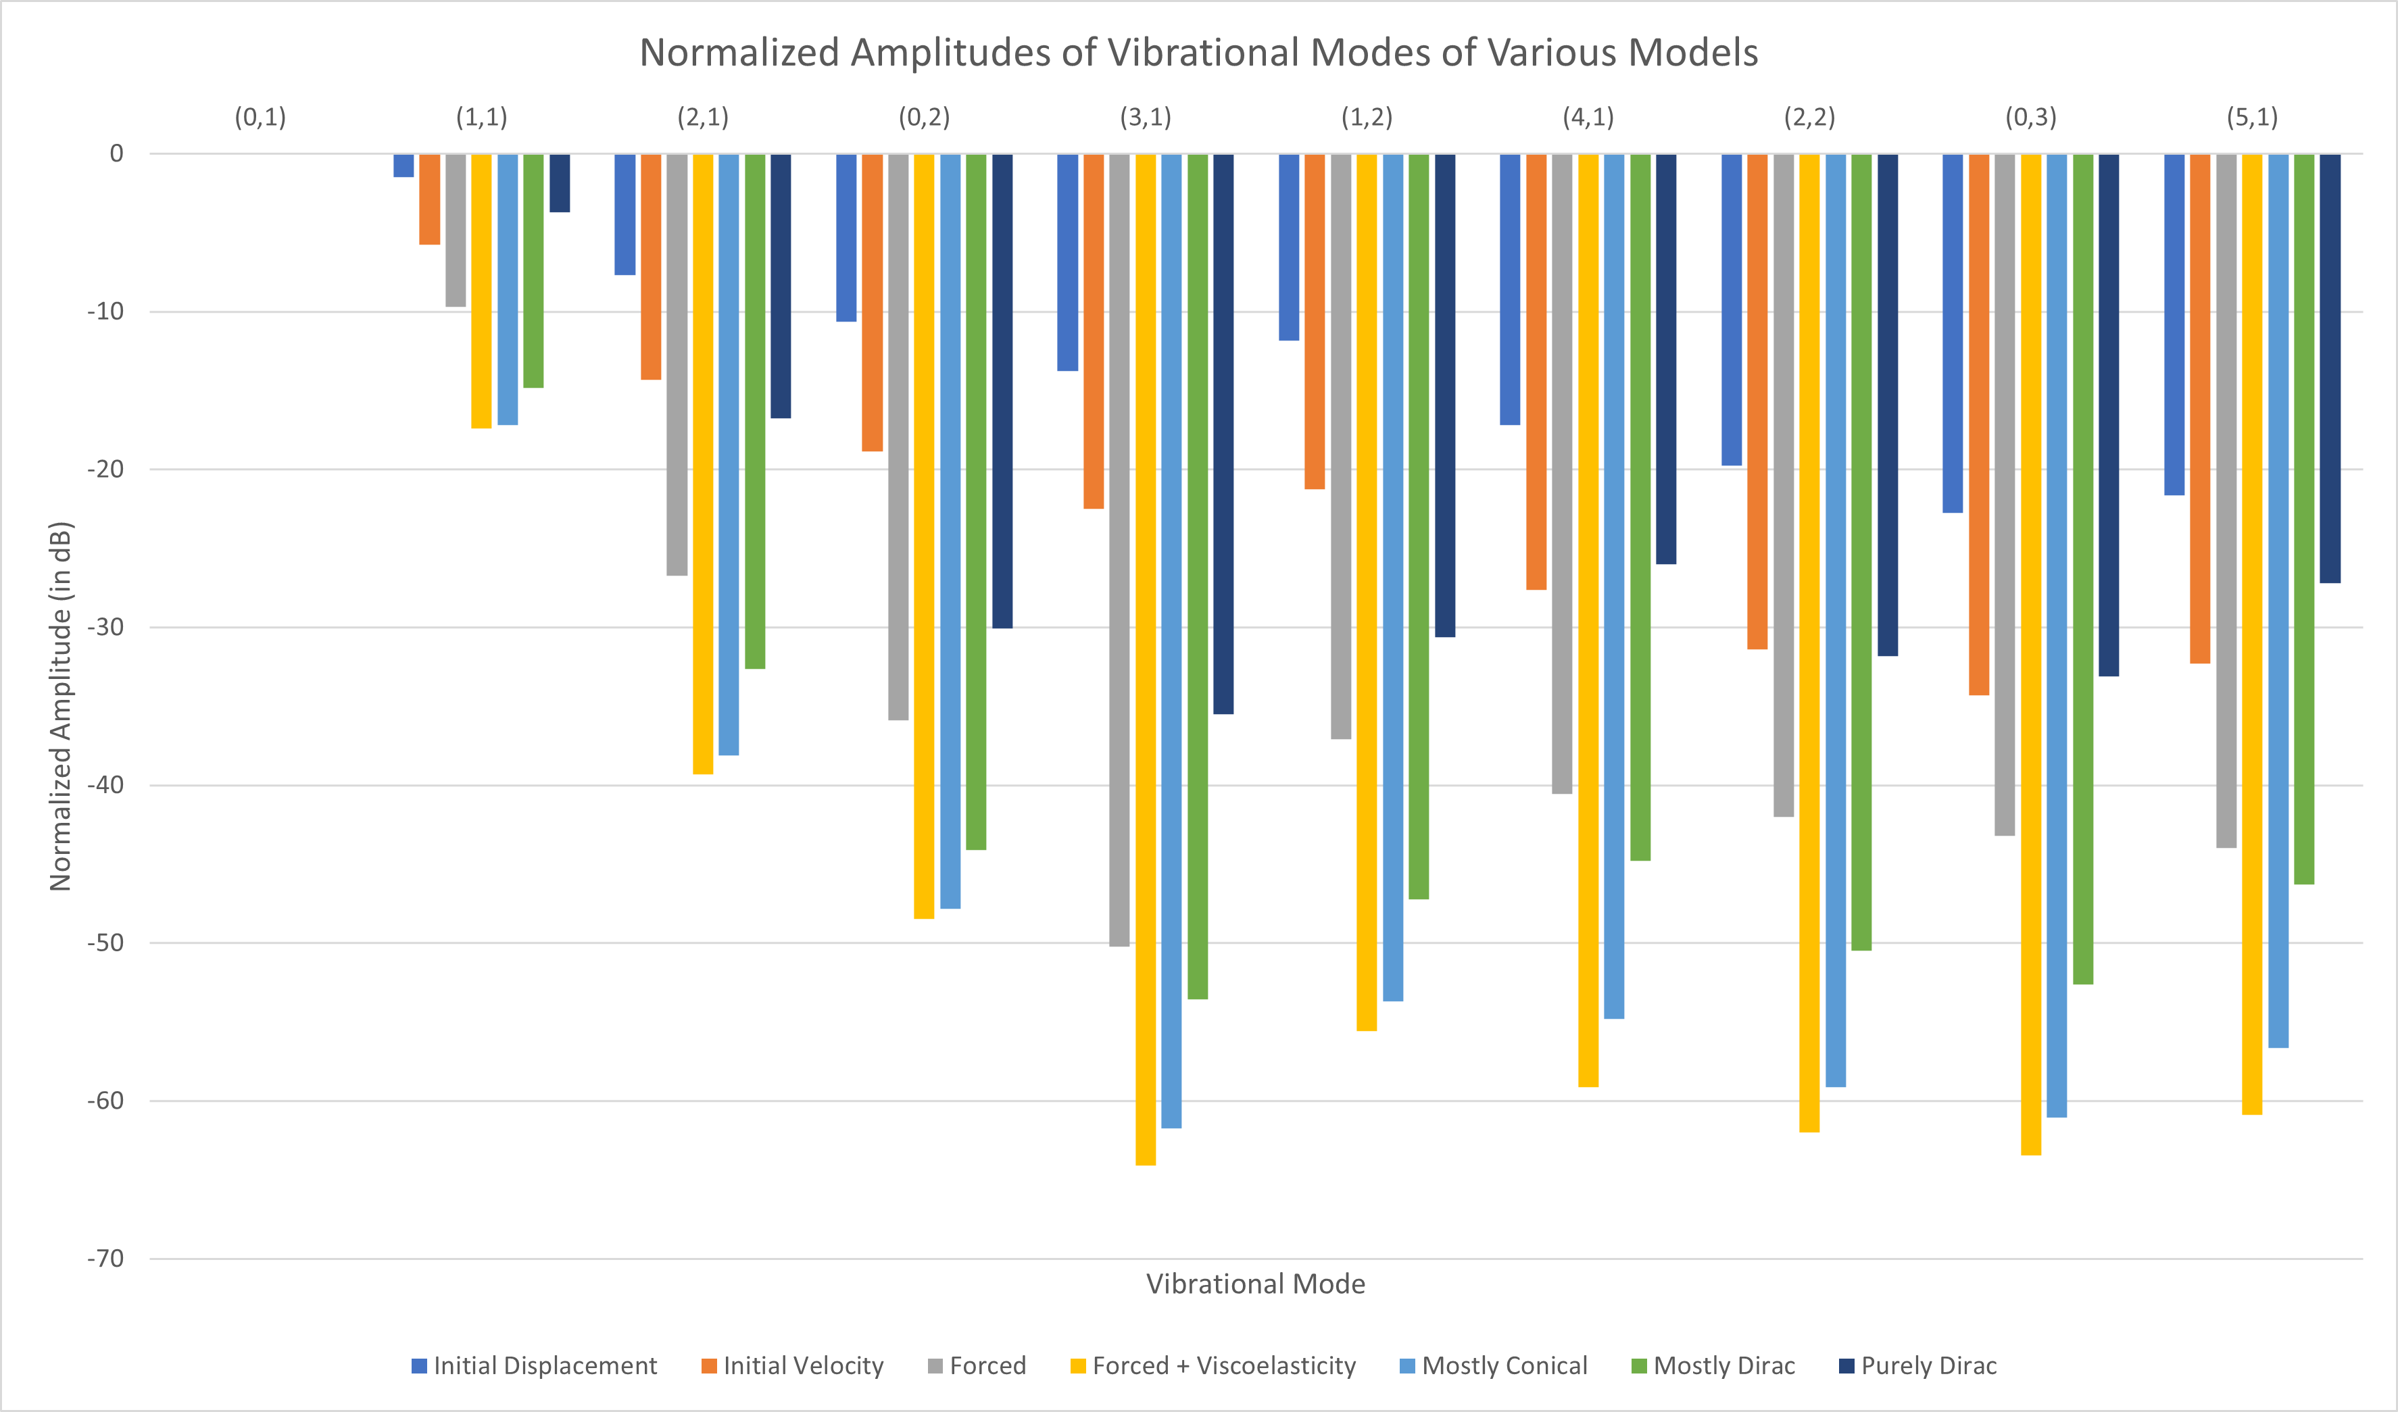
Normalized Amplitudes of Vibrational Modes

Slide 33
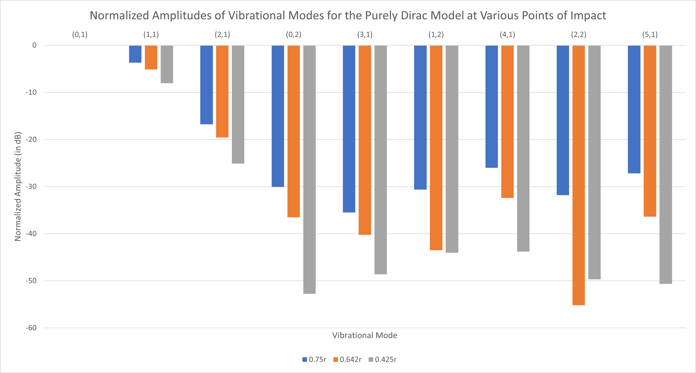
Normalized Amplitudes of Vibrational Modes for Different Points of Impact

Slide 34
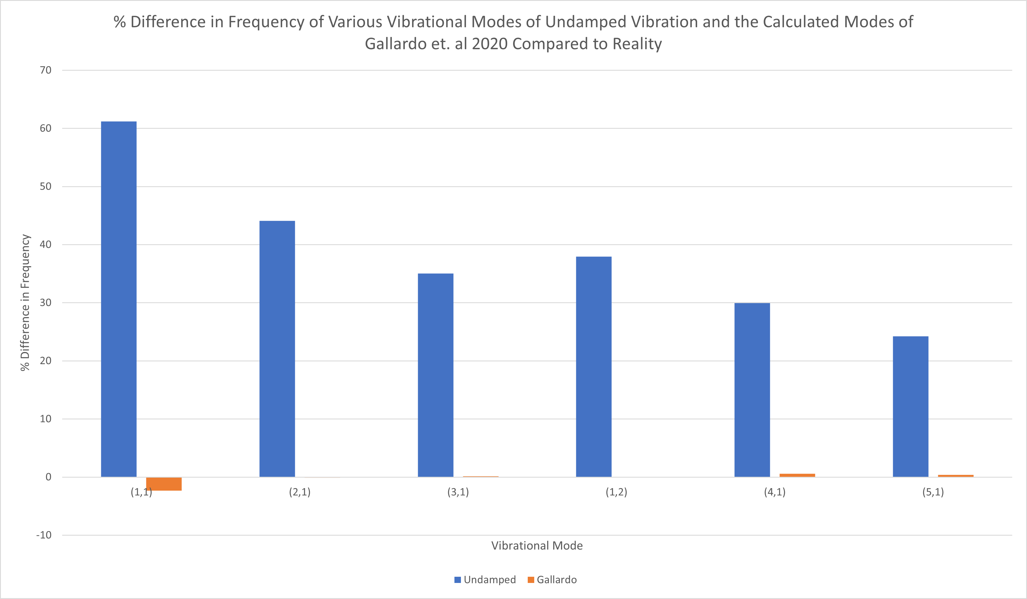
Comparison of Frequencies to the Undamped Wave Equation

Slide 35
Effect of Initial Conditions, Damping and Viscoelastic Effects
Choice of approximating initial conditions has significant effect on resulting sound and animation of wave
  Specifying an initial force (rather than attempting prescribe an initial velocity or displacement) leads to the most realistic/physical results, with certain forcing terms being better than others (Dirac vs conical)
  While an extremely fine mesh (~8000 elements) was needed for the mallet radius model, much coarser meshes could be used to produce realistic animations, periodograms and sounds for other models
None of these led to significant changes in the frequencies of the vibrational modes
  All had the same fundamental of 111 Hz (approximately A2)
  The resulting change in sound was due to changes in amplitudes
  Small but discernible increase in frequency of higher frequency modes observed in PDE models that specified a viscoelastic term (~0.2-0.6%)

Slide 36
Effect of the Point of Impact
Point of impact has no significant effect on the frequencies of vibrational modes
  Difference between alternative points of impact and 0.75r did not exceed 0.2%
Can drastically affect amplitude of modes (and thus the sound and vibration)
  (0,3) undetectable in periodogram of 0.642r and 0.425r
  The increased “parity” of contributions between higher and lower frequency modes of the purely Dirac term was counteracted by moving closer to the center
  Affected the sound – sound of initial impact became “fuzzier”
Contrast to Nishimura et. al 2018’s experiments on an air-loaded timpani
  Demonstrated no significant change in (1,1), (2,1), (3,1) modes when moving closer to the center
  (4,1) mode increased in amplitude
  Suggests that air-loaded membrane is more tolerant to deviations in impact than one that is not loaded
  May explain the variation observed in survey results

Slide 37
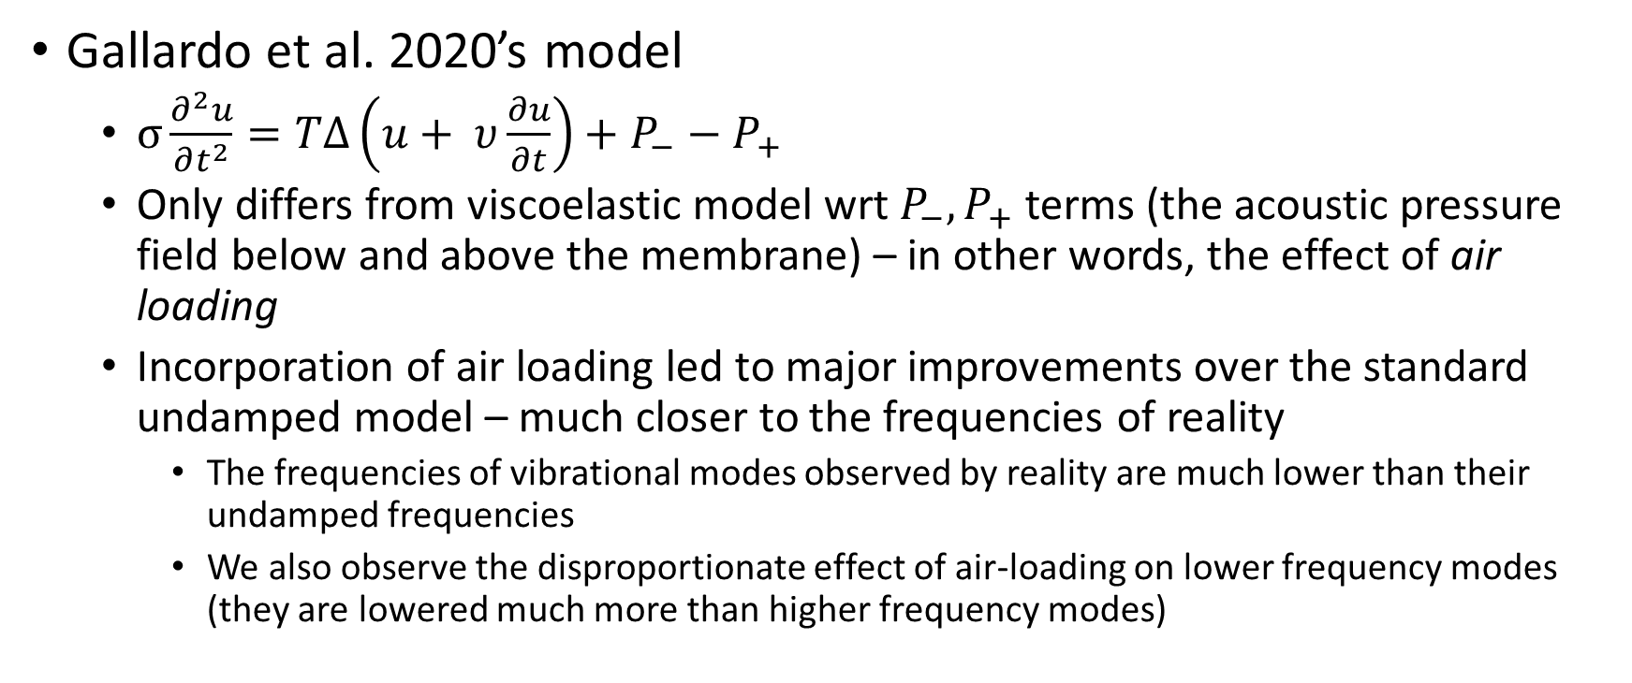
Effect of Air Loading on the Vibration of the Membrane - Gallardo
Gallardo et al. 2020’s model
  $σ\frac{∂^{2}u}{∂t^{2}}=TΔ\left(u+ υ\frac{∂u}{∂t}\right)+P_{−}−P_{+}$
  Only differs from viscoelastic model wrt $P_{−}, P_{+}$ terms (the acoustic pressure field below and above the membrane) – in other words, the effect of air loading
  Incorporation of air loading led to major improvements over the standard undamped model – much closer to the frequencies of reality
    The frequencies of vibrational modes observed by reality are much lower than their undamped frequencies
    We also observe the disproportionate effect of air-loading on lower frequency modes (they are lowered much more than higher frequency modes)

Slide 38
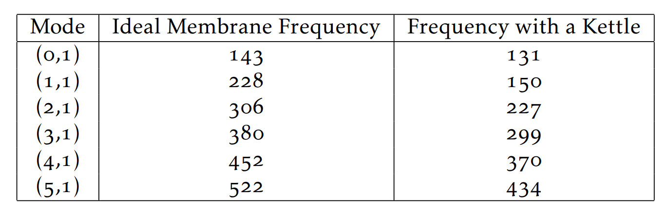
Effect of Air Loading on the Vibration of the Membrane – Fletcher
Corroborated by Fletcher et al. 1997
  Kettledrum model specified similarly to Gallardo
  Significant drops in frequency were noticed in all modes compared to an ideal membrane (except for (0,1), which experienced a less significant drop)

Slide 39
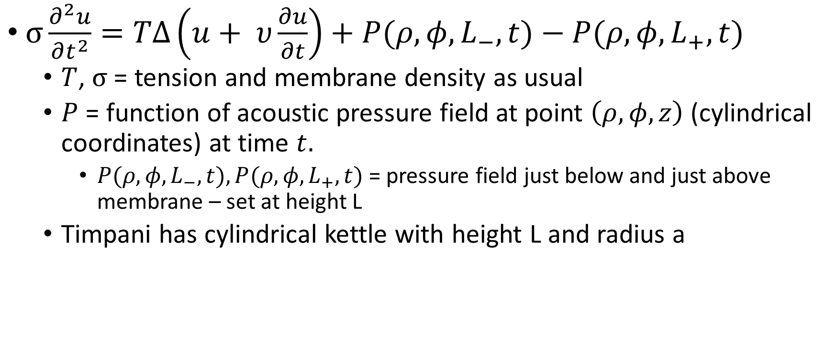
Future Steps - Accounting for Air Loading: The Membrane
$σ\frac{∂^{2}u}{∂t^{2}}=TΔ\left(u+ υ\frac{∂u}{∂t}\right)+{P(ρ,φ,L}_{−},t)−{P(ρ,φ,L}_{+},t)$
  $T$, $σ$ = tension and membrane density as usual
  $P$ = function of acoustic pressure field at point $\left(ρ,φ,z\right)$ (cylindrical coordinates) at time $t.$
    ${P(ρ,φ,L}_{−},t), {P(ρ,φ,L}_{+},t)$ = pressure field just below and just above membrane – set at height L
  Timpani has cylindrical kettle with height L and radius a

Slide 40
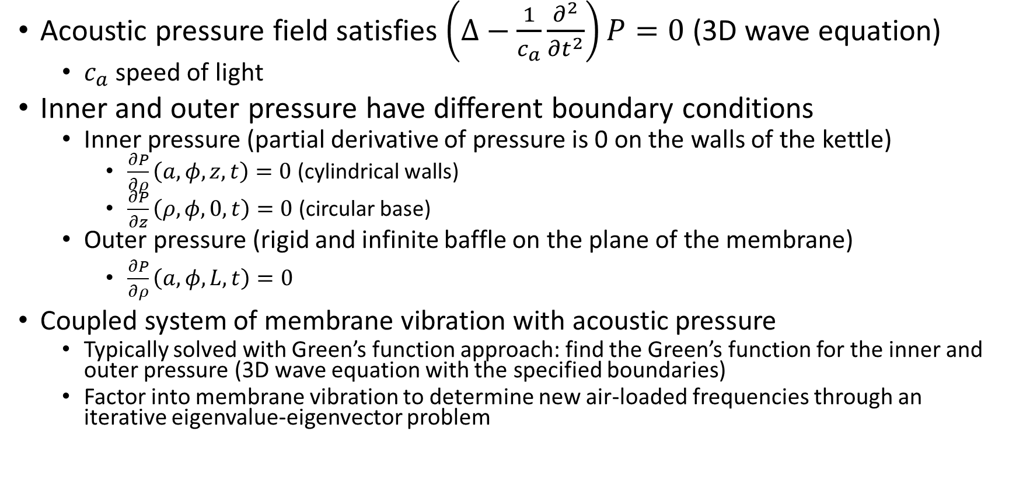
Future Steps - Accounting for Air Loading: The Pressure Field
Acoustic pressure field satisfies $\left(∆−\frac{1}{c_{a}}\frac{∂^{2}}{{∂t}^{2}}\right)P=0$ (3D wave equation)
  $c_{a}$speed of light
Inner and outer pressure have different boundary conditions
  Inner pressure (partial derivative of pressure is 0 on the walls of the kettle)
    $\frac{∂P}{∂ρ}\left(a, φ, z, t\right)=0$ (cylindrical walls)
    $\frac{∂P}{∂z}\left(ρ, φ, 0, t\right)=0$ (circular base)
  Outer pressure (rigid and infinite baffle on the plane of the membrane)
    $\frac{∂P}{∂ρ}\left(a, φ, L, t\right)=0$
Coupled system of membrane vibration with acoustic pressure
  Typically solved with Green’s function approach: find the Green’s function for the inner and outer pressure (3D wave equation with the specified boundaries)
  Factor into membrane vibration to determine new air-loaded frequencies through an iterative eigenvalue-eigenvector problem

Slide 41
Near-harmonic ratios in an unloaded membrane
Despite these large frequency disparities, the pitch of synthesized sounds was still similar to the “real” drum recording – especially apparent in refined models
  Sound was also quite harmonic
Even when not air-loaded, a 2:3:4:5:6 frequency ratios can be observed, but of different modes
  (0,1), (1,1), (2,1), (3,1), (1,2)
  The frequencies also match that of the true air-loaded harmonic modes (differences of at most 10%)
We still air-load, however, because (0,1) mode radiates sound well (and thus dissipates quickly and does not contribute to the sound of a drum beyond a “thump”)
  Air-loading adjusts the frequencies so that modes that contribute more to the pitch make up the harmonic ratio

Slide 42
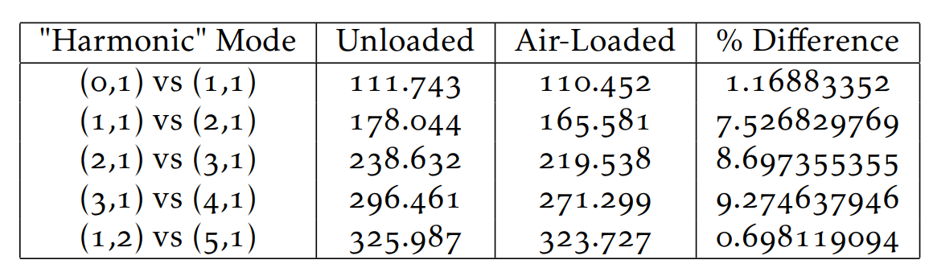
Near-harmonic ratios in an unloaded membrane

Slide 43
Optional: Other Future Steps – Other Effects and Interpersonal and Intrapersonal Variability
Factor in other effects in the introduction not accounted for
  Nonvertical vibrations, bending stiffness
Account for human variation in the sound
  Interpersonal variation
    Obtain more survey results from other professional timpani players
    Construct a more accurate distribution of point of impact across interpersonal variation
  Intrapersonal variation
    For a specific timpanist, gauge point of impact from several repeated trials, and generate a distribution modeling the variation inherent to a person striking the drum repeatedly
  Using variation in digital music composition
    For each individual piece, select from the “interpersonal distribution” to generate a specific timpanist
    For each individual drum hit within the piece, select from the “intrapersonal distribution” to model the human variation of the generated timpanist

Slide 44
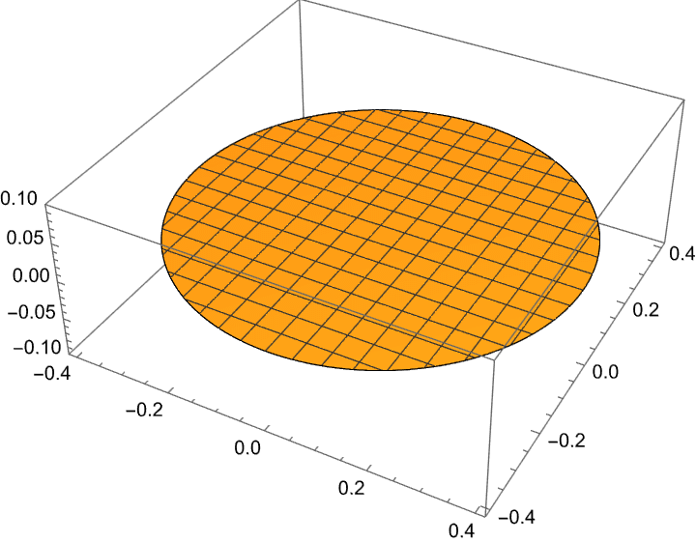

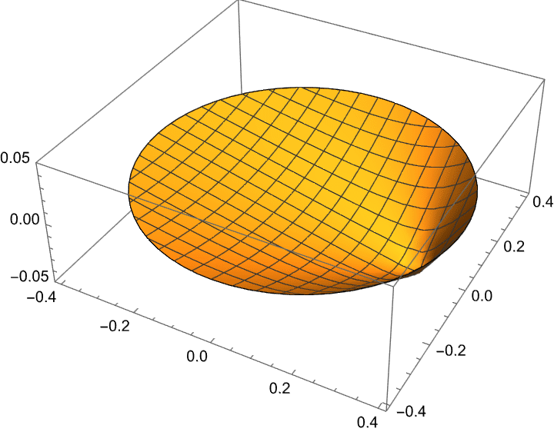
Supplementary Material: Animations (1)
Mallet Radius
Initial Velocity
Initial Displacement

Slide 45
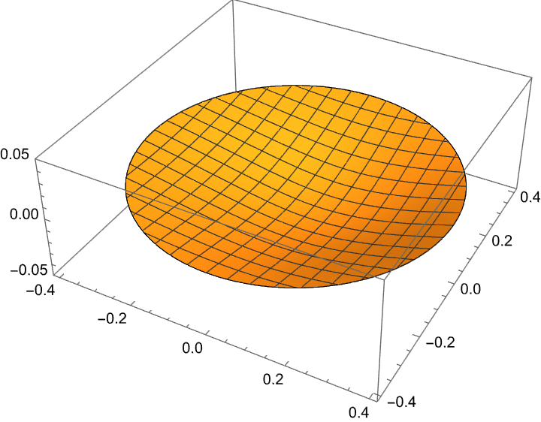
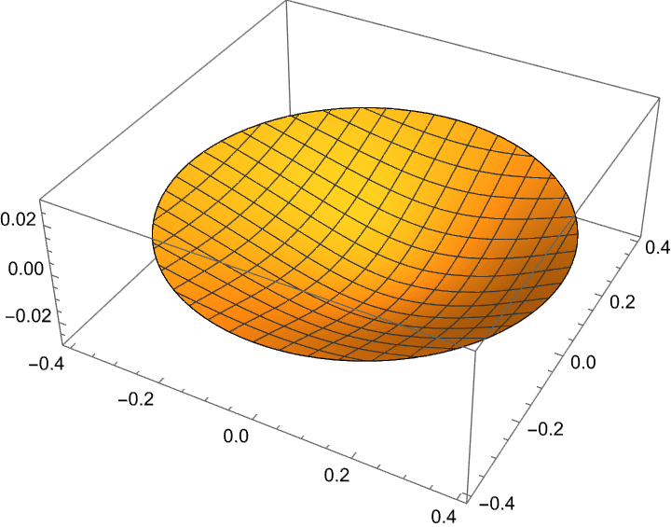
Supplementary Material: Animations (2)
Forced Model
Free Phase
Modified Forced Model
Free Phase
Forced Model
Forced Phase
Modified Forced Model
Forced Phase

Slide 46
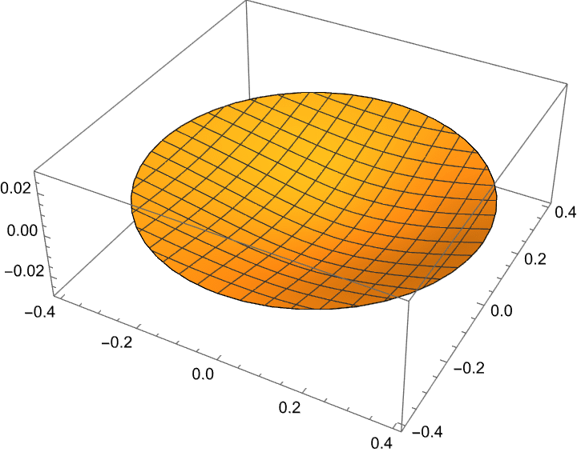
Supplementary Material: Animations (3)
Modified Forced Model
Free Phase
Mostly Dirac
Modified Forced Model
Free Phase
Mostly Conical
Modified Forced Model
Forced Phase
Mostly Conical
Modified Forced Model
Forced Phase
Mostly Dirac

Slide 47
Supplementary Models: Sounds
Modified Forced Model
Mostly Conical
Initial Displacement
Modified Forced Model
Mostly Dirac
Initial Velocity
Forced Model
Modified Forced Model

