Slide 1
Larsen as a lens
the Male Gaze and the Female Voice
By Cloe Gentile

Slide 2
Purpose
Visibility for the works of female composers
Undergraduate Graduate Professional
Reconstruct the ways in which females are portrayed in classical vocal repertoire
Expose the depth of these portrayals

Slide 3
Theoretical Framework
Laura Mulvey’s Theory of the Male Gaze
Male perspective normalized and omnipresent
Male/female, active/passive, subject/object binary
Stereotypical portrayals of women
Female body vulnerable to objectification and sexualization
Female voice silenced

Slide 4
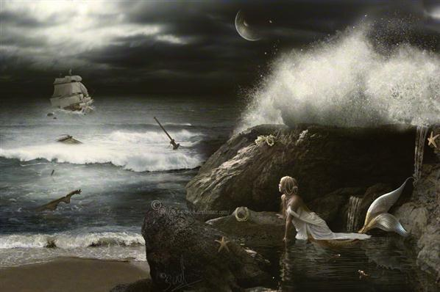
The Male Gaze in Art Song
Lack of female perspectives in sacred texts
Transgressive vocality in classical mythology
Siren’s song
“…the most transgressive feminine figures
are simultaneously the most vocal.”
- Leslie C. Dunn and Nancy A. Jones,
Embodied Voices: Representing Female Vocality in Western Culture

Slide 5
Madrigal traditional notions of gazing, uninterested women as cruel
Ex. Music: Alessandro Striggio Text: Unknown
Dolce materno un bascio in un bel riso?
O io non son Cupido
Come sparget’il grido,
O voi madre crudel al vostro figlio.
Ahi, empia sorte e ria!
Con complessi, con basci in mille modi
Stringon le matre i figli, e me la mia
Con catene e con nodi stringe solo,
Ne ancor prende consiglio
Volger ver me pietosa il suo bel ciglio.
“A sweet maternal kiss with a lovely smile?
O, I am not Cupid
As you proclaim,
O, you mother cruel to your own son.
Ah, merciless and evil fate!
With embraces, with kisses in a thousand ways
Mothers bid their sons to them, and mine
Binds me only with chains and bonds,
Nor does she yet take advice
To turn toward me mercifully her beautiful brow.”
Se nel bel vostro viso L’alta madre d’Amor serba sua imago, Ani l’istessa voi Venere siete, Perche non mi porgete, Et for’al mio desir contento e pago, Dolce materno un bascio in un bel riso? O io non son Cupido Come sparget’il grido, O voi madre crudel al vostro figlio. Ahi, empia sorte e ria! Con complessi, con basci in mille modi Stringon le matre i figli, e me la mia Con catene e con nodi stringe solo, Ne ancor prende consiglio Volger ver me pietosa il suo bel ciglio. | If in your beautiful face The lofty mother of Love keeps her image, Indeed, if you yourself are Venus, Why do you not offer me, And it would be comfort and satisfaction for my desire, A sweet maternal kiss wth a lovely smile? O, I am not Cupid As you proclaim, O, you mother cruel to your own son. Ah, merciless and evil fate! With embraces, with kisses in a thousand ways Mothers bid their sons to them, and mine Binds me only with chains and bonds, Nor does she yet take advice To turn toward me mercifully her beautiful brow.

Slide 6
Ex. Der Kuss Music: Ludwig van Beethoven Text: Christian Felix Weisse
Classical Era
hedonism, nonconsensual sexual encounters
“Ich war bei Chloen ganz allein,
Und küssen wollt’ ich sie.
Jedoch sie sprach, sie wurde schrein,
Es sei vergebne Müh!
Ich wagt’ es doch und küßte sie,
Trot ihrer Gegenwehr.
Und schrie sie nicht? Jawohl, sie schrie –
Doch lange hinterher.”
“I was alone with Chloe,
and wanted to kiss her;
but she said
that she would scream -
it would be a futile attempt.
Yet I dared, and kissed her
despite her resistance.
And did she not scream?
Oh yes, she did;
but not until long afterward.”

Slide 7
Ex. Frauenliebe und –Leben Music: Robert Schumann Text: Adelbert von Chamisso
Romantic Era
female body as metaphor, impersonation of female voice
“Ich [werd']⁴ ihm dienen, ihm leben,
Ihm angehören ganz,
Hin selber mich geben und finden
Verklärt mich in seinem Glanz.”
“I want to serve him, live for him,
belong to him entire,
Give myself and find myself
transfigured in his radiance.”
«Nur die da säugt, nur die da liebt
Das Kind, dem sie die Nahrung giebt;
Nur eine Mutter weiß allein,
Was lieben heißt und glücklich sein.
O, wie bedaur' ich doch den Mann,
Der Mutterglück nicht fühlen kann!”
“Only she that suckles, only she that loves
the child, to whom she gives nourishment;
Only a mother knows alone
what it is to love and be happy.
O how I pity then the man
who cannot feel a mother's joy!”

Slide 8
Performance, publication, analysis
Posthumously neglected works; Fanny Hensel’s 400 pieces almost forgotten
Publication under different names; Felix Mendelssohn’s Op. 9
No performance or performance within private sphere; Josephine Lang
Not too feminine but not too masculine; Hensel’s Schwanenlied
Notes:
Symbolic Interactionism
Theory of performativity
Sex-segregated socialization
Symbols and semantic meaning
Tokenism
Internalization

Slide 9
Subverting the Male Gaze
Improvisations of the 12th and 13th centuries; troubairitz and geishas
Barbara Strozzi and the reconstruction of the soprano voice, Lagrime mie
Fanny Hensel and Ethel Smyth using song as “self-narrative”
Hensel and deconstruction of male/female composer binary through collaboration with Mendelssohn, Op. 9

Slide 10
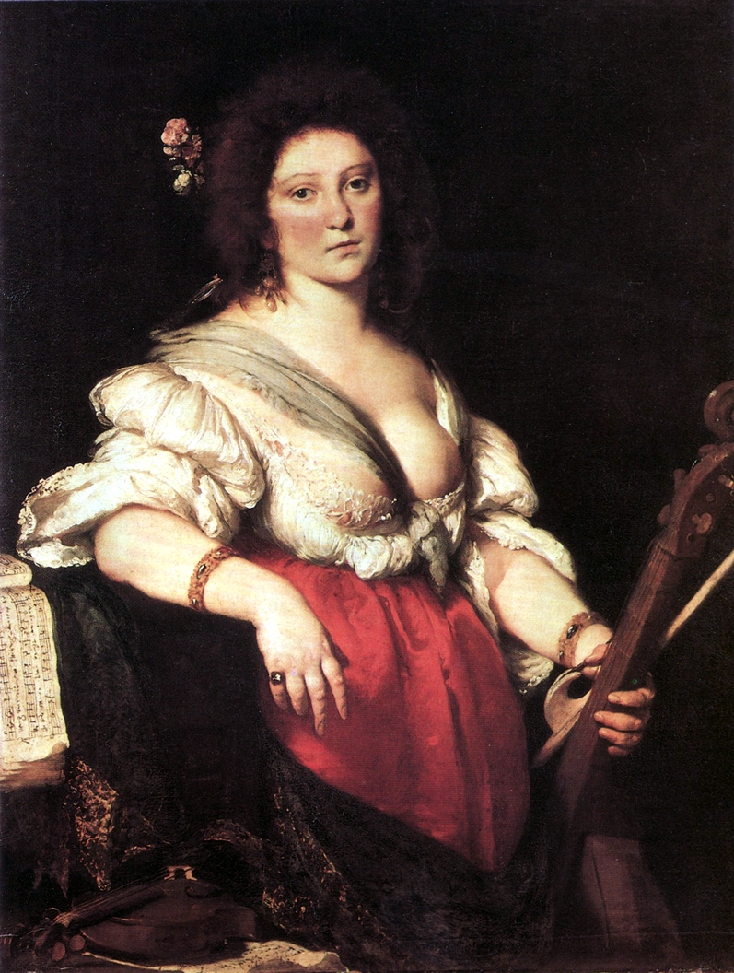
Barbara Strozzi

Slide 11
Subverting the Male Gaze
Improvisations of the 12th and 13th centuries; troubairitz and geishas
Barbara Strozzi and the reconstruction of the soprano voice, Lagrime mie
Fanny Hensel and Ethel Smyth using song as “self-narrative”
Hensel and deconstruction of male/female composer binary through collaboration with Mendelssohn, Op. 9

Slide 12
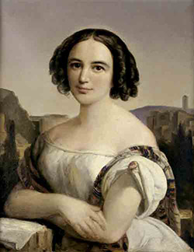
Fanny Hensel

Slide 13
Barbara Strozzi
Fanny Hensel

Slide 14
“New Moon” for Women and Music -Sophie Drinker, Music and Women: The Story of Women in Their Relation to Music
Where are we in the symbolic?
“communication presupposes a medium; poetry not so much, as it elicits emotion, and varies according to individual connotation”
- Pierre Bourdieu, Language and Symbolic Power
Women must reclaim language in its most symbolic form: poetry.
True agency in art song = Musical interpretation + Semantic meaning
20th-21st century: more texts by women than any other era
Notes:
New Moon phase
feminist scholarship must now seek to “expose the depth and profundity of these [man made] images in the Western psyche and discover how to reconstruct images of women that represent their complexity and power.” - Susan Bowers, Medusa and the Female Gaze
Text setting
Alternative Narrative
Reclaiming language

Slide 15
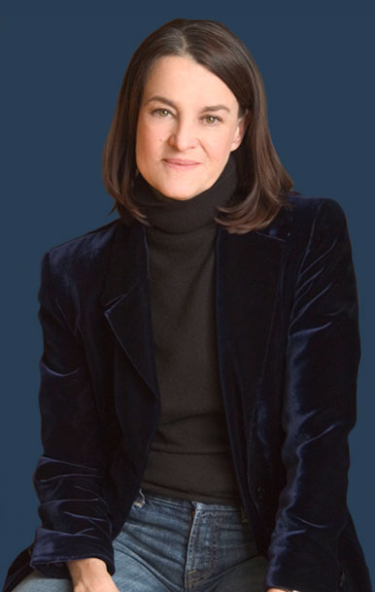
Libby Larsen
Larsen is one of the most prolific composers of the 21st century
“champion of female voice and mind”
– Dr. Bonnie Pomfret
Groundbreaking songs and cycles:
The Birth Project
Center Field Girl
De Toda la Eternidad
Notes:
- first presentation of mother by mother

Slide 16
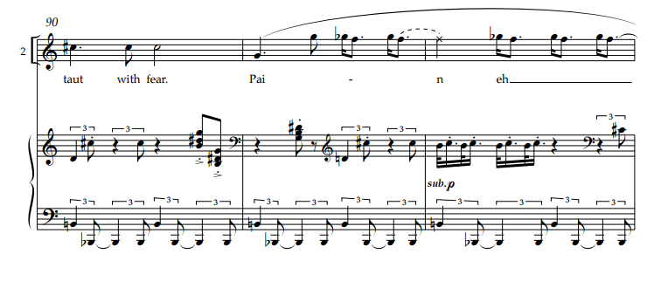
The Birth Project
emotionally active, motherhood redefined
“Pain everywhere
I did not know how to fight something
That was everywhere…”
“…it’s difficult to believe and
greater than anything she could conceive.”

Slide 17
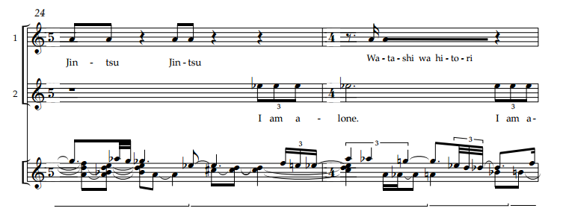
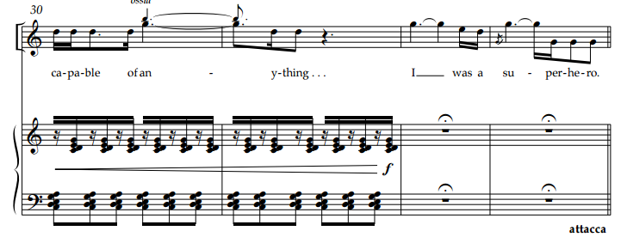
The Birth Project cont.
“I am alone”
“I was a superhero”

Slide 18
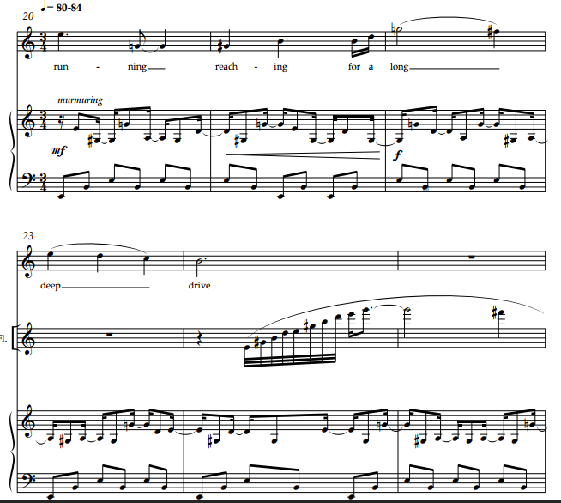
Center Field Girl
body positive imagery, women as physically active beings
“girl running reaching for a long
deep drive lunging ballet of limbs
gloved hand out legs afloat slap!
of ball to leather breaks the silence
exhilaration in the raised glove
ball trapped inside from the cloud up
in the blue I see feel it again
was anything ever so pure
or true
as that racing leaping catch
triumphant skip home for lunch gloved hand
at my side?”

Slide 19
De Toda la Eternidad female perspective on love and God, spiritual agency
Five poems – sacred and secular
I. The origin story
II. The Assumption
III. Love song to Maria Luisa
IV. Heartache
V. Loss of hope

Slide 20
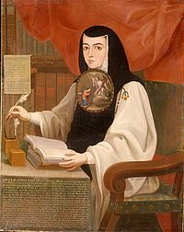
De Toda la Eternidad
Sor Juana Ines de la Cruz
Baroque nun, poet, scholar
Respuesta a Sor Filotea
“Sor Juana used her art and her religion to be a scholar, and she used her scholarship to create a piece of literary art that defends the sacredness of poetry (as well as of women).”
-Electa Arenal and Amanda Powell, The Answer = La Respuesta

Slide 21
“Un instante me escuchen” text
¡Un instante me escuchen,
que cantar quiero
un instante que estuvo
fuera del tiempo!
Escúchenme mientras cante,
que poco habrá que sufrir,
pues lo que quiero decir
es sola mente un instante.
Un instante es, de verdad,
pero tan privilegiado
que fue un instante cuidado
de toda la eternidad.
Gender ambiguity of speaker
Commanding voice
Powerful woman untamed and unsupervised

Slide 22
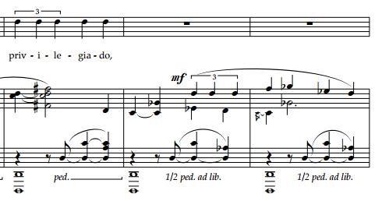
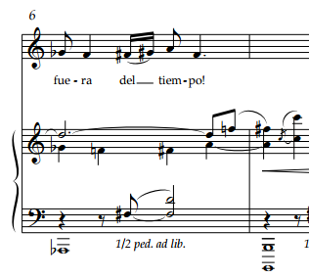
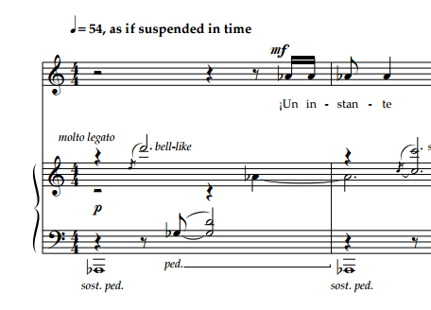
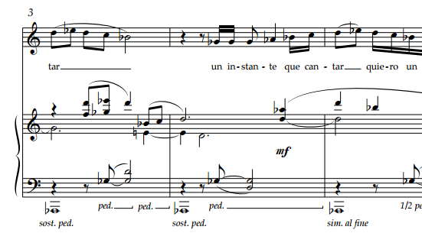
“Un instante, me esuchen” music
ABA’ form
Ab-D tritone sonority Chant-like
Syncopation

Slide 23
“Afuera, afuera, afuera!” text
¡Afuera, afuera, afuera
Aparta, aparta, aparta,
Que trinan los clarines,
Que suenan la dulzainas!
Estrellas se despeñan,
Auroras se levantan.
Bajen las luces,
Suban fragancias,
Cuadrillas de jazmines,
Claveles y retamas,
Que corren,
Que vuelan,
Que tiran,
Que alcanzan,
Con flores,
Con brillos,
Con rosas,
Con llamas.
Come out, come out, come out!
Stand aside, stand aside, stand aside,
The bugles are blowing,
The flageolets are piping!
Stars are shooting over cliffs,
Dawn is arising,
Lower the lights,
Fragrances rise,
Troops of jasmine,
Carnations and bushes,
They run,
They fly,
They throw,
They catch,
With flowers,
With brilliance,
With roses,
With flames.
the Assumption
Reunites Goddess with her sexuality
Not deemed sexually unruly, but spiritually ecstatic
“the woman is not mute, her voice may speak the body.” Yorke, Impertinent voices

Slide 24
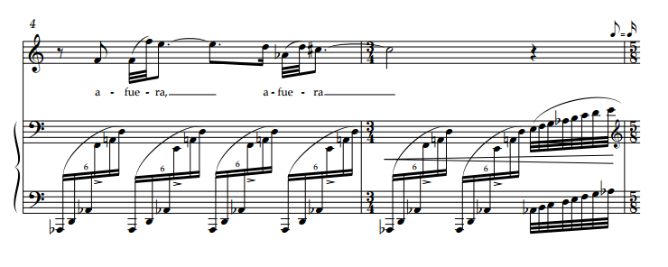
“Afuera” music
“Afuera” motive
Ascending sextuplets
Ab-D sonority
Ascending and descending scales

Slide 25
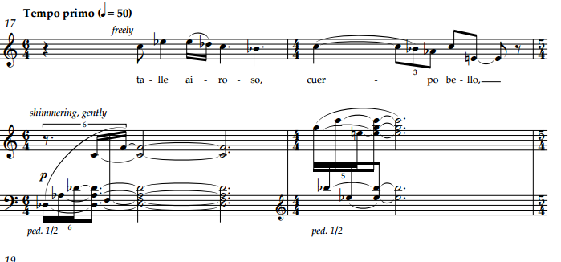
“Tersa frente, oro el cabello” music
Syncopated blocked chords
Measure 2 motive to be used in vocal line
Arpeggiated chords still motionless
Vocal line floats

Slide 26
“Tersa frente” text
Tersa frente, oro el cabello
Cejas arcos, zafir ojos,
Bruñida tez, labios rojos,
Nariz rectra, ebúrneo cuello;
Talle airoso, cuerpo bello,
Candidas manos en que
El cetro de amor se ve,
Tiene Fili; en oro engasta
Pie tan breve, que no gasta
Ni un pie.
Smooth brow, golden hair
Arched eyebrows, sapphire eyes
Glowing skin, red lips,
Ivory throat, straight nose,
Lyric figure, beautiful countenance;
Innocent hands, in which the
Scepter of love rests,
Has Fili: Slippered in gold,
Small feet, that do not take up
Even a foot.
Love song to Maria Luisa
Chaste female body allowed to love
Musically free from tension, textually controversial

Slide 27
“Tersa frente” controversy
Internalization
Liberation
Male ideals of female beauty
Females may bear male gaze
Larsen’s dilutes internalization
Baroque archetypal poetry
Structure vs. agency ≠ no agency
Pun: “pie tan breve, que no gasta ni un pie”
reclaiming language through humor

Slide 28
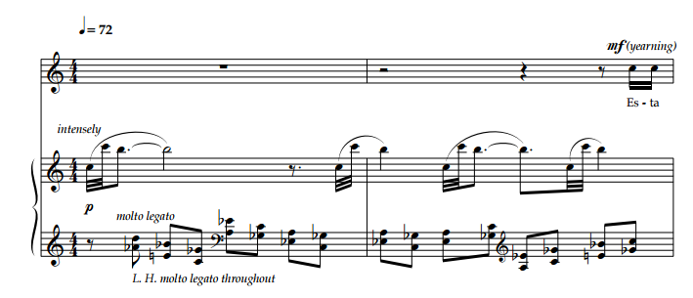
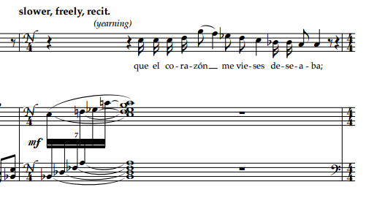
“Esta tarde” music
Return of the Ab-D sonority
Motion returns in piano
Conversational
Baroque opera simple recitative techniques
Small range
Explicit use of recit (figure)
Opera “freed the female voice”
- Kenny and Wollenberg, Women in the Nineteenth Century Lied

Slide 29
“Esta Tarde” text
First sense of anger, loss, heartache
Revolutionary expression
Ambiguity maintained throughout dialogue
Esta tarde, mi bien, cuando te hablaba
Como en tu rostro y tus acciones
Vía que con palabras no te persuadía,
Que el corazón me vieses deseaba;
Y amor, que mis intentos ayudaba,
Venció lo que imposible parecía:
Pues entre el llanto, que dolor vertía,
El corazón deshecho destilaba.
Baste ya de rigores, mi bien, baste,
No te atormenten más celos tiranos
Ni el vil recelo tu quietud contraste
Con sombras necias,
Con indicios vanos, pues ya en liquido
Humor viste y tocaste
Mi corazón deshecho entre tus manos.
This afternoon, my love, when I spoke to you,
Through your face and actions
I saw that my words would not convince you,
So I desired to show you my heart.
Then Love, who helped my intentions,
Won even the most impossible state:
Then with swelling and tears,
My broken heart was distilled.
Cease this harshness, beloved, cease;
Jealousy will cease if you command,
And doubts will not disturb your peace of mind
With nasty gloom,
With vain shams, in tears,
You saw and touched
My broken heart in your hands.

Slide 30
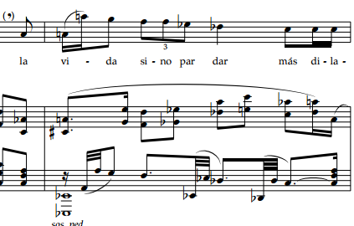
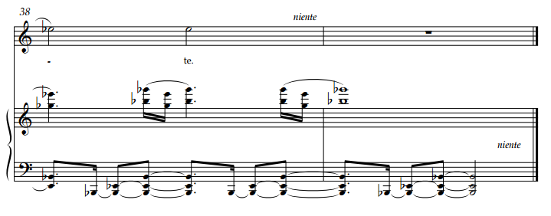
“Diuturna enfermedad de la esperanza”
Aria of the cycle
Follows recitative
Largest vocal range
Piano ostinato
Tragic text
Through-composed
slow development of past motives
Circularity through retrograde
Eb minor ending

Slide 31
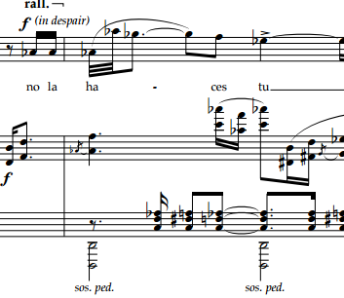
“Afuera” throughout the cycle
Movement IV
Movement V
Movement II

Slide 32
“Diuturna enfermedad” text
Hope as an illness
Diuturna enfermedad de la esperanza,
Que así entre tienes mis cansados años
Y en el fiel de los bienes y los daños
Tienes en equilibria la balanza
Que siempre suspendida en la tardanza
De inclinarse, no déjan tus engaños
Que lleguen a excederse en los tamaños
La desesperación o confianza
Quien te ha quitado el nombre de homicide?
Pues lo eres más severa si se advierte
Que suspendes el alma entretenida;
Y entre la infausta o la felice suerte,
No las haces tú por conservar la vida
La vida sino par dar más dilatada muerte.
Oh, malady of hope
That within you lies my tired years
And in the faith of the good and the ugly
There remains a balance
That is always suspended,
With the indolence to incline yourself
To not take your deceptions too far
Despair or confidence
Still, who has taken away your murderess name?
For the severe murderess you are, when it is owned
In your suspended soul
And as the cursed or the lucky
You do not act to prolong my life
But rather, that in life death be prolonged.
Release of tension through death
Theme in Hensel’s Die Nonne and Strozzi’s Lagrime mie

Slide 33
Further Reading
Thesis will be published in May and searchable under my name in Emory’s card catalog
Appendix for psychological studies of male gaze on female psyche
More theory

