Slide 1
Figure 1.5 RNAseq analysis of differentially expressed genes in aggregate-treated healthy control organoids relative to untreated healthy control organoids. Organoids treated with both rapid AD nucleus (A) and slow AD nucleus (B) show increased upregulation of inflammatory response pathways.

Slide 2
Figure 1.6 RNAseq analysis of differentially expressed genes in aggregate-treated fAD organoids. fAD organoids treated with rapid AD nucleus (A) and slow AD nucleus (B) show overall upregulated inflammatory response, but only fAD organoids treated with the slow AD nucleus exhibit intense activation of neurogenesis, which surpassed the organoid’s inflammatory response.

Slide 3
Figure 1.7 Differential pTau expression in nucleus-treated organoids. Immunostaining for pTau in organoids revealed distinct pTau expression profiles in aggregate-treated organoids relative to untreated organoids. (A) Fluorescence tagged anti-pTau (red) exhibited higher fluorescence intensity relative to anti-tau (green) in both healthy and fAD aggregate-treated organoids. Scale bar = 50 μm. (B) The ratio of pTau : tau fluorescence intensity was quantified to further disclose the discrepancy in global tau levels between healthy and fAD organoids when untreated (circle), treated with “slow” tissue-derived aggregates (square), and treated with “rapid” tissue-derived aggregates (triangle).

Slide 4
Figure 1.8 Electron micrographs of tissue-derived aggregates treated with synthetic Aβ42. Both frontal and occipital brain sections of AD individuals are shown against their ND counterparts as labeled. Scale bar = 200 nm.

Slide 5
Figure 1.9 Electron micrographs of Aβ42-seeded and unseeded PHF6 assemblies. Scale bar = 200 nm.

Slide 6
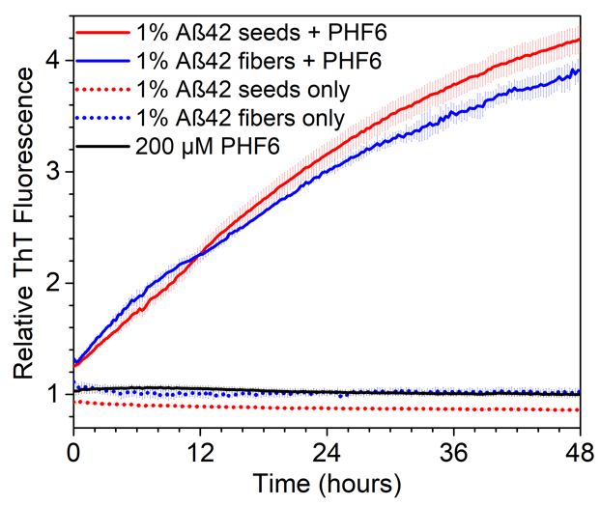
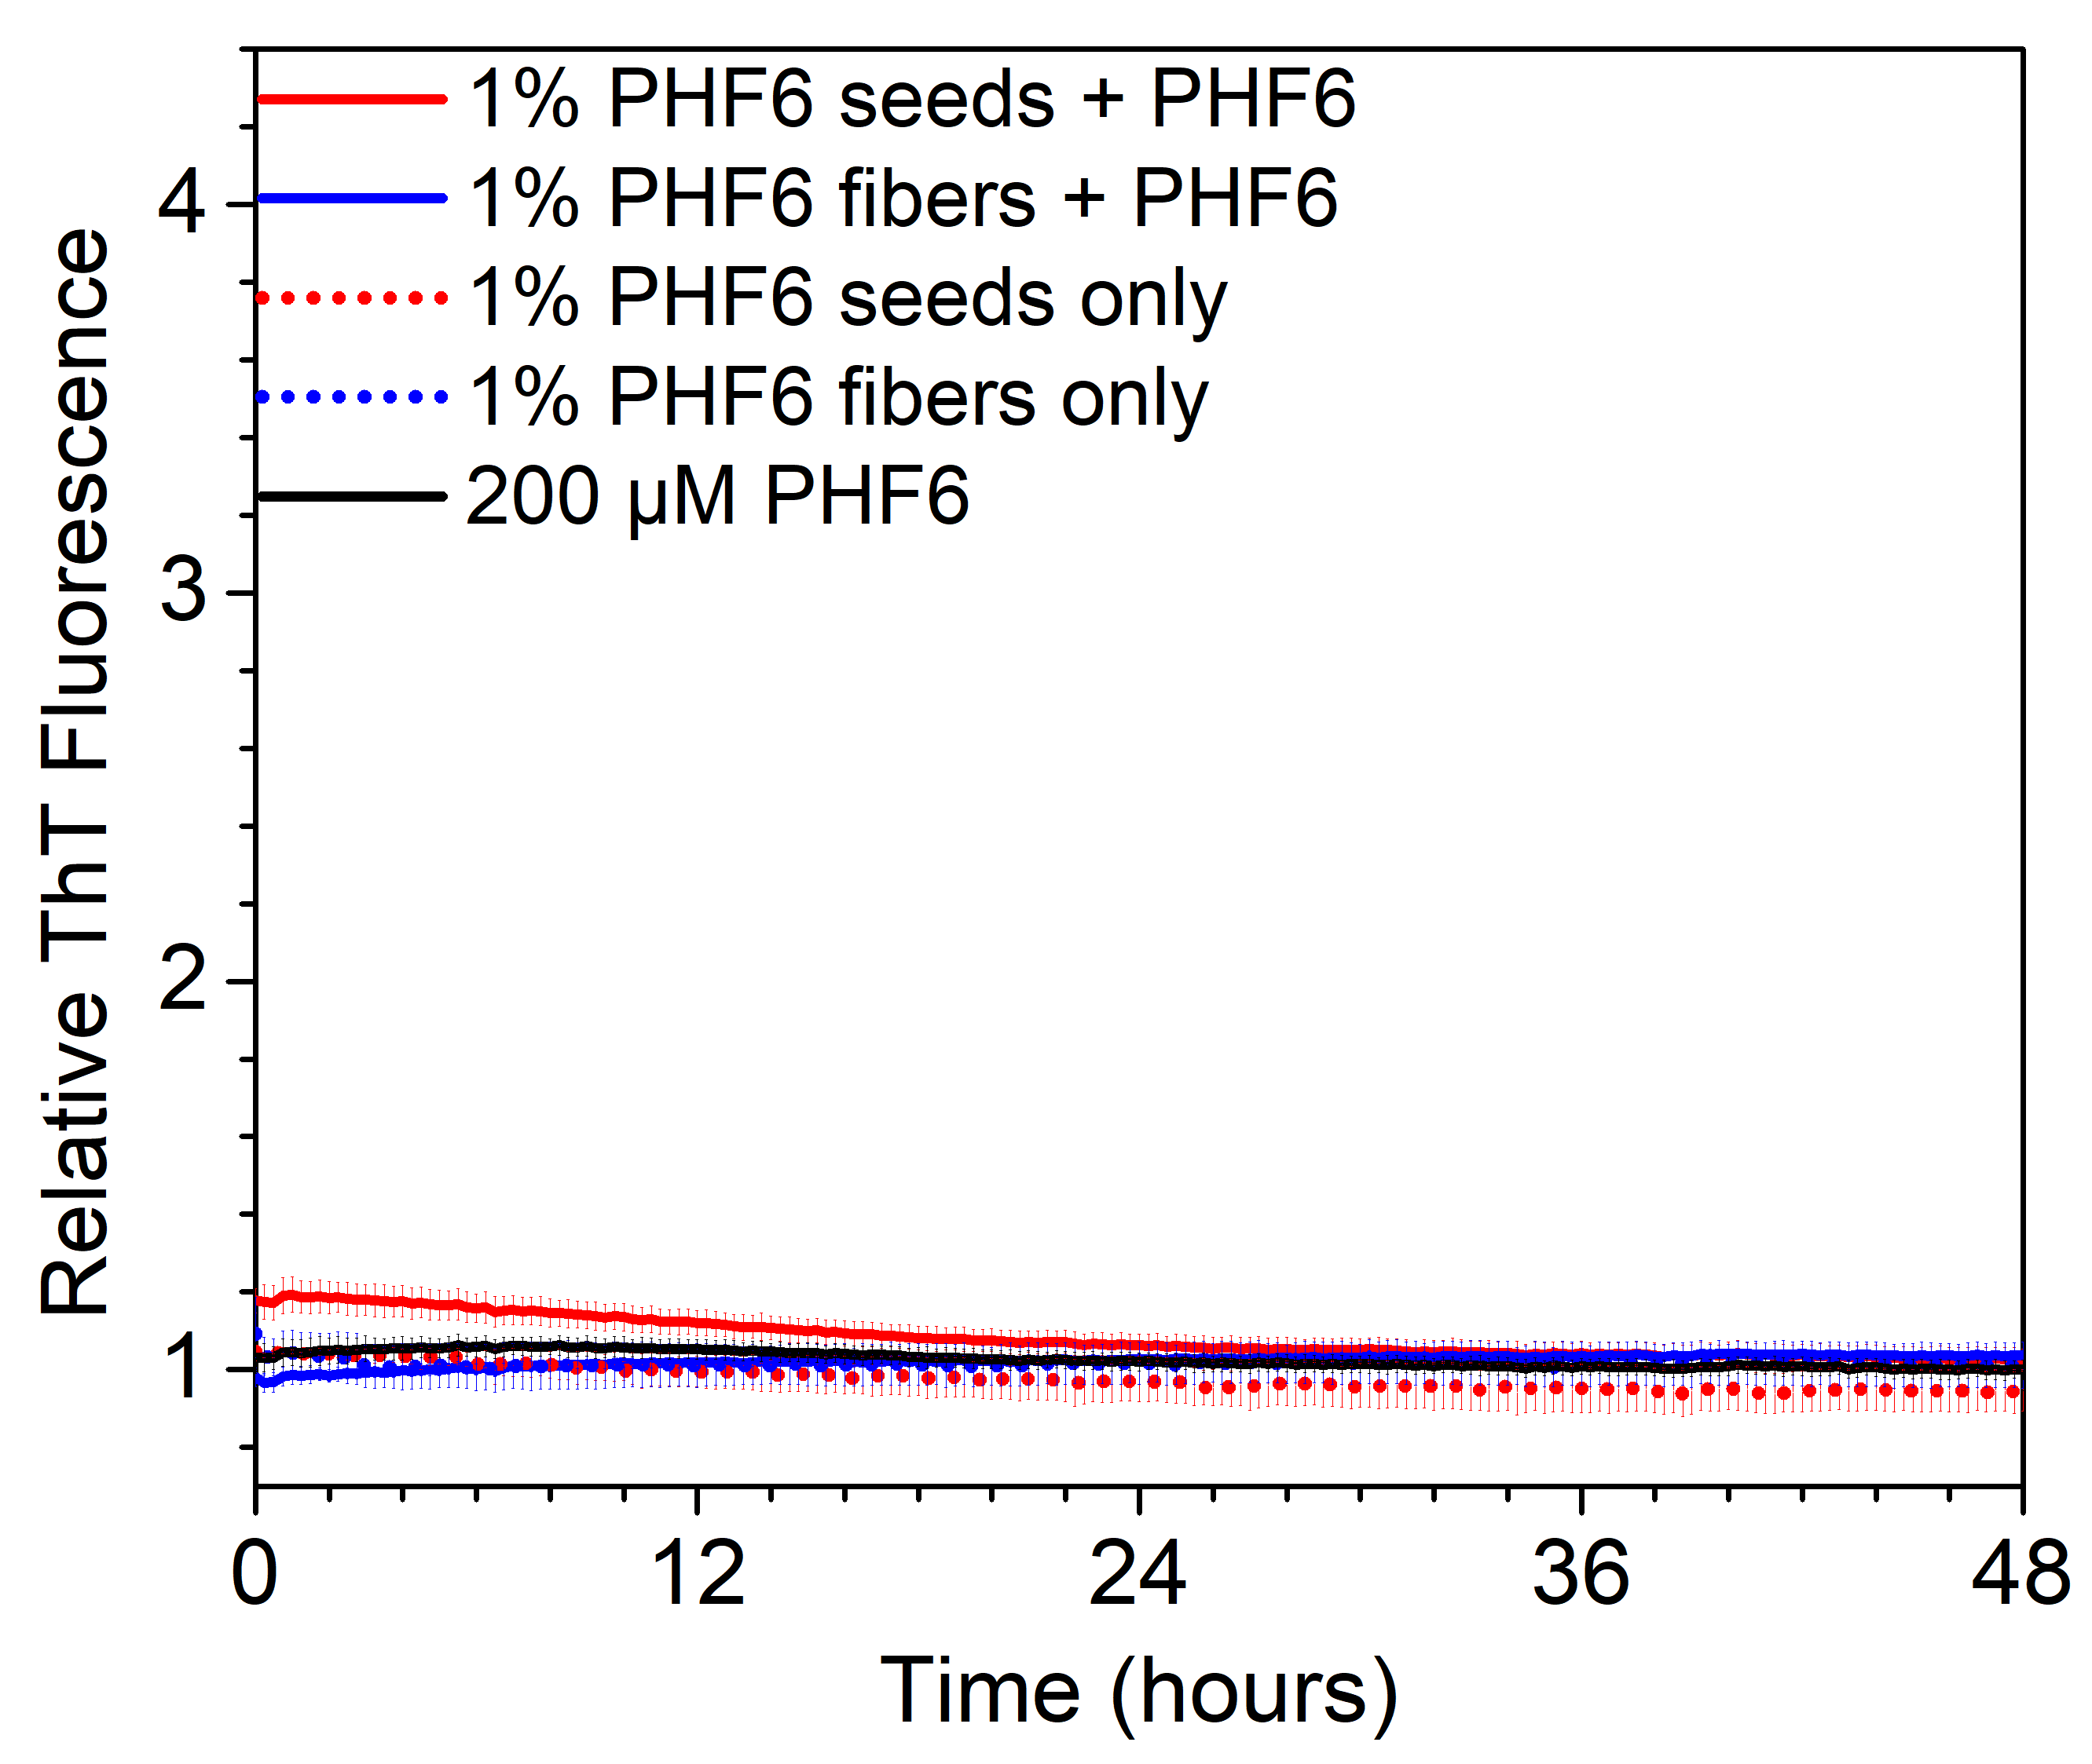
Figure 1.10 Kinetics analysis by thioflavin T of cross-seeded PHF6 assemblies. The left panel shows thioflavin T fluorescence intensities in differently seeded PHF6 assemblies by Aβ42. The right panel shows thioflavin T fluorescence intensities in differently seeded PHF6 assemblies by PHF6.

Slide 7
Figure 1.11 Electron micrographs reveal the distinct morphologies of E22 congener seeds. E22Q (A, D) and E22L (B, E) quickly assembled into fibrils and nanotubes, respectively, within 24 hours of peptide dissolution, while PHF6 (C, F) took considerably longer to mature into the long fibril morphology exhibited at maturity. Scale bar = 200 nm.

Slide 8
Figure 1.12 Electron micrographs of both seeded and unseeded PHF6 assemblies. E22Q-seeded PHF6 assemblies (A, E) were densely populated with fibrils but were sparse at 1 month (I). E22L-seeded PHF6 assemblies (B, F) retained the seed nanotube morphology up to 1 week but then transformed into fibril morphology at 1 month (J). PHF6-seeded PHF6 assemblies (C) retained the seed fibril morphology, but large particles were found at 1 week (G), and only fibrils were observed at 1 month (K). Unseeded PHF6 assemblies (D) showed highly heterogeneous assemblies of fibrils and less ordered aggregates but exhibited homogeneous fibril morphology after 1 week (H, L). Scale bars = 200 nm

Slide 9
Figure 1.13 Highly laminated structures observed in untreated AD brain tissue samples. Collagen (A), short fibrils, and possibly apolipoprotein E complex (yellow boxes in A and B) were observed in all samples. (C) A zoomed-in view of the possible apolipoprotein E complex. Scale bar = 1 μm unless otherwise noted.

