Slide 1
The Medicaid Expansion and its Effects on hospital revenue
Honor’s Thesis for the Emory economics department by:
Anders Olsen
Advisor: Dr. Ian McCarthy
Committee : Dr. Jose Soria and Dr. Sara Markowitz
Notes:
DSH funding reductions for Medicare took effect in 2014, whilst Medicaid reductions are to take effect in 2018 organized by the head of the HHS. However, these reductions were assumed to be replaced by Medicaid reimbursements. This creates a potential downside to states denying the expansion as many hospitals who rely on DSH payments will have to adapt and diversify their payer mix to survive with less supplemental payments.

Slide 2
Introduction
Research Question: The Medicaid Expansion’s effect on overall revenue
  Importance:
    Adding a new perspective to the current literature
    The extent of the expansion on the population and the federal budget
    The downstream effects of + or – overall revenues
Notes:
1 in 5 Americans, or 74 million people, have coverage through Medicaid as of July 2017
In 2016, Medicaid spending totaled $553 billion, accounting for 1 in every 6 dollars spent in the US healthcare system
+ hospitals in expansion states will have a greater resource pool from which to re-invest and spend money
- The expansion has negative impacts on specific revenue streams

Slide 3
Policy background
The Patient Protection and Affordable Care Act (ACA)
  Faced major scrutiny
  Legal action: National Federation of Independent Business (NFIB) v. Sebelius
    Provisions of interest: Mandate and Medicaid Expansion
  Importance of the Mandate and the Expansion
Notes:
Coercive for states: States were not given adequate notice to voluntarily consent to the major shifts in the Medicaid program.
Keep in mind, each state had different programs so to some the expansion was an easy transition and for others it was much more difficult.

Slide 4

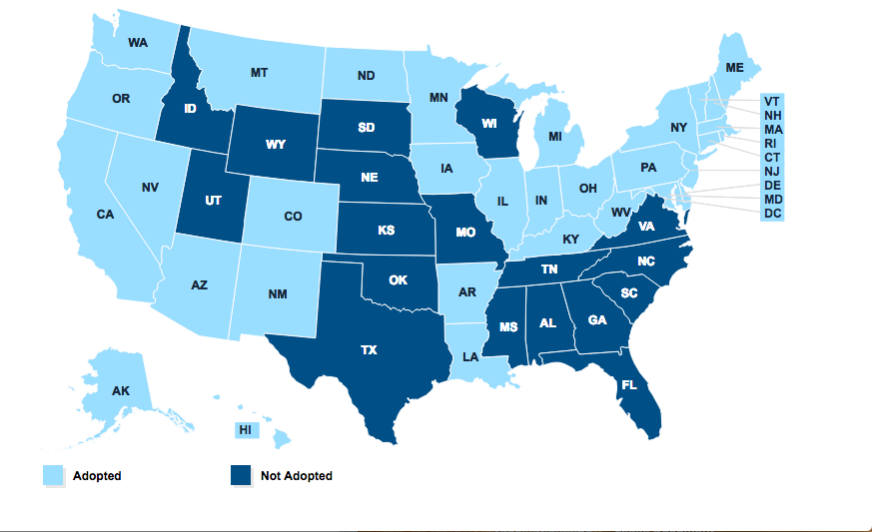
Policy background
The Medicaid Expansion
  33 States accepted
  18 did not
  Reasons for not expanding
Fig. 2. The Kaiser Commission on Medicaid and the Uninsured, “Status of State Action on the Medicaid Expansion Decision (as of November 8th, 2017).”
Notes:
State Medicaid programs, uncertain future spending projections and political standing.

Slide 5
Related Literature on Hospital financials
Financial Metrics Analyzed
Impacts of Expansion
Net Revenue from Medicaid
State Population Proportion Uninsured
Instances of Uninsured Patient Visits
Uncompensated and Unreimbursed Care Costs
Emergency Departments Usage
Hospital Operating Margins
Increase
Decrease
Decrease
Decrease
Unclear Impact
Not-definitive, but select types showed improvements
Notes:
Hospital operating margins were improved most for hospitals that were smaller in size, for-profit, non-government run and in non-metropolitan areas.

Slide 6

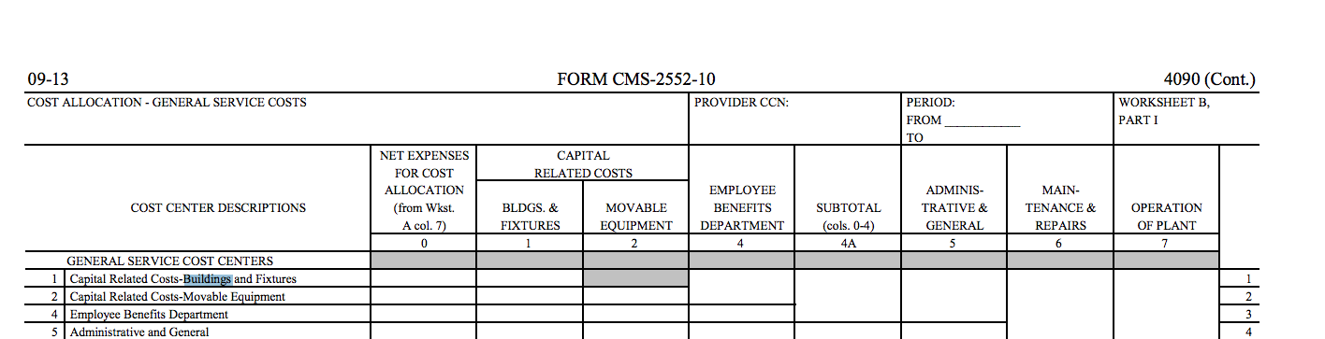
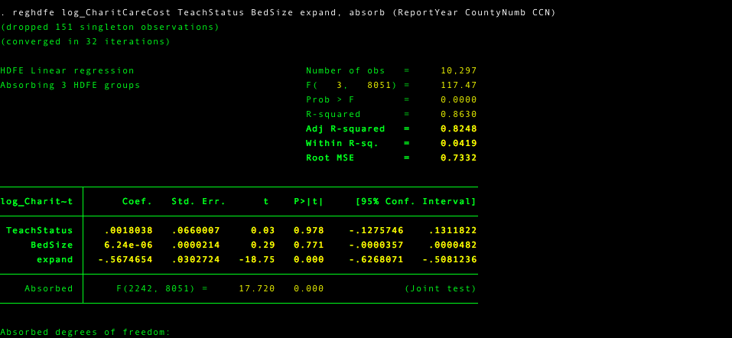
Data
Data source: NBER HCRIS
CMS-2552-10 Form (2011-2016)
dependent variables:
  Net Revenue Medicaid
  Net Hospital Revenue
  Total Patient Revenue
  Total Uncompensated/unreimbursed care cost
independent Variables
  Hospital County
  Bed size
  Teaching status
  Treatment: Expansion status
Dataset Refinements: Negative values, missing values, bS <35, CAH, duplicates, Rural
Notes:
NBER HCRIS database is drawn from the CMS cost report database, organized by the NBER
Removed rural to lower the variability of the sample. Rural hospitals often face unique situations that do not align with the findings of urban hospitals. Also, the average American is most likely to acquire care from an urban rather than a rural health facility.

Slide 7

Exp= Expansion accepted, Non= Expansion not accepted
~ Expansion policy does not take effect until 2014, the “Exp~” category for years 2011-2013 includes all hospitals that would eventually expand from 2014-2016
Mean reported on top [in millions if specified]
(Standard Deviation) reported on bottom in parentheses [in millions if specified]
Notes:
Draw attention to the 2015 revenue values and the spikes the occurred across the country.
Many of these can be attributed to the ACA’s provisions taking effect in 2014, one of which, was the Medicaid expansion
Overall Medicaid spending for states increased by an exceptional 13.5% in 2015 and 3.5% in 2016

Slide 8
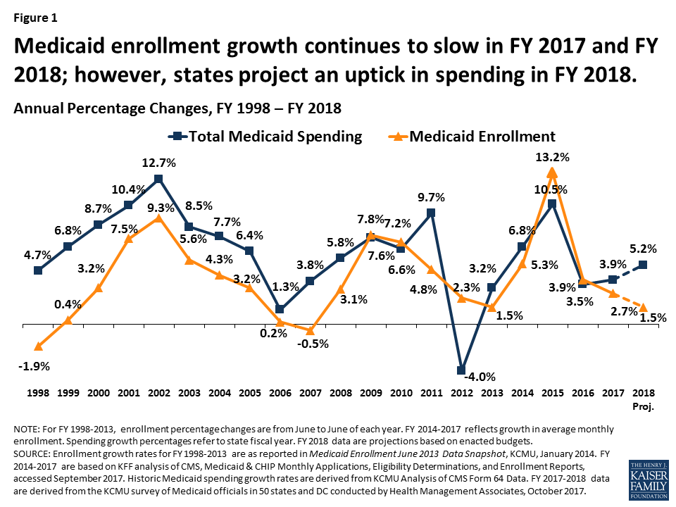

Slide 9

Regression: Linear Fixed Effects Model
$ln(Yht)=\text{β}\text{i}X$_{it}$+$η_{h}$+ λ$_{m}$+δ$_{t} $+$β₃$expand$_{ht} + $ε$_{it}
Based of a Differences-in-Differences model (DiD)
Fixed Effects:
  Market: County ($λ$_{m} )
  Time: Report Year (1-6) ($δ$_{t} )
  Hospital: Characteristics such as DSH Qualification and profit status (η_{h} )
Treatment Effect (β₃$expand$_{ht} )
Natural Log transformation
Notes:
Fixed effects hold certain characteristics so we can focus our study on the effect of the treatment and the other regressor variables on the estimator of interest.
Increased ease of interpretation and reduced impact from extreme outliers, which data like these have plenty of.

Slide 10
Results:
*Denotes Statistical Significance at 95% Confidence Interval
Coefficient reported on top
(Standard Error) reported in the middle in parentheses
[T-statistic] reported on the bottom in brackets
n=10,720
Notes:
Smiley faces denote alignment with current literature findings
Interpreting coefficients
Ramifications: Overall hospital revenue metrics show a negative impact as a result of expansion. This means that there are more complex mechanisms at play with the revenue streams of hospitals than the streams studied by the current literature alone.

Slide 11
Robustness and Sensitivity Tests
Parallel Trends for Hospital Inpatient revenue
Parallel Trends for Total Patient Revenue
Notes:
Major assumption of parallel trends with DiD regression.

Slide 12
Robustness and Sensitivity Tests Cont.
- *Denotes Statistical Significance at 95% Confidence Interval
Coefficient reported on top
- (Standard Error) reported in the middle in parentheses
- [T-statistic] reported on the bottom in brackets
n=3,768
Notes:
Unbalanced panel: missing values from certain years
Missed report submission
Missing information drives results
Balanced Panel: 628 hospitals and sample of 3768 finds similar results

Slide 13
Discussion
Main Findings: (-) Net Revenue from Expansion
  Factors to keep in mind: Profits and Disproportionate Share Hospital (DSH) payments
  Downstream effects: Services, investment, cost-shifting and prices for commercial insurance.
  Areas for future research:
    Payer Mix
    Private Patient Revenue Streams
Notes:
DSH funding reductions for Medicare took effect in 2014, whilst Medicaid reductions are to take effect in 2018 organized by the head of the HHS. However, these reductions were assumed to be replaced by Medicaid reimbursements. This creates a potential downside to states denying the expansion as many hospitals who rely on DSH payments will have to adapt and diversify their payer mix to survive with less supplemental payments.

Slide 14
Payer Mix Analysis
Medicaid patient days as a percentage of total patient days.
Results of expansion on this metric
*Denotes Statistical Significance at 95% Confidence Interval
Coefficient reported on top
(Standard Error) reported in the middle in parentheses
[T-statistic] reported on the bottom in brackets

Slide 15
Limitations
Study duration: issue for all current studies
CMS-2552-10 (‘11-’16) vs CMS-2552-96 (‘96-’10)
CMS database vs NBER

Slide 16
Additional analysis in spending habits
Notes:
Are these reductions in cost causing reduced inefficiencies to improve margins, or are these a result of a lower net revenue stream

Slide 17
Questions?
Thank you all for giving me your time to hear about my senior honor’s thesis this morning.
I am really happy I went through this process and could NOT have done it without all of your help.

