Slide 1
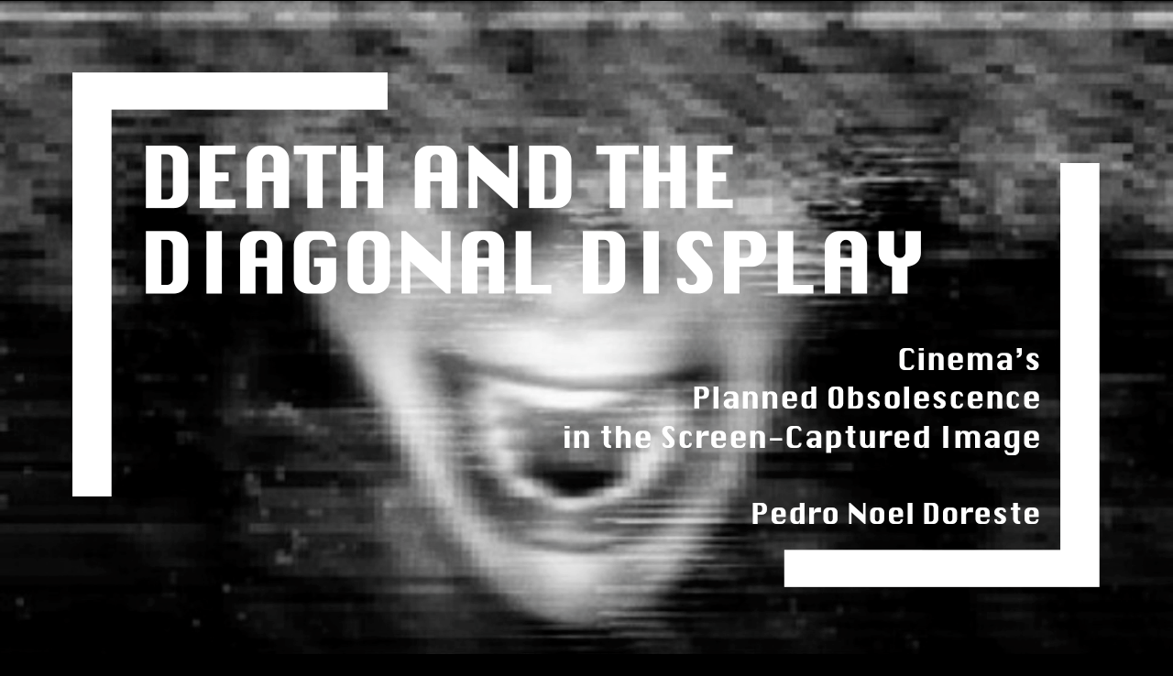

Slide 2
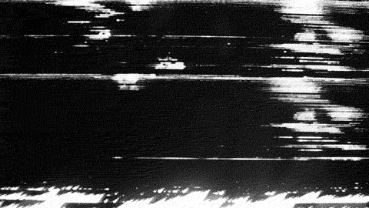
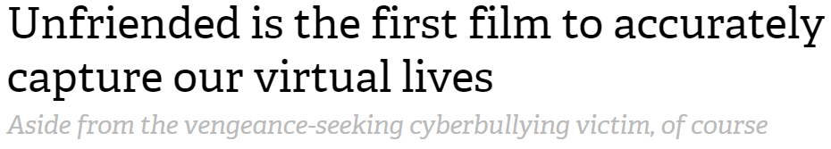
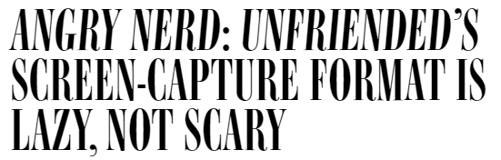
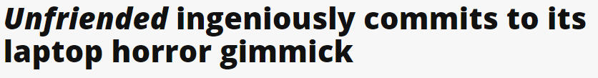
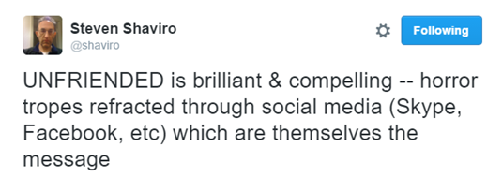

Slide 3
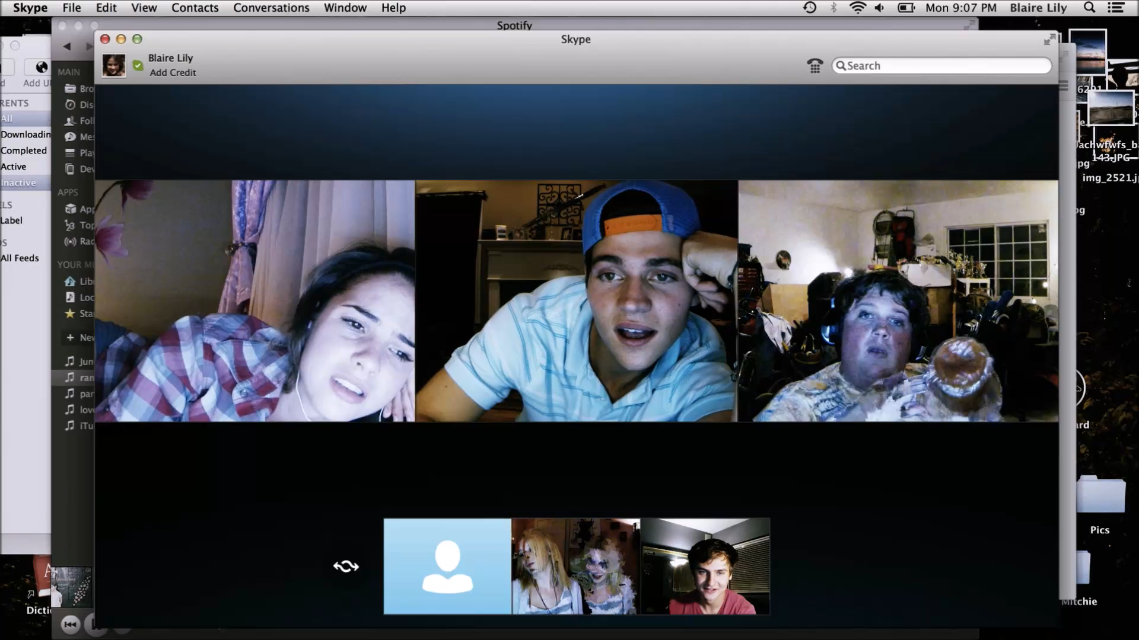

Slide 4
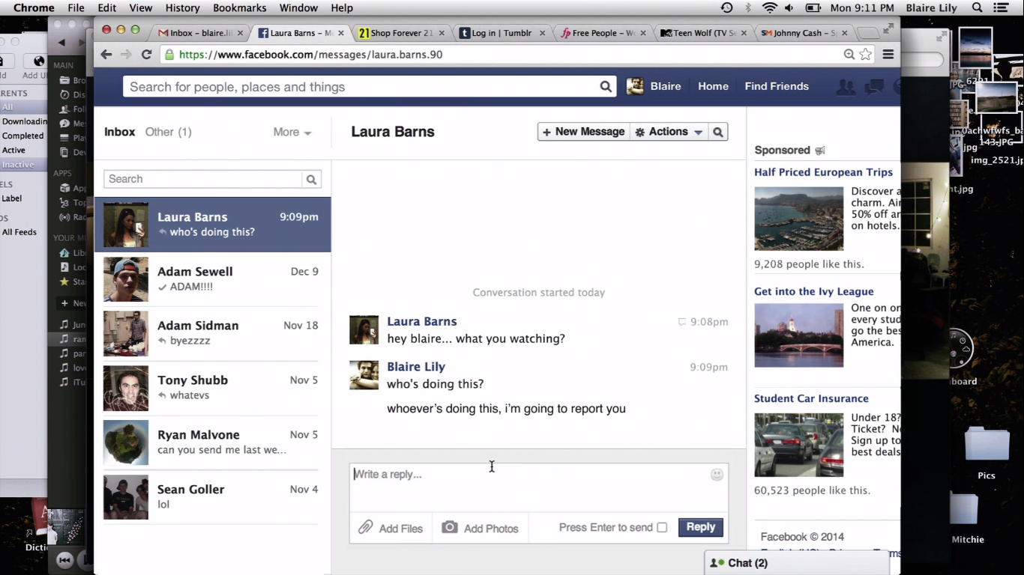

Slide 5
“The only way I can transform the Photograph is into refuse: either the drawer or the wastebasket. Not only does it commonly have the fate of paper (perishable), but even if it is attached to more lasting supports, it is still mortal: like a living organism, it is born on the level of the sprouting silver grains, it flourishes a moment, then ages... Attacked by light, by humidity, it fades, weakens, vanishes; there is nothing left to do but throw it away.”
Roland Barthes, Camera Lucida

Slide 6
“Computers will die. They’re dying in their present form. They’re just about dead as distinct units. A box and a screen, keyboard. They’re melting into the texture of everyday life… Even the word ‘computer’ sounds backward and dumb.”
Cosmopolis (David Cronenberg, 2012)
Thank you.

