Slide 1
NADPH
oxidase
SOD
CATALASE
H⁺
O₂
O₂
O₂^{•-}
H₂O₂
H₂O + O₂
+e⁻
2GSH
GSH-Px
GSSG
H₂O
Figure 1.1. ROS Generation by Nox Enzymes and the Metabolism of ROS. Production of superoxide (O₂•-) by NADPH oxidases occurs when NADPH oxidases catalyze the one electron reduction of molecular oxygen. Superoxide is then rapidly converted to hydrogen peroxide (H₂O₂) spontaneously or by superoxide dismutase (SOD). Hydrogen peroxide can then be metabolized to water and other secondary metabolites by catalase, glutathione peroxidase (GSH-Px), and/or peroxiredoxins (Prx).

Slide 2
H₂O₂
H₂O₂
H₂O₂
PTP
SH
PTP
SOH
PTP
SO₂H
PTP
SO₃H
Trx
Trx
Sulfenic
Sulfinic
Sulfonic
Figure 1.2. Oxidation and Reduction of Protein Tyrosine Phosphatases. Protein tyrosine phosphatases (PTPs) contain a reactive and, potentially, redox-sensitive cysteine (Cys) residue. These cystine residues can be oxidized by H₂O₂ to sulfenic acid (Cys-SOH). H₂O₂ can further oxidize these Cys residues to sulfinic (Cys-SO₂H) and sulfonic (Cys-SO₃H) forms. While the oxidation of sulfenic and sulfinic reactions are reversible, the sulfonic reaction renders the PTP irreversibly inactivated.

Slide 3
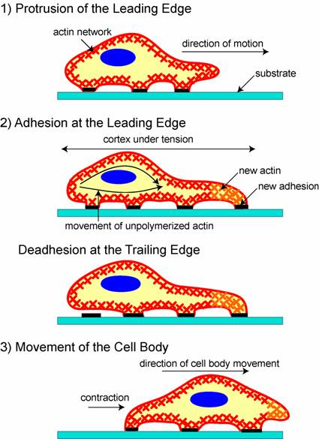
Figure 1.3. Regulation of Cell Migration. Migration begins with an initial protrusion or extension of the plasma membrane at the front/leading edge of the cell. The formation of these protrusions requires the polymerization of a network of cytoskeletal actin filaments. The protrusion is then stabilized through the formation of new adhesive complexes within the protrusion. Next, as the cell migrates, the focal complexes at the front of the cell strengthen into larger, more organized focal adhesions that serve as points of traction over which the cell body moves. For the cell to make forward progression, it must release its rear adhesions to allow a net forward displacement.
Image adapted with permission from: Ananthakrishnan R, Ehrlicher A. The Forces Behind Cell Movement. Int J Biol Sci 2007; 3:303-317.

Slide 4
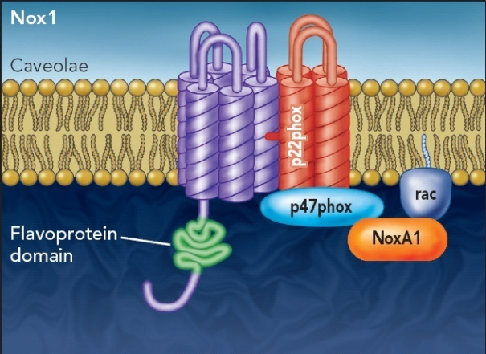
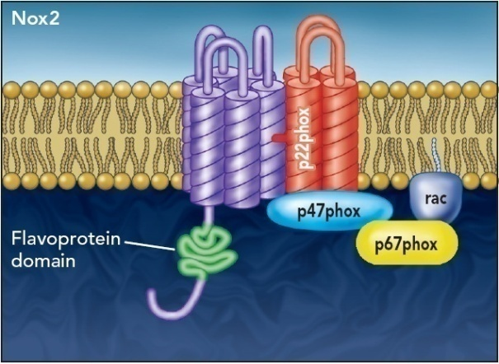
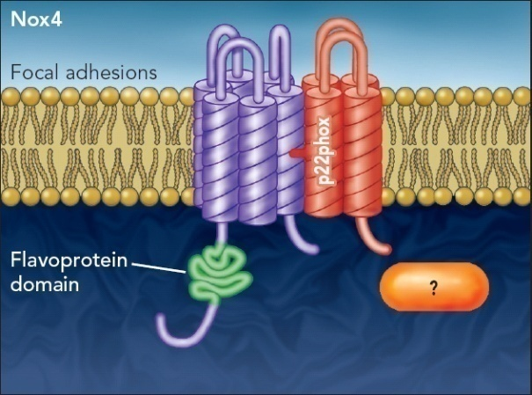
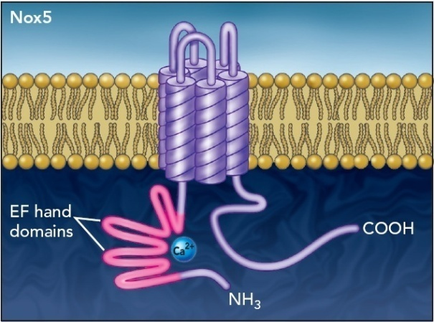
Image used with permission from: Lyle AN and Griendling KK (2006) Modulation of vascular smooth muscle signaling by reactive oxygen species. Physiology (Bethesda, MD) 21:269-280.
Figure 1.4. Structure and Assembly of Vascular NADPH Oxidases. The gp91phox homologues expressed in vascular smooth muscle cells (VSMCs) include Nox1, Nox2, Nox4, and Nox5. Each Nox subunit consists of six transmembrane domains. Nox1, Nox2 and Nox4 require the subunit p22phox for stabilization and to form functional ROS-generating enzymes. In contrast, Nox5 does not require p22phox or additional cytosolic subunits. The subcellular distribution of Nox1 and Nox4 differ in VSMC, where Nox1 is localized to caveolae and Nox4 is localized in focal adhesions. The subcellular distribution of Nox2 and Nox5 in VSMC is unknown. Nox1 associates with two cytosolic factors, p47phox and NoxA1, and the small molecular weight G-protein Rac to form a functional enzyme complex. Nox2 is regulated by p47phox and p67phox, while Nox4 presently has no known regulatory subunits. Nox5 is contains 4 EF-hand domains, at the N-terminus that serve as Ca²⁺ binding domains.

Slide 5
BD
p22^{phox}
Y
AD
DNA
Transcription is activated only if the binding domain coupled to p22phox binds Y to recruit the activation domain (AD) to the appropriate DNA binding site.
BD
DNA binding domain
AD
Transcriptional
activation domain
BD
p22^{phox}
Y
BD-p22phox fusion
protein; aka “bait”
AD
AD-Y fusion protein
Figure 2.1. Yeast Two-Hybrid Method. A yeast two-hybrid screen was performed on a VSMC cDNA library in which the cytosolic C-terminal tail of rat p22phox was used as bait by cloning it into a vector to make a pLexA-BD-p22phox construct (containing the DNA binding domain). The VSMC cDNA library was inserted into the pB42AD vector, containing the activator domain, such that if one of the AD-Y fusion proteins from the cDNA library binds to the BD-p22phox construct, transcription is activated and drives the expression of a marker used to screen colonies.

Slide 6
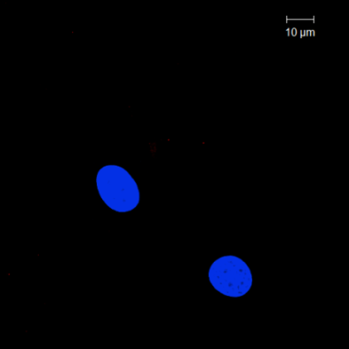

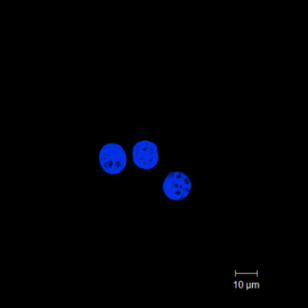
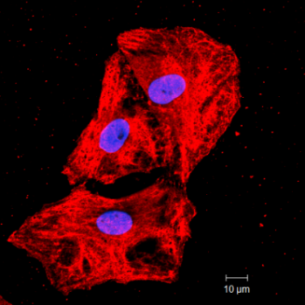
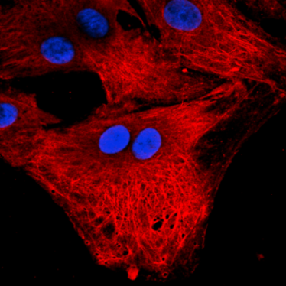
a.
Epitope
117-130
aa48 aa49
aa238
aa363
N
ApaG
C
b.
Ab
alone
Ab
+ BP 1:5
IB Poldip2
37 kDa
c.
1° Poldip2 only
2° only
1° 1:10 Goat IgG
1° 1:10 Poldip2
1° 1:25 Poldip2
Figure 2.2. Poldip2 Antibody Characterization. a, The Poldip2 goat antibody (Ab) was raised against amino acids 117-130 (peptide sequence NPAGHGSKEVKGKTC). b, Western analysis of Poldip2 protein expression in rat VSMC lysate immunoblotted with goat Poldip2 Ab alone or 1:5 ratio of goat anti-Poldip2 Ab to blocking peptide (BP). c, Immunocytochemistry of rat VSMCs single labeled with Poldip2 Ab (red), or normal IgG, or 2° Ab alone as negative controls. Images acquired at the focal adhesion plane are shown.

Slide 7
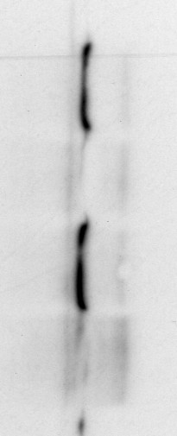

IP:
V5
V5-p22phox
+
+
-
Myc-Poldip2
-
+
-
50 kDa
Myc-Poldip2
IB Myc
37 kDa
IB V5
V5-p22phox
Figure 2.3. Association of p22phox and Myc-Poldip2 in Co-Transfected HEK 293 cells. HEK 293 cells were co-transfected with V5-tagged p22phox (V5-p22phox) and either empty vector (-) or vector expressing Myc-tagged Poldip2 (+; Myc-Poldip2). Cells were immunoprecipitated (IP) with V5 antibody and immunoblotted (IB) with a Myc (upper) or V5 (lower) antibody.

Slide 8
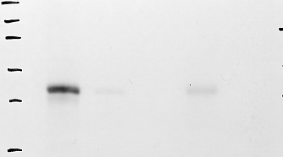
GST-vector
GST-p22phox
Poldip2 + + – + –
50 kDa
Poldip2
37 kDa
Figure 2.4. GST-p22phox Pulls Down Poldip2 in Vascular Smooth Muscle Cells. Rat VSMCs were transfected with vector control (-) or Poldip2 (+), labeled with ³⁵S-Methionine, and used in a GST-pulldown assay. Binding partners for GST-vector control and GST-p22phox were detected by autoradiography. Positive control: in vitro translated Poldip2 (lane 1). We thank Yoshihiro Taniyama, M.D. and Pingfeng Du, M.D. for kindly providing this figure.

Slide 9
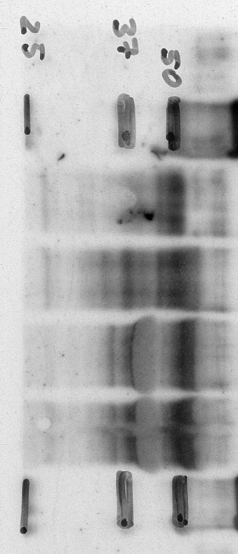
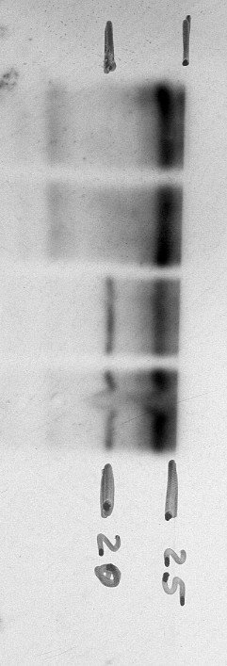
IP:
p22
IgG
p22
LB
37 kDa
Poldip2
IB Poldip2
IB p22phox
p22phox
Figure 2.5. Association of p22phox with Endogenous Poldip2 in Vascular Smooth Muscle Cells. Human VSMC lysates were immunoprecipitated (IP) with rabbit IgGs (IgG) or p22phox antibody and immunoblotted (IB) with a Poldip2 (upper) or p22phox (lower) antibody. Lysis buffer (LB), to which the 1° IP antibody and protein-conjugated agarose beads are added, was used as a negative control in all IP experiments to show what bands are attributable to possible cross-reactivity between the IP antibody and IB antibody. Poldip2 is detected as a 37 kDa band; IgGs interfere with resolution of the 42 kDa band.

Slide 10
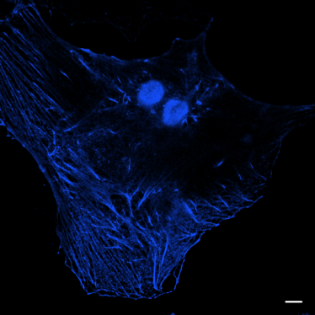
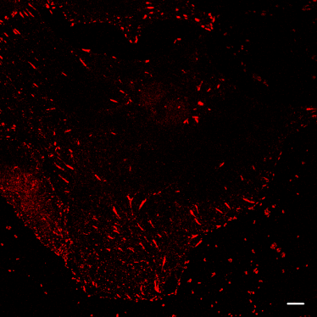
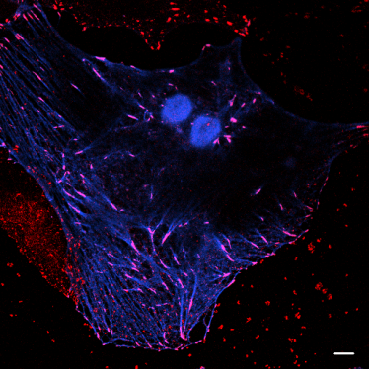
a.
Poldip2
Ad:
CMV
50 kDa
IB Myc
Myc-Poldip2
37 kDa
b.
Myc-Poldip2
p22phox
Merge
Focal Adhesions
Figure 2.6. a, Expression of Myc-Poldip2 in Vascular Smooth Muscle Cells using Adenovirus. Rat VSMCs transduced with either control adenovirus (AdGFP) or adenovirus to express Myc-tagged Poldip2 (AdPoldip2) for 72 h were immunoblotted (IB) with a Myc antibody to verify expression of Myc-Poldip2. Myc-Poldip2 is detected at 42 kDa and 37 kDa. b, Myc-Poldip2 Co-localizes with p22phox in Vascular Smooth Muscle Cells. Rat VSMCs transduced with AdPoldip2 were double labeled with Myc (pseudo-colored blue) and p22phox (red) antibodies. Arrows indicate areas of co-localization (purple) in the merge. Scale bars, 10 µm.

Slide 11
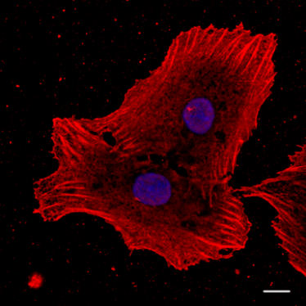
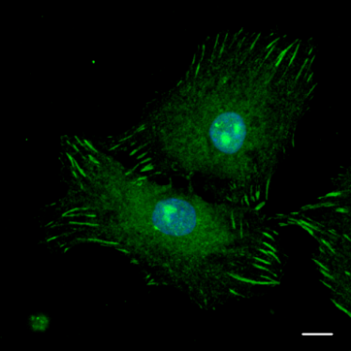
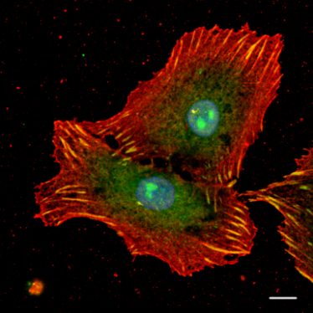
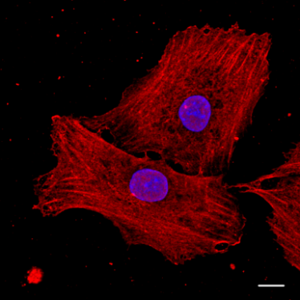
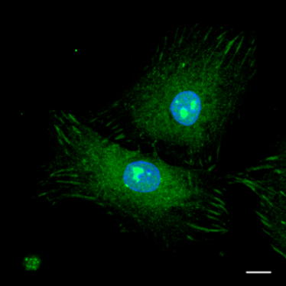
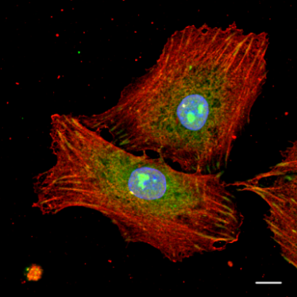
Poldip2
p22phox
Merge
Focal Adhesions
Stress Fibers
Figure 2.7. Endogenous Poldip2 Co-Localizes with p22phox in Vascular Smooth Muscle Cells. Rat VSMCs were double labeled with Poldip2 (red) and p22phox (green) antibodies. Arrows indicate areas of co-localization (yellow) in the merge. Nuclei are labeled with DAPI (blue). Images acquired at the focal adhesion (upper panel) and stress fiber (lower panel) planes are depicted. Scale bars, 10 µm.

Slide 12


IP:
Myc
IgG
Myc
AdPoldip2 - + + -
Nox4 (80 kDa)
IB Nox4
Nox4 (65 kDa)
IB Myc
Myc-Poldip2
Figure 2.8. Association of Myc-Poldip2 with Nox4 in Vascular Smooth Muscle Cells. Rat VSMCs were transduced with 125 μL/dish of control adenovirus ( - ) or Myc-tagged Poldip2 adenovirus ( + , AdPoldip2). Lysates were immunoprecipitated (IP) with IgGs or a Myc antibody and immunoblotted (IB) with a Nox4 (upper) or Myc (lower) antibody. Nox4 is detected as an 80 kDa and 65 kDa band.

Slide 13

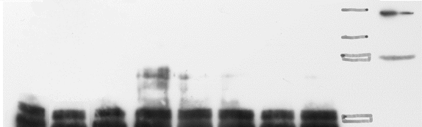

IP:
Myc
AdPoldip2
LB No Ad 37.5 75 125 175 225 AdGFP
IB Nox4
Nox4 (80 kDa)
Nox4 (65 kDa)
IB Nox1
Nox1 (65 kDa)
IB Myc
Myc-Poldip2
Figure 2.9. Increasing Amounts of Nox4 Associate with Myc-Poldip2 in Vascular Smooth Muscle Cells. Rat VSMCs were transduced with no adenovirus (No Ad), 125 µL/dish of control adenovirus (AdGFP) or increasing amounts of Myc-tagged Poldip2 adenovirus (AdPoldip2). Lysates were immunoprecipitated (IP) with a Myc antibody and immunoblotted (IB) with a Nox4 (upper), Nox1 (middle), or Myc (lower) antibody. Lysis buffer (LB) was used as a negative control.

Slide 14
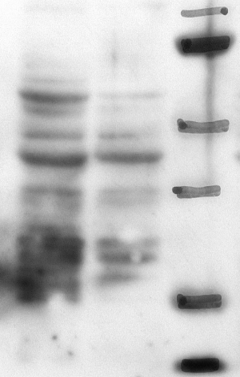
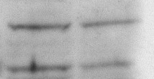
Vector
p22AS
IB p22phox
IB Nox4
Nox4 (80 kDa)
Nox4 (65 kDa)
Figure 2.10. Expression of p22phox and Nox4 in Vector Control and p22phox Antisense Vascular Smooth Muscle Cells. Western analysis of rat VSMCs stably transfected with antisense p22phox (p22AS) or vector control (vector) to verify knockdown of p22phox (upper) and to determine the expression levels of Nox4 (lower).

Slide 15
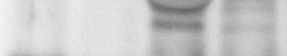
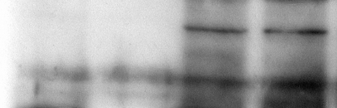
IP:
Nox4
IgG
Nox4
LB
Vector
Vector
p22AS
IB Poldip2
Poldip2 (37kDa)
IB Nox4
Nox4 (80 kDa)
Nox4 (65 kDa)
Figure 2.11. Association of Endogenous Poldip2 with Nox4 in Vascular Smooth Muscle Cells Requires p22phox. Rat VSMCs stably transfected with empty vector (Vector) or antisense p22phox (p22AS) vector were immunoprecipitated (IP) with rabbit IgGs or a Nox4 antibody and immunoblotted (IB) with a Poldip2 (upper) or Nox4 (lower) antibody. Lysis buffer (LB) was used as a negative control.

Slide 16
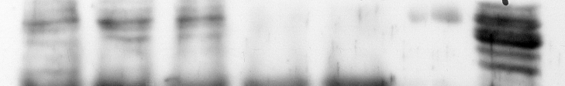
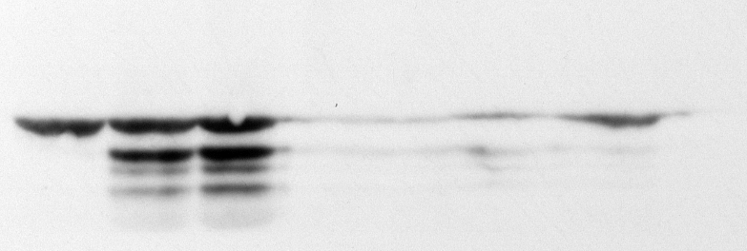
IP:
IgG
Nox1
Nox1
AdNox1HA
+
LB
-
+
+
100 nmol/L Ang II
-
-
-
-
+
IB Poldip2
37 kDa
Poldip2
IB HA
Nox1-HA
50 kDa
Nox1-HA
Figure 2.12. Association of Endogenous Poldip2 with HA-tagged Nox1 in Vascular Smooth Muscle Cells. Rat VSMCs transduced with AdGFP ( - ) or HA-tagged Nox1 ( + , AdNox1HA) adenovirus were untreated or stimulated for 4 hours with 100 nmol/L Angiotensin II (Ang II) prior to being immunoprecipitated (IP) with goat IgGs or a Nox1 antibody and immunoblotted (IB) with a Poldip2 (upper) or HA (lower) antibody. Lysis buffer (LB) was used as a negative control.

Slide 17
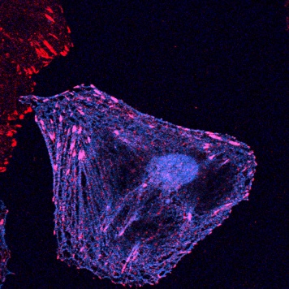
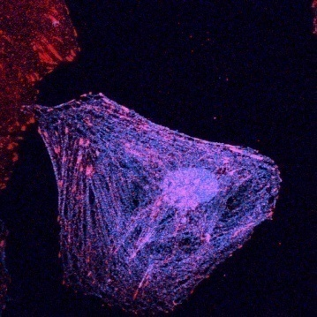
Myc-Poldip2
Nox4
Merge
Focal Adhesions
Stress Fibers
Figure 2.13. Myc-Poldip2 Co-localizes with Nox4 in Vascular Smooth Muscle Cells in Focal Adhesions and Along Stress Fibers. Rat VSMCs were transduced with AdPoldip2 and double labeled with anti-Myc (pseudo-colored blue) and anti-Nox4 (red) antibodies. Arrows indicate areas of co-localization (purple) in the merge at the focal adhesion (upper panel) and stress fiber (lower panel) planes. Scale bars, 10 µm.

Slide 18
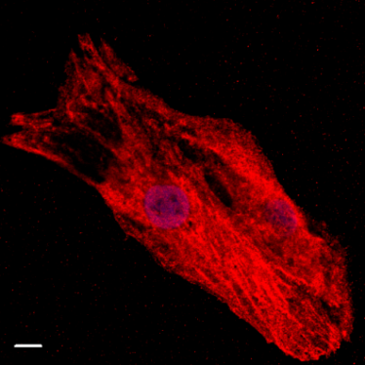
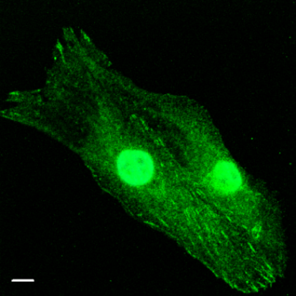
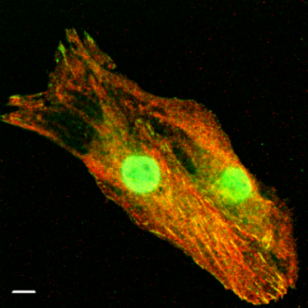
Poldip2
Nox4
Merge
Figure 2.14. Endogenous Poldip2 Co-localizes with Nox4 in Vascular Smooth Muscle Cells in Focal Adhesions and Along Stress Fibers. Rat VSMCs were double labeled with Poldip2 (red) and Nox4 (green) antibodies. Arrows indicate areas of co-localization (yellow) in the merge. Scale bars, 10 µm.

Slide 19
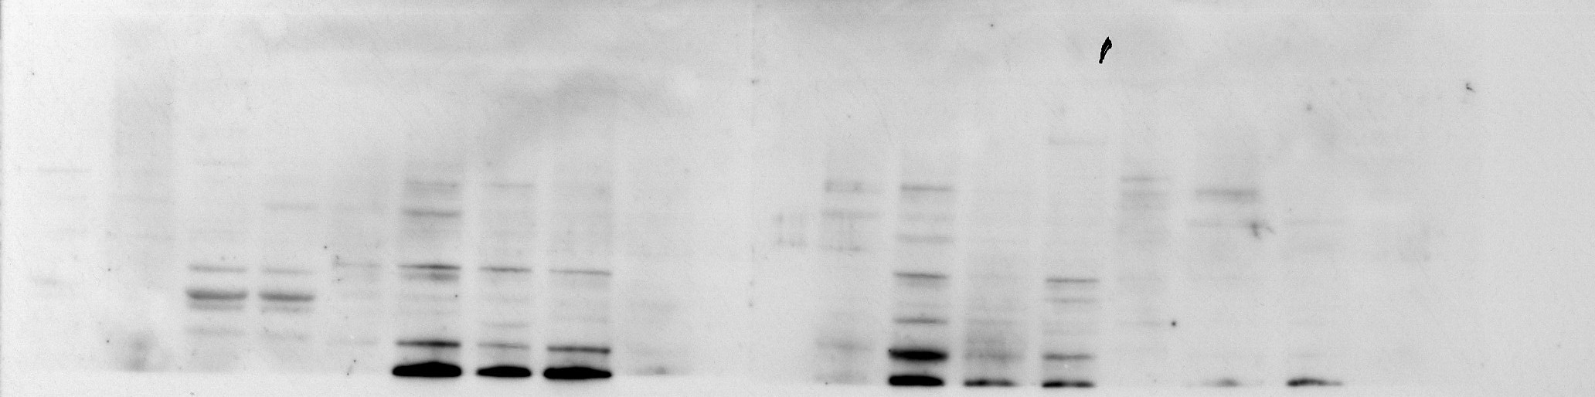
a.
0.04
0.03
Poldip2 / 18S
0.02
0.01
0.00
spleen
thymus
atria
aorta
kidney
diaphragm
b.
spleen
thymus
heart
aorta
Poldip2 (42 kDa)
Poldip2 (37 kDa)
kidney
diaphragm
lung
Poldip2 (42 kDa)
Poldip2 (37 kDa)
Figure 2.15. a, Poldip2 mRNA Expression in Tissues. Quantitative real-time PCR analysis of poldip2 mRNA expression in tissues from Sprague Dawley rats. mRNA is normalized to 18S. Bars are mean ± S.E.M. of triplicates from a representative experiment, repeated twice. b, Poldip2 Protein Expression in Tissues. Western blot of Poldip2 protein expression in rat tissue lysates. The 42 kDa Poldip2, containing the predicted signal peptide, and the 37 kDa Poldip2, after peptide cleavage, are shown.

Slide 20
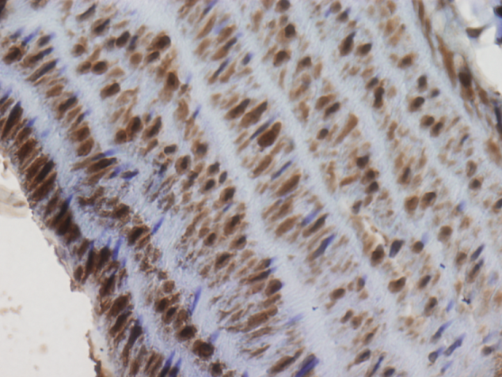
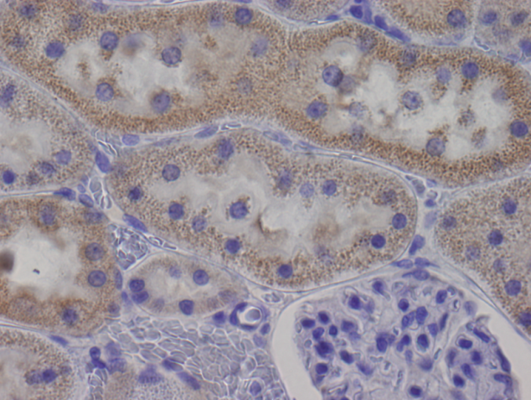
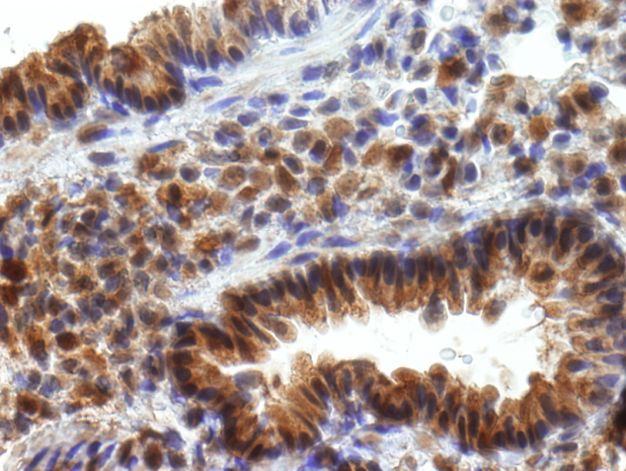
Aorta
Kidney
A
M
T
L
G
Lung
B
Figure 2.16. Expression of Poldip2 in Tissue Sections. Immunohistochemical distribution of Poldip2 in rat aorta (L-lumen, M-media, A-adventitia), kidney (G-glomerulus, T-tubule), and lung (B-bronchiole) tissues using an anti-Poldip2 antibody. Poldip2 signal appears brown from use of horse raddish peroxidase (HRP) . Nuclei are counterstained with hematoxylin (blue/purple).

Slide 21
†
400
300
NADPH oxidase activity
*
% Control
200
100
-Ang
+Ang
37.5
37.5
75
125
225
225
No Ad
AdGFP
AdPoldip2
AdGFP
Figure 3.1. Overexpression of Poldip2 Increases Basal Oxidase Activity in a Dose-dependent Manner. Rat VSMCs were transduced with no adenovirus (No Ad), 37.5 or 225 µL/dish of AdGFP, or 37.5 µL/dish to 225 µL/dish of AdPoldip2. Lucigenin enhanced chemiluminescence was used to measure NADPH oxidase activity in membrane fractions. Bars are mean ± S.E.M. of 3-4 independent experiments. †p<0.05 vs. AdGFP. Positive control: VSMCs stimulated with 100 nmol/L Ang II for 4 hours. *p<0.05 vs. No Ad - Ang.

Slide 22
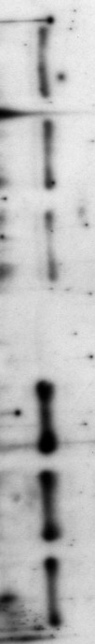
a.
20000000
350000
300000
nox4 copies /
1x10 ⁸ luciferase
250000
nox1 copies /
1x10 ⁸ luciferase
10000000
200000
150000
100000
0
50000
AdGFP
AdPoldip2
0
AdGFP
AdPoldip2
5000000
4000000
p22phox copies /
1x10 ⁸ luciferase
3000000
2000000
1000000
0
AdGFP
AdPoldip2
b.
AdPoldip2
-
-
+
IB Nox4
IB p22phox
Figure 3.2. The Increase in Basal NADPH Oxidase Activity is Not Due to Increased Oxidase Subunit Expression. a, Quantitative real-time PCR of nox4, nox1, and p22phox mRNA expression in rat VSMCs transduced for 72 hours with control adenovirus (AdGFP) or adenovirus to overexpress Poldip2 (AdPoldip2); mRNA levels are normalized to luciferase. Bars are mean ± S.E.M of 3 independent experiments. No statistical difference was found. b, Western analysis of rat VSMCs transduced with either no adenovirus ( - , left), control adenovirus ( - , AdGFP, middle), or adenovirus to overexpress Poldip2 ( + , AdPoldip2) for 72 hours prior to immunoblotting (IB) for Nox4 or p22phox.

Slide 23
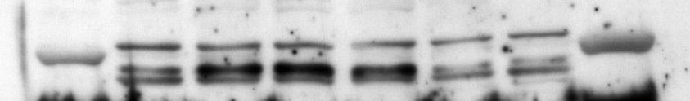
No Ad
AdGFP
AdNox4AS
AdPoldip2
-
+
-
+
-
+
IB Nox4
Figure 3.3. Nox4 Antisense Decreases Nox4 Protein Levels. Western analysis of rat VSMCs transduced with either no adenovirus (No Ad), control adenovirus (AdGFP), or adenovirus to express antisense Nox4 (AdNox4AS) for 48 h prior to transducing cells with either control adenovirus ( - , AdGFP) or adenovirus to overexpress Myc-tagged Poldip2 ( +, AdPoldip2) for an additional 72 h to verify the knockdown of Nox4 by AdNox4AS.

Slide 24
250
*
†
200
150
NADPH oxidase activity
% Control
100
‡
50
AdPoldip2
-
+
-
+
-
+
No Ad
AdGFP
AdNox4AS
Figure 3.4. Overexpression of Poldip2 Increases Basal Oxidase Activity, which is Blocked by Nox4 Antisense, as Measured by Lucigenin Enhanced Chemiluminescence. Rat VSMCs were transduced with either no adenovirus (No Ad), control adenovirus (AdGFP), or adenovirus to express antisense Nox4 (AdNox4AS) for 48 h prior to transducing cells with either control adenovirus ( - , AdGFP) or adenovirus to overexpress Myc-tagged Poldip2 ( +, AdPoldip2) for an additional 72 h before using lucigenin enhanced chemiluminescence to measure NADPH oxidase activity. Bars are mean ± S.E.M. of 4 independent experiments. *p<0.001 vs. No Ad – AdPoldip2; †p<0.01 vs. AdGFP – AdPoldip2; ‡p<0.001 vs. AdGFP + AdPoldip2.

Slide 25
25
†
20
*
15
‡
Superoxide
(µmol/µg protein)
10
5
AdPoldip2
-
+
-
+
-
+
No Ad
AdGFP
AdNox4AS
Figure 3.5. Overexpression of Poldip2 Increases Superoxide Production, which is Blocked by Nox4 Antisense, as Measured by DHE-HPLC. Rat VSMCs transduced with either no adenovirus (No Ad), control adenovirus (AdGFP), or adenovirus to express antisense Nox4 (AdNox4AS) for 48 h prior to transducing cells with either control adenovirus ( - , AdGFP) or adenovirus to overexpress Myc-tagged Poldip2 ( + , AdPoldip2) for an additional 72 h prior to using DHE-HPLC to measure O₂•- production. Bars are mean ± S.E.M. of 4 independent experiments. *p<0.001 vs. No Ad – AdPoldip2; †p<0.001 vs. AdGFP – AdPoldip2; ‡p<0.001 vs. AdGFP + AdPoldip2.

Slide 26
35
*
30
†
25
20
H₂O₂ (µmol/ µg protein)
15
‡
10
5
AdPoldip2
-
+
-
+
-
+
No Ad
AdGFP
AdNox4AS
Figure 3.6. Overexpression of Poldip2 Increases Basal Hydrogen Peroxide Production, which is Blocked by Nox4 Antisense, as Measured by Amplex Red Assay. Rat VSMCs transduced with either no adenovirus (No Ad), control adenovirus (AdGFP), or adenovirus to express antisense Nox4 (AdNox4AS) for 48 h prior to transducing cells with either control adenovirus ( - , AdGFP) or adenovirus to overexpress Myc-tagged Poldip2 ( + , AdPoldip2) for an additional 72 h prior to using the Amplex Red Assay to measure H₂O₂ production. Bars are mean ± S.E.M. of 4 independent experiments. *p<0.05 vs. No Ad – AdPoldip2; †p<0.01 vs. AdGFP – AdPoldip2; ‡ p<0.001 vs. AdGFP + AdPoldip2.

Slide 27
150
*
100
H₂O₂ , pmol/mg/min
50
n.s.
AdPoldip2
‒
+
‒
+
Vector
p22AS
Figure 3.7. Nox4-Dependent ROS Production Mediated by Poldip2
Overexpression Requires the Presence of p22phox, as Demonstrated
in p22phox Antisense Cells . Rat VSMCs stably transfected with empty vector (Vector) or antisense p22phox (p22AS) were transduced for 72 h with AdPoldip2 ( + ) or AdGFP ( - ) prior to using ESR to detect H₂O₂ levels. Bars are mean ± S.E.M. of 3 independent experiments. *p<0.01 vs. Vector – AdPoldip2, not significant (n.s.) vs. p22AS – AdPoldip2.

Slide 28
35
‡
30
25
†
20
*
H₂O₂ (µmol/ µg protein)
15
10
5
AdPoldip2
-
+
-
+
-
+
No Ad
AdGFP
AdNox1AS
Figure 3.8. Overexpression of Poldip2 Increases Basal Hydrogen Peroxide Production, which is Not Blocked by Nox1 Antisense, as Measured by Amplex Red Assay. Rat VSMCs were transduced with either no adenovirus (No Ad), control adenovirus (AdGFP), or adenovirus to express antisense Nox1 (AdNox1AS) for 48 h prior to transducing cells with either control adenovirus ( - , AdGFP) or adenovirus to overexpress Myc-tagged Poldip2 ( + , AdPoldip2) for an additional 72 h prior to using the Amplex Red Assay to measure H₂O₂ production. Bars are mean ± S.E.M. of 4 independent experiments. *p<0.05 vs. No Ad – AdPoldip2; †p<0.05 vs. AdGFP – AdPoldip2; ‡p<0.001 vs. AdGFP + AdPoldip2.

Slide 29
400
†
300
n.s.
NADPH oxidase activity
*
‡
% increase over baseline
200
100
100 nmol/L Ang II
-
+
-
+
-
+
No Ad
AdGFP
AdPoldip2
Figure 3.9. Overexpression of Poldip2 Does Not Increase ROS Production by Nox1 in Response to Ang II Stimulation of VSMCs. Rat VSMCs were transduced with no adenovirus (No Ad), control adenovirus (AdGFP), or adenovirus to overexpress Myc-Poldip2 (AdPoldip2) for 72 h prior to no stimulation or stimulation for 4 hours with 100 nmol/L of angiotensin II (Ang II). Lucigenin enhanced chemiluminescence was then used to measure NADPH oxidase activity. Bars are mean ± S.E.M. of 4-6 independent experiments. *p<0.01 vs. No Ad – Ang II; not significant (n.s.) vs. AdGFP – Ang II; †p<0.01 vs. AdGFP – Ang II; ‡ p< 0.05 vs. AdPoldip2 – Ang II.

Slide 30
a.
15
10
Superoxide
pmol/mg/min
5
AdPoldip2
‒
+
‒
+
WT
nox1^{y/-}
b.
250
*
200
150
Hydrogen Peroxide
pmol/mg/min
†
100
50
AdPoldip2
‒
+
‒
+
WT
nox1^{y/-}
Figure 3.10. Overexpression of Poldip2 Increases Nox4-Mediated ROS
Production in nox1^{y/-} VSMCs, as Measured by ESR. Mouse nox1 wild-type (WT) or mouse nox1 knockout (nox1^{y/-}) VSMCs were transduced for 72 h with AdGFP ( - ) or AdPoldip2 ( + ) prior to using ESR to detect a, O₂•- and b, H₂O₂ levels. Bars are mean ± S.E.M. of 3 independent experiments. No statistical difference was detected in O₂•- measurements. * p<0.001 vs. WT – AdPoldip2; † p<0.05 vs. nox1^{y/-} – AdPoldip2.

Slide 31
Untreated
5.0
siCont
siPoldip2
4.0
3.0
poldip2
(10⁵ copies /µl cDNA)
2.0
1.0
*
*
*
2 days
3 days
4 days
Figure 3.11. siPoldip2 Decreases Endogenous Poldip2 mRNA Expression. Quantitative real-time PCR of poldip2 mRNA expression in rat VSMCs transfected with control siRNA (siCont) or siRNA against Poldip2 (siPoldip2) for the indicated times. Bars are mean ± S.E.M. of 3 independent experiments. *p<0.001 vs. siCont.

Slide 32
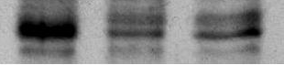
siPoldip2
siCont
seq. 1
seq. 2
IB Poldip2
37 kDa
IB CDK4
Figure 3.12. siPoldip2 Decreases Endogenous Poldip2 Protein Expression, as Shown by Western Blot Analysis. Western analysis of Poldip2 protein expression in extracts from rat VSMCs transiently transfected for 4 days with 15 nmol/L of either control siRNA (siCont), siRNA against Poldip2 (siPoldip2) sequence 1 (seq.1), or siPoldip2 sequence 2 (seq. 2). CDK4 levels (lower blot) were included as a loading control. siPoldip2 sequence 1 was used for all siPoldip2 experiments shown herein, unless otherwise indicated.
Notes:
*p<0.01

Slide 33
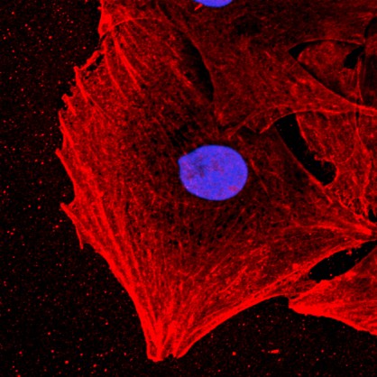
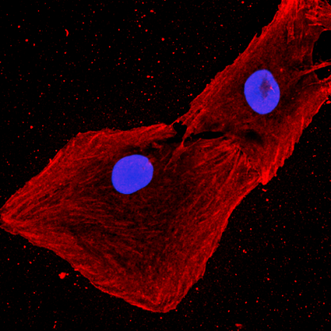
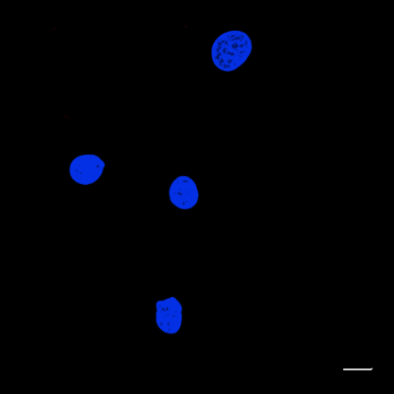
Untreated
siControl
siPoldip2
Figure 3.13. siPoldip2 Decreases Endogenous Poldip2 Protein Expression, as Shown by Immunocytochemistry. Rat VSMCs were either untreated or transiently transfected for 4 days with 15 nmol/L of either siControl or siPoldip2 before single labeling with an anti-Poldip2 antibody (red). Immunocytochemistry images were acquired using confocal microscopy. Images acquired at the focal adhesion plane are depicted. Scale bars, 10 µm.

Slide 34
a.
40
30
Superoxide
(µmol/µg protein)
*
20
10
Untreated
siCont
siPoldip2
b.
100
*
50
% Change vs. Untreated
H₂O₂
Untreated
siCont
siPoldip2
Figure 3.14. siPoldip2 Decreases Basal Superoxide Production, as Measured by DHE-HPLC, and Basal Hydrogen Peroxide Production, as Measured by Amplex Red Assay. a, DHE-HPLC was used to assess intracellular O₂•- production in rat VSMCs that were either untreated or transiently transfected for 4 days with 15 nmol/L of either siControl or siPoldip2. Bars are mean ± S.E.M. of 4 independent experiments. *p<0.01 vs. siCont. b, Amplex Red Assay was used to assess H₂O₂ production in rat VSMCs that were either untreated or transiently transfected for 4 days with 15 nmol/L of either siControl or siPoldip2 VSMCs. Bars are means ± S.E.M. of 4 independent experiments. *p<0.001 vs. siCont.

Slide 35
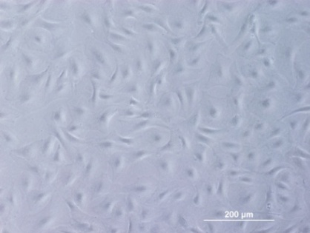
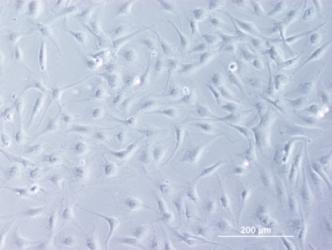
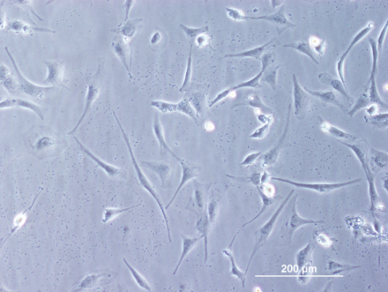
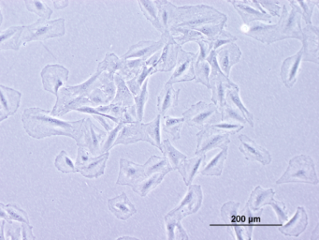
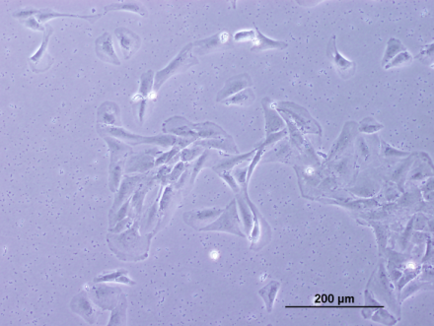
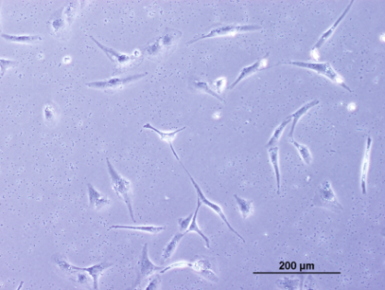
Untreated
siCont
siNox4
Untreated
siCont
siPoldip2
Figure 3.15. siPoldip2 Changes VSMC Phenotype, Similarly to siNox4. Rat VSMCs were either untreated or transiently transfected for 5 days with 25 nmol/L of siControl (siCont) or siNox4 (upper) for maximal Nox4 downregulation, or for 4 days with 15 nmol/L of siControl (siCont) or siPoldip2 (lower) for maximal Poldip2 downregulation and visualized by phase contrast microscopy. Scale bars, 200 µm.

Slide 36
30
*
15
anti-phosphatidylserine
% of cells positive for
1
0
Untreated
siControl
siPoldip2
Heat Shock
Figure 3.16. Changes in Cell Phenotype Mediated by siPoldip2 are Not
Due to an Increase in Apoptosis. Rat VSMCs that were either untreated or transiently transfected for 4 days with 15 nmol/L of either siControl or siPoldip2 were stained with propidium iodide and anti-Phosphatidylserine, a marker of early apoptosis, prior to assessment of cell surface expression of Phosphatidylserine by fluorescence activated cell sorting (FACS) analysis. Untreated rat VSMCs heat shocked at 50°C for 1 h prior to Phosphatidylserine staining were included as a positive control. Bars are mean ± S.E.M. of 3 independent experiments. No statistical difference was found. *p<0.05 vs. all other treatments.

Slide 37






Untreated
siControl
siPoldip2
Vinculin
Paxillin
Figure 4.1. siPoldip2 Decreases the Focal Adhesion Markers Vinculin and Paxillin and Stress Fiber Formation. Rat VSMCs were either untreated or transiently transfected with 15 nmol/L of siControl or siPoldip2. Vinculin, upper. Cells were double labeled with vinculin (green) and phalloidin (red). Paxillin, lower. Cells were double labeled with paxillin (green) and phalloidin (red). Yellow appears where stress fibers (red) insert into focal adhesions (green). Nuclei are labeled with DAPI (blue). Confocal images acquired at the focal adhesion plane are depicted. Scale bars, 10 µm.

Slide 38



Untreated
siControl
siPoldip2
IB Paxillin
IB Vinculin
IB β-Tubulin
Paxillin
Vinculin
1.25
1.25
1.00
1.00
0.75
*
Paxillin / beta-Tubulin
0.75
Vinculin / b-tubulin
0.50
0.50
0.25
0.25
Untrx
siCont
siPoldip2
Untrx
siCont
siPoldip2
Figure 4.2. siPoldip2 Alters Paxillin, but Not Vinculin, Protein Expression Levels. Western analysis of paxillin and vinculin protein expression in protein extracts from rat VSMCs that were either untreated (Untrx) or transiently transfected with 15 nmol/L of siControl (siCont) or siPoldip2. β-Tubulin levels (lower blot) were included as a loading control. Bars are mean ± S.E.M. of 3 independent experiments. *p<0.05 vs. siCont. No statistical difference in vinculin was found.
Notes:
* p<0.05

Slide 39






Untreated
siScrambled
siNox4
Vinculin
Paxillin
Figure 4.3. siNox4 Decreases the Focal Adhesion Markers Vinculin and Paxillin and Stress Fiber Formation. Rat VSMCs were either untreated or transiently transfected with 25 nmol/L of siScrambled or siNox4. Vinculin, upper. Cells were double labeled with vinculin (green) and phalloidin (red). Paxillin, lower. Cells were double labeled with paxillin (green) and phalloidin (red). Yellow appears where stress fibers (red) insert into focal adhesions (green). Nuclei are labeled with DAPI (blue). Confocal images acquired at the focal adhesion plane are depicted. Scale bars, 10 µm.

Slide 40




AdGFP
AdPoldip2
Vinculin
GFP
Figure 4.4. Overexpression of Poldip2 Increases Focal Adhesion Formation. Rat VSMCs were transduced with control adenovirus (AdGFP) or adenovirus to overexpress Myc-Poldip2 (AdPoldip2) for 72 hours before labeling with the focal adhesion marker vinculin (red). Cells transduced with adenovirus are detected as green in the GFP panels (lower). Nuclei are labeled with DAPI (blue). Confocal images acquired at the focal adhesion plane are depicted. Scale bars, 10 µm.

Slide 41




AdGFP
AdPoldip2
Phalloidin
GFP
Figure 4.5. Poldip2 Overexpression Increases Stress Fiber Formation. Rat VSMCs were transduced with control adenovirus (AdGFP) or adenovirus to overexpress Myc-Poldip2 (AdPoldip2) for 72 hours before labeling with the stress fiber marker phalloidin (purple). Cells transduced with adenovirus are detected as green in the GFP panels (lower). Nuclei are labeled with DAPI (blue). Confocal images acquired at the focal adhesion plane are depicted. Scale bars, 10 µm.

Slide 42






Untreated
siControl
siPoldip2
Nox4
p22phox
Figure 4.6. The Absence of Poldip2 Prevents Proper Localization of Nox4 and p22phox to Focal Adhesions. Rat VSMCs were either untreated or transiently transfected with 15 nmol/L of siControl or siPoldip2. Nox4, upper. Cells were single labeled with anti-Nox4 (red) antibody. p22phox, lower. Cells were double labeled with anti-p22phox (green) and phalloidin (red) to stain stress fibers. Yellow appears where stress fibers (red) insert into focal adhesions (green). Nuclei are labeled with DAPI (blue). Confocal images acquired at the focal adhesion plane are depicted. Scale bars, 10 µm.

Slide 43


IP GST-Rhotekin RBD
No Ad
AdPoldip2
AdGFP
IB Active RhoA
IB Total RhoA
1.25
*
1.00
Active RhoA/
Total RhoA (A.U.)
0.75
0.50
0.25
No Ad
AdPoldip2
AdGFP
Figure 4.7. Poldip2 Overexpression Increases Active RhoA. Rat VSMCs were transduced with no adenovirus (No Ad), adenovirus to overexpress Myc-Poldip2 (AdPoldip2), or with control adenovirus (AdGFP) for 72 hours prior to being used to measure active, GTP-bound RhoA. Cells were immunoprecipitated (IP) with beads bound to GST-Rhotekin RBD before immunoblotting (IB) for GTP-bound, active RhoA (upper) and total RhoA (lower). The western blots shown are from a representative experiment. Bars are mean ± S.E.M. from 3 independent experiments. *p<0.05 vs. AdGFP.

Slide 44
7
*
6
5
†
Active Rho/ Total Rho
(x10⁻⁵)
4
3
2
1
0
‒
‒
+
‒
‒
+
AdPoldip2
24h, 20 mmol/L NAC
‒
‒
‒
+
+
+
Total Rho
Figure 4.8. The Increase in Active RhoA Mediated by Poldip2 Overexpression is Blunted by N-acetyl Cysteine. Rat VSMCs were transduced with no adenovirus ( - , white bars), control adenovirus ( - , medium grey bars), or adenovirus to overexpress Myc-Poldip2 ( + , dark grey bars) for 48 hours prior to no treatment ( - ) or treatment with 20 mmol/L N-acetyl cysteine ( + , NAC) for 24 h. Active, GTP-bound RhoA was quantified using a G-LISA method in which the amount of active GTP-bound Rho, which binds to the Rho-GTP-binding substrate, is detected with a RhoA specific antibody and a luminometer. The Total RhoA western blot shown is from a representative experiment. Bars are mean ± S.E.M. from 3 independent experiments. *p<0.01 vs. AdGFP – NAC; †p<0.05 vs. AdPoldip2 – NAC.

Slide 45






a.
AdGFP
AdPoldip2
No Ad
FAK pY397
IB FAK pY397
1.25
*
1.00
0.75
IB FAK pY576/577
pY397 / Total FAK (A.U.)
0.50
IB Total FAK
0.25
No Ad
AdGFP
AdPoldip2
IB Myc-Poldip2
b.
No Ad
AdGFP
AdPoldip2
p190RhoGAP
35000
IB p190RhoGAP
30000
25000
20000
p190RhoGAP (A.U.)
15000
IB β-Tubulin
10000
5000
No Ad
AdGFP
AdPoldip2
Figure 4.9. Poldip2 Mediated Increases in Active RhoA are Not Due to
Increases in Phospho-FAK, Total FAK, or p190RhoGAP Expression. a, Rat VSMCs were transduced with no adenovirus (No Ad), control adenovirus (AdGFP), or adenovirus to overexpress Myc-Poldip2 (AdPoldip2) for 72 hours prior to immunoblotting (IB) for phospho-FAK Y397 and Y576/577 and total FAK. Lysates were immunoblotted for Myc to show overexpression of Myc-Poldip2. * p<0.05 vs. AdGFP. b, The same lysates were immunoblotted for total p190RhoGAP. β-Tubulin levels were included as a loading control. The western blots shown are from a representative experiment. Bars are mean ± S.E.M. from 3 independent experiments. No statistical difference in p190RhoGAP was found.
Notes:
* p<0.05

Slide 46



No Ad
AdGFP
AdPoldip2
Biotintylated (reduced)
PTP-PEST
40000
30000
*
Total Biotin
Reduced PTP-PEST (A.U.)
20000
PTP-PEST
expression
10000
No Ad
AdGFP
AdPoldip2
Figure 4.10. Poldip2 Overexpression Increases PTP-PEST Oxidation. Rat VSMCs were transduced with no adenovirus (No Ad), control adenovirus (AdGFP), or adenovirus to overexpress Myc-Poldip2 (AdPoldip2) for 72 hours. The oxidation of proteins was assessed using a N-(biotinoyl)-N-(iodoacetyl) ethylenediamine (BIAM) labeling assay by lysing cells in acidic (pH 6.5) MES-NaOH buffer containing 20 μM BIAM to label reduced cysteines. Biotinylated proteins were pulled down using Streptavadin. Reduced PTP-PEST that was labeled with BIAM was detected by Western with a PTP-PEST antibody, where the loss of signal is indicative of in vivo oxidation. Lysates were immunoblotted with Total Biotin, to show the same amout of BIAM was used in each sample, and with anti-PTP-PEST to show total PTP-PEST protein expression. The western blots shown are from a representative experiment. Bars are mean ± S.E.M. from 3 independent experiments. *p<0.05 vs. AdGFP.
Notes:
p < 0.05 vs. AdGFP
Method from JR Kim, et.al. Analytical Biochemistry, 2000.

Slide 47




siCont
siPoldip2
nox1^{y/+} VSMC
nox1^{y/-} VSMC
Figure 4.11. The Phenotypic Changes in Focal Adhesions and Stress Fiber Formation Associated with siPoldip2 are Mediated by Nox4, as Demonstrated in nox1^{y/-} VSMCs. Confocal images of mouse nox1 wild-type (nox1^{y/+}) or mouse nox1 knockout (nox1^{y/-}) VSMCs that were transiently transfected with 15 nmol/L of either control siRNA (siCont) or siPoldip2 before labeling with vinculin (green) and phalloidin (purple). Nuclei are labeled with DAPI (blue). Confocal images acquired at the focal adhesion plane are depicted. Scale bars, 10 µm.

Slide 48












nox1^{y/+} VSMC
nox1^{y/-} VSMC
AdGFP
AdPoldip2
AdGFP
AdPoldip2
Vinculin
Phalloidin
GFP
Figure 4.12. The Phenotypic Changes in Focal Adhesions and Stress Fiber Formation Associated with Poldip2 Overexpression are Mediated by Nox4, as Demonstrated in nox1^{y/-} VSMCs. Confocal images of mouse nox1 wild-type (nox1^{y/+}) or mouse nox1 knockout (nox1^{y/-}) VSMCs transduced with control adenovirus (AdGFP) or adenovirus to overexpress Myc-Poldip2 (AdPoldip2) for 72 hours before labeling with vinculin (red) or with phalloidin (pseudocolored cyan). Cells transduced with adenovirus are detected as green in the GFP panels (lower). Nuclei are labeled with DAPI (blue). Confocal images acquired at the focal adhesion (upper) and stress fiber (middle) planes are depicted. Scale bars, 10 µm.

Slide 49












AdLacZ
Untreated
siCont
siPoldip2
Phalloidin + HA
Vinculin
AdRhoGV
Untreated
siCont
siPoldip2
Phalloidin + HA
Vinculin
Figure 4.13. CA-RhoA Rescues the Loss of Stress Fibers and Focal Adhesions Caused by siPoldip2 . Rat VSMCs were transduced with either control adenovirus (AdLacZ) or HA-tagged constitutively active Rho (AdRhoGV) prior to leaving untreated or transiently transfecting with 15 nmol/L of either siCont or siPoldip2. VSMCs were triple labeled with anti-HA antibody (HA; red) to detect cells transduced with AdRhoGV, Phalloidin (green) to detect stress fibers, and vinculin (pseudo-colored cyan) to detect focal adhesions. Confocal images acquired at the stress fiber and focal adhesion planes are depicted. Scale bars, 10 µm.

Slide 50












AdLacZ
No Ad
AdGFP
AdPoldip2
GFP + HA
Phalloidin
AdRhoTN
No Ad
AdGFP
AdPoldip2
GFP + HA
Phalloidin
Figure 4.14. DN-RhoA Blocks the Increase in Stress Fibers and Focal Adhesions Caused by Poldip2 Overexpression. VSMCs non-transduced (No Ad) or transduced with AdGFP or AdPoldip2 prior to transduction with either AdLacZ or an HA-tagged dominant negative Rho (AdRhoTN). Cells transduced with AdGFP or AdPoldip2 appear green from GFP. Cells were double labeled with anti-HA antibody (HA; red) to detect cells transduced with AdRhoTN, and Phalloidin (pseudo-colored cyan) to detect stress fibers. Nuclei are labeled with DAPI (blue). Scale bars,10 µm.

Slide 51
150
100
Cell Adhesion (30 min)
number of cells/ field
50
0
Untreated
siCont
siPoldip2
Figure 4.15. siPoldip2 Does Not Interfere with Cell Adherence and Spreading. Rat VSMCs were either untreated or transiently transfected with 15 nmol/L of siControl (siCont) or siPoldip2 for 4 days prior to trypsinizing and replating. Cell attachment was measured after 30 minutes. Cell attachment was quantified by phase contrast microscopy where images were taken of 5 random fields of view per treatment group and counted. No statistical difference was found.

Slide 52
Untreated
siControl
siPoldip2
100
% change in Migration
(vs. Untreated)
*
50
Untreated
siCont
siPoldip2
Figure 4.16. siPoldip2 Decreases Vascular Smooth Muscle Cell Migration. Rat VSMCs were transiently transfected with no siRNA (Untreated), control siRNA (siCont), or siRNA against Poldip2 (siPoldip2) prior to using the Boyden Chamber Assay to measure cell migration in response to 10 ng/mL platelet-derived growth factor (PDGF) for 4 h. Bars are means ± S.E.M. of 3 independent experiments. *p<0.01 vs. siCont.

Slide 53



No Ad
AdGFP
AdNox4AS
90
80
70
60
50
Number of cells / field
40
30
20
*
10
No Ad
AdGFP
AdNox4AS
Figure 4.17. Nox4 Antisense Decreases VSMC Migration. Rat VSMCs were transduced with no adenovirus (No Ad), control adenovirus (AdGFP) or adenovirus expressing antisense Nox4 (AdNox4AS) prior to using the Boyden Chamber Assay to measure cell migration in response to 10 ng/mL platelet-derived growth factor (PDGF) for 4 h. Bars are means ± S.E.M. of 3 independent experiments. *p<0.01 vs. AdGFP.

Slide 54



No Ad
AdGFP
AdPoldip2
100
% change in Migration
(vs. No Ad)
50
*
0
No Ad
AdGFP
AdPoldip2
Figure 4.18. Poldip2 Overexpression Decreases Vascular Smooth Muscle Cell Migration. Rat VSMCs were transduced with no adenovirus (No Ad), control adenovirus (AdGFP) or adenovirus to overexpress Myc-Poldip2 (AdPoldip2) prior to using the Boyden Chamber Assay to measure cell migration in response to 10 ng/mL platelet-derived growth factor (PDGF) for
4 h. Bars are means ± S.E.M. of 3 independent experiments. *p<0.01 vs. AdGFP.

Slide 55


Figure 5.1. Overexpression of Poldip2 Increases the Frequency of Polyploid, Bi-nucleated VSMCs. Rat VSMCs transduced with adenovirus to overexpress Myc-Poldip2 (AdPoldip2) for 72 hours were single labeled with Phalloidin (red) to detect stress fibers. Cells transduced with AdPoldip2 appear green from GFP. Nuclei are labeled with DAPI (blue). Arrows indicate polyploid, bi-nucleated cells. Scale bars,10 µm.

Slide 56
Tetraploid RASMs
30000
20000
Density
10000
No Ad
AdGFP
AdPoldip2
Figure 5.2. Effect of Poldip2 Overexpression on VSMC Polyploidy, as Measured by FACS Analysis. Passage 2 rat VSMCs were transduced with no adenovirus (No Ad), control adenovirus (AdGFP) or adenovirus to overexpress Myc-Poldip2 (AdPoldip2) for 72 hours prior to labeling with propidium iodide. Cellular DNA content was quantified as diploid (2N) or polyploid (4N and greater) by FACS analysis. Bars are mean ± S.E.M. of 3 independent experiments. No statistical difference was found.

Slide 57
VSMCs in G₂/M
12.5
*
10.0
7.5
% of Cells Counted
5.0
2.5
No Ad
AdGFP
AdPoldip2
Figure 5.3. Overexpression of Poldip2 Increases the Number of Cells
in G₂/M of the Cell Cycle, as Measured by FACS Analysis. Passage 2 rat VSMCs were transduced with no adenovirus (No Ad), control adenovirus (AdGFP) or adenovirus to overexpress Myc-Poldip2 (AdPoldip2) for 72 hours prior to labeling with propidium iodide. Cellular DNA content was used to quantify cellular position in the cell cycle by FACS analysis. Bars are mean ± S.E.M. of 3 independent experiments. *p<0.05 vs. AdGFP.
Notes:
* = 0.03 vs. 0 Adv

Slide 58



AdGFP
AdPoldip2
IB pTyr15-cdc2
IB total cdc2
IB Myc
Myc-Poldip2
Figure 5.4. Overexpression of Poldip2 Increases Basal cdc2 Phosphorylation. Rat VSMCs were transduced with control adenovirus (AdGFP) or adenovirus to overexpress Myc-Poldip2 (AdPoldip2) for 72 hours prior to western analysis to assess phosphorylation of cdc2 on Tyr15 and total cdc2 protein levels. Lysates were also immunoblotted for Myc to show overexpression of Myc-Poldip2.

Slide 59









a.
4 hours @ 19.5°C in TBSS
Time @ 37°C
90
2 hours 100µg/mL Cycloheximide
b.
0 siRNA
15 nM siCont
15nM siPoldip2
SS, 37°C
0 min 37°C
90 min 37°C
Figure 6.1. siPoldip2 Decreases the Trafficking of Nox4 to Focal Adhesions. Rat VSMCs were transiently transfected with no siRNA (Untreated), control siRNA (siCont), or siRNA against Poldip2 (siPoldip2) prior to transferring to 19.5°C and treating with cycloheximide or leaving at 37 °C (SS). Cells were then released by transfer to 37°C for 0 or 90 min before fixing and double labeling with GM130, to label the Golgi (red), and Nox4 (green). Nuclei are labeled with DAPI (blue). The outlines of cells are shown in blue.
Notes:
Nox4

Slide 60










0 siRNA
15 nM siCont
15nM siPoldip2
SS, 37°C
0 min 37°C
90 min 37°C
Figure 6.2. siPoldip2 Decreases the Trafficking of p22phox to Focal Adhesions. Rat VSMCs were transiently transfected with no siRNA (Untreated), control siRNA (siCont), or siRNA against Poldip2 (siPoldip2) prior to transferring to 19.5°C and treating with cycloheximide or leaving at 37 °C (SS). Cells were then released by transfer to 37°C for 0 or 90 min before fixing and double labeling with GM130, to label the Golgi (red), and p22phox (green). Nuclei are labeled with DAPI (blue). The outlines of cells are shown in blue.
Notes:
p22phox

Slide 61









Untreated
siCont
siPoldip2
Steady State
0 min 37°C
90 min 37°C
Figure 6.3. siPoldip2 Does Not Affect the Proper Trafficking of the PDGFR-β to Caveolae. Rat VSMCs were transiently transfected with no siRNA (Untreated), control siRNA (siCont), or siRNA against Poldip2 (siPoldip2) prior to transferring to 19.5°C and treating with cycloheximide or leaving at 37°C (SS). Cells were then released by transfer to 37°C for 0 or 90 min before fixing and double labeling with GM130 to label the Golgi (red) and PDGFR-β (green). Nuclei are labeled with DAPI (blue). The outlines of cells are shown in blue.

Slide 62




a.
Untreated
siControl
siPoldip2
b.
siPoldip2
-
+
-
+
-
+
2 days
3 days
4 days
Figure 6.4. siPoldip2 Treatment Increases Expression of the ER Stress Marker GRP78. a, Rat VSMCs were transiently transfected with no siRNA (Untreated), control siRNA (siCont), or siRNA against Poldip2 (siPoldip2) for 4 days prior to single labeling with GRP78 (green). Nuclei are labeled with DAPI (blue). Scale bars,10 µm. b, Rat VSMCs were transiently transfected with control siRNA ( - ) or siRNA against Poldip2 ( + ) for 2, 3, or 4 days prior to use for western analysis to assess GRP78 protein expression.

